Slide 2
WHAT IS a taxonomy architecture?
In computer engineering, computer architecture is the conceptual design and fundamental operational structure of a computer system.
<< The Financial Reporting Taxonomies Architecture (FRTA) document guides the creation of taxonomies under version 2.1 of the Specification. It sets out a recommended design architecture and establishes rules and conventions which help make taxonomies more usable and efficient >>
<< The purpose of this document is to detail the architecture of the XBRL US GAAP Taxonomies
v1.0 (version 1.0). The document also explains the design rationale and how the architecture
satisfies the version 1.0 requirements >>
Information architecture (IA) is the art of expressing a model of information used in activities that require explicit details of complex systems.

Slide 3
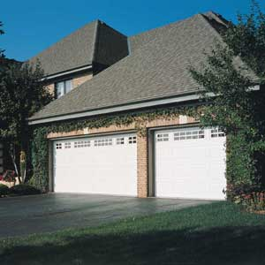
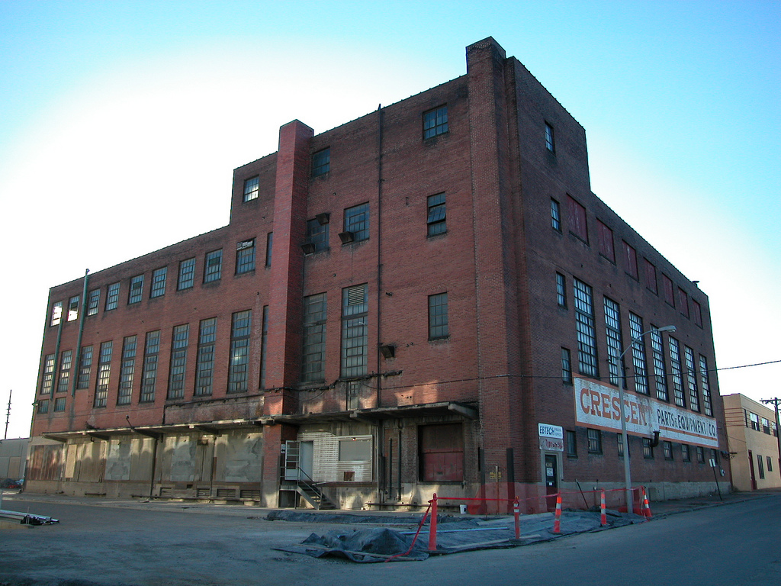

WHAT IS a taxonomy architecture?

Slide 4


BANKING SUPERVISORS’ REPORTING process
Reporting
Requirements
(XBRL Taxonomy)
Credit institutions
Supervisor

Slide 5
COMMUNICATING OUR REPORTING REQUIREMENTS
Definition of financial concepts
Code
Label (different languages, contexts, …)
Basic properties (credit / debit, stock / flow, monetary / ratio ...)
References to guidelines
Relationships with other concepts (validation)

Slide 6
COMMUNICATING OUR REPORTING REQUIREMENTS
 |  | Unimpaired assets | Impaired assets [gross carrying amount] | Allowances for individually assessed financial assets | Allowances for collectively assessed financial assets | Allowances for incurrred but not reported losses | Carrying amount
 | References | IFRS 7.36 (c) | IFRS 7.37; IFRS 7.IG 29 (a) | IAS 39 AG.84-86; IFRS 7.37 (b) | IAS 39.AG 84-92 | IAS 39.AG 84-92
Debt securities | IAS 39.9 | 1.680 | 59 | 25 | 2 | - | 1.712
Central banks |  | 10 | 1 | 1 | - | - | 10
General governments |  | 100 | 1 | 1 | - | - | 100
Credit institutions |  | 250 | 1 | 1 | - | - | 250
Other financial corporations |  | 300 | 5 | 1 | 1 | - | 303
Non-financial corporates |  | 1.000 | 50 | 20 | 1 | - | 1.029
Retail |  | 20 | 1 | 1 | - | - | 20
Loans and advances | IAS 39.9 | 17.590 | 587 | 33 | 13 | 10 | 18.121
Central banks |  | 30 | 1 | 1 | - | - | 30
General governments |  | 60 | 1 | 1 | - | - | 60
Credit institutions |  | 2.000 | 5 | 1 | - | - | 2.004
Other financial corporations |  | 2.500 | 80 | 5 | 2 | 1 | 2.572
Non-financial corporates |  | 5.000 | 200 | 10 | 5 | 4 | 5.181
Retail |  | 8.000 | 300 | 15 | 6 | 5 | 8.274
Loans and receivables | IAS 39.9; IAS 39.AG26 | 19.270 | 646 | 58 | 15 | 10 | 19.833
Central banks |  | 5 | - | - | - | - | 5
General governments |  | 10 | - | - | - | - | 10
Credit institutions |  | 50 | 1 | 1 | - | - | 50
Other financial corporations |  | 100 | 2 | 1 | - | - | 101
Non-financial corporates |  | 200 | 10 | 3 | 2 | 1 | 204
Retail |  | 20 | 1 | 1 | - | - | 20
Held-to-maturity investments | IAS 39.9; IAS 39.AG26 | 385 | 14 | 6 | 2 | 1 | 390
Concept: Loans and receivables and held-to-maturity investments
Dimension Counterparty: Central Banks
Dimension Allowance type: Allowances for individually assessed financial assets

Slide 7
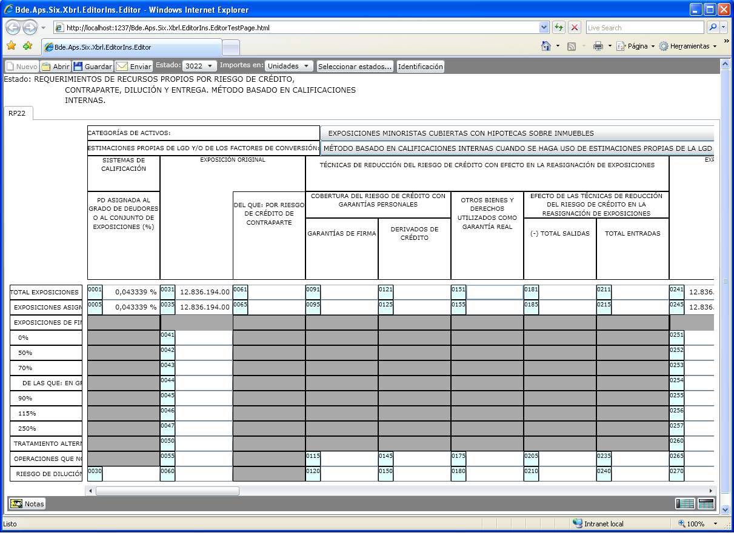

Slide 8
BANKING SUPERVISORS’ REPORTING process
Extraction process
Loading process
XBRL
Data model
Credit institutions
Supervisor

Slide 9
BANKING SUPERVISORS’ REPORTING process
Quality checks
Credit institutions
Supervisor

Slide 10
REPORTING REQUIREMENTS EVOLVE IN TIME
A
B
C
D
…
X
A’
B’
C’
D’
…
Y
Z
New
Deprecated
FINREP 2012
FINREP 20??

Slide 11
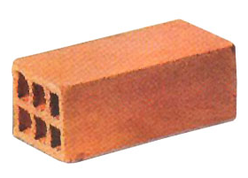
Information requirements summary
Definition of concepts
“Table” views of concepts
Data model
Quality checks
Correspondence of concepts along different versions
Information
Requirements

Slide 12


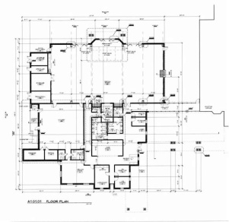
NEXT BRICK…
Information
Requirements
Design rules
Next step is HOW:
- Design approach
- Naming conventions
CEBS
Guidelines
Data Matrix
Normalized tables
Taxonomy

Slide 13
Architecture principles OR PRIORITIES
Simplicity of the reporting process
Stability and consistency
XBRL specifications, IFRS-GP taxonomy and common practice compliance
Maintainability of taxonomies
Other technical advantages (small size of instance documents, …)
Principles

Slide 14
P1: Simplicity of the reporting process
Both sides of the communication channel
But we must give a higher priority to the “other side”: its effect is to be multiplied by hundreds
Benefits:
  Quality of the data
  Data available sooner
  Fewer resources needed on the supervisor side to debug data

Slide 15
P1: DATA Mapping
Data mapping is a transformation process between data models
Three data models
  Database of the supervisor
  Data base of the supervised company
  Model represented by our taxonomies (dimensional model)
The simpler the transformations, the simpler the whole process is

Slide 16
P1 DATA Mapping: APPROACHES
View oriented approaches
  Straightforward approach
  Redundancy problems
  Less stable
Data oriented approaches
  More complex but flexible approach
  No redundancy
  More stable

Slide 17
P1 DATA MAPPING: Supervised bank’s model
DEXIA’s provisions tables is a good example (the only example)
Banks databases are based on accountancy systems, which are based on operations
These systems are data oriented
Even if some systems were “view” oriented, we cannot expect homogeneity at this level
CODE | LABEL | MAPPING | F000 Opening | F001 Entry into the consolidation scope | F002 Contribution of activity by third parties and mergers | F110 Result of the period | F115 Result of the period before taxes | F116 Taxes of the period | F120 Dividends paid out | F121 Advances on dividends paid out | F123 Dividends received | F124 Advances on dividends received
207110 | Provisions and other oblig. - Long term defined benefit plans | Balance sheet | 1 | 1 | 1
207120 | Provisions and other oblig. - Other postretirement obligations | Balance sheet | 1 | 1 | 1
207210 | Provisions and other oblig. - Other Provisions - Staff / Other long term employee benefits | Balance sheet | 1 | 1 | 1
207220 | Provisions and other oblig. - Other Provisions - Staff / Termination benefits (restructuring staff) | Balance sheet | 1 | 1 | 1
207230 | Provisions and other oblig. - Other Provisions - Staff / Other provisions | Balance sheet | 1 | 1 | 1
207310 | Provisions and other oblig. - Litigation claims / staff | Balance sheet | 1 | 1 | 1
207311 | Provisions and other oblig. - Litigation claims / taxes | Balance sheet | 1 | 1 | 1
207312 | Provisions and other oblig. - Litigation claims / administrative and other than operational | Balance sheet | 1 | 1 | 1
207313 | Provisions and other oblig. - Litigation claims / other operational | Balance sheet | 1 | 1 | 1
207320 | Provisions and other oblig. - Restructuring (other than staff) | Balance sheet | 1 | 1 | 1
207330 | Provisions and other oblig. - Provision for off-balance sheet Credit commitment and guarantee | Balance sheet | 1 | 1 | 1
207340 | Provisions and other oblig. - Other provisions (non insurance) | Balance sheet | 1 | 1 | 1
207350 | Provisions and other oblig. - Onerous contracts | Balance sheet | 1 | 1 | 1
607581 | Credit Enhancement - Allowance for case basis reserve | P&L
607582 | Credit Enhancement - Loss - Guaranty insurance | P&L
607591 | Credit Enhancement - Allowance for general reserve | P&L
607680 | Cost of risk - off-balance sheet commitment - specific risk | P&L
607692 | Cost of risk - off-balance sheet commitment - country risk provision | P&L
707581 | Credit Enhancement - Write-off case basis reserve | P&L
707582 | Credit Enhancement - Write-off loss - Guaranty insurance | P&L
707591 | Credit Enhancement - Write-off general reserve | P&L
707680 | Cost of risk - write-back / Cost of risk - off-balance sheet commitment - specific risk | P&L
707692 | Cost of risk - write-back / Cost of risk - off-balance sheet commitment - country risk provision | P&L

Slide 18
P1 DATA Mapping: XBRL MODEL
XBRL is data oriented
  A fact is identified by a concept (which is global in the DTS) and other dimensions (time, …)
  Views of the data are represented on the taxonomy (PLB or Rendering), but do not impact data
XBRL could be forced to be view oriented
  By shoving the “table” information in the data model, i.e.: giving internal concept names dependent on the table… But if so, why not use Excel?

Slide 19
P1 DATA Mapping: XBRL MODEL
Data oriented approach
  Easier mapping on the supervised side
  Better traceability of the data
  More flexible solution
  Better maintainability (formulae)
  Alignment with major XBRL projects
  Proper use of XBRL
View oriented approach
  Easier mapping for table oriented supervisors solutions
  Favours manual handling of the data
  Worse stability (dependency on views)
  Redundant data
  Contrived use of the standard

Slide 20
P1: ERROR REPORTING
Formula specification ready
It solves limitations of previous specifications
Working in Banco de España and Banque de France
Error messages produced by formulae must be clear to business users

Slide 21
P2: Stability
Changes should have a minimum impact on the reporting process
  - If the concept doesn’t change, the instance document must not change
Internal concept codes must not change if:
  There is a change in the naming conventions at business level (or just a correction)
  A concept is moved from a template to another, or added to another as part of an extension
  A concept is kept from an old version in a new one
  There is a change in the business constraints
Abstract codification

Slide 22
P2: CODIFICATION OF NAMES
FRTA (LABEL BASED) APPROACH PREVIOUSLY USED:
Examples:
AllowancesMovementsForCreditLossesAmountsReversedForEstimatedProbableLoanLossesSpecificAllowancesForIndividuallyAssessedFinancialAssetsAndCollectivelyAssessedFinancialAssetsDebtInstruments
OfWhichOriginalOwnFunds
Labels are not stable:
  Depend on the language
  Depend on the context (many COREP concepts have two or
  more different labels)
  IFRS-GP experience / last release of FINREP
  Naming approach for extensions?

Slide 23
REPORTING REQUIREMENTS EVOLVE IN TIME
m12i1
m12i2
m12i3
m12i4
…
m12i25
m12i1
m12i2
m12i3
m12i4
…
m14d1
m14d2
Deprecated
New
FINREP 2012
FINREP 2014

Slide 24
P3: IFRS and common practices alignment
Related to principle 1:
  Common concepts identified the same way across different taxonomies
  Common structures / patterns modelled the same way
But at the same time…
  The approaches chosen by other projects can have a negative impact on ours.
  A high coupling between two taxonomies can limit its evolution

Slide 25
P3: IFRS alignment APPROACH: LOOSE COUPLING
FINREP uses its own approach, but includes a formula relationships from IFRS-GP facts to FINREP facts
  Independent naming conventions
  Independent sign conventions
  Independent approach for common structures
  Banks filing IFRS-GP can create FINREP facts using a standard processor
  Different linkbases for different IFRS-GP versions
  Most companies still don’t have formula processor (don’t have XBRL processors either)
IFRS-GP
FINREP
Form-lb
f(ifrs-gp) = finrep
instance

Slide 26
P4: IFRS alignment APPROACHE: HIGH COUPLING
IFRS-GP
Classic approach: FINREP extends IFRS-GP schema
  Less effort for bank that are filing IFRS-GP
  IFRS-GP concepts follow IFRS-GP naming conventions
  Common concepts must have the same naming conventions
  Common structures should follow the same approach
imports
FINREP
instance

Slide 27
P4: IFRS alignment APPROACHES: MEDIUM COUPLING
Dutch approach: IFRS-GP are created on FINREP schema. A definition linkbase relates common concepts
  No need to follow common naming conventions
  Common concepts must have the same naming conventions
  Common structures should follow the same approach
IFRS-GP
FINREP
def-lb
instance

Slide 28
P4: FORMULAE RELATIONSHIPS APPROACH
Cash =
+ Financial assets held for trading
+ Financial assets designated at fair value through …
+ Available for sale financial assets
Customer resources distributed but not managed >
+ Collective investment
+ Insurance products

Slide 29
CONCLUSIONS
Establishes more clearly the purpose of the taxonomy
Improves the quality of our taxonomy
Makes easier the generation of instance documents
Makes easier the manipulation of the information and the development of specific tools
Provides a more stable framework
Allows us to focus on design issues rather than taxonomy edition details
Design rules
Principles
Information
Requirements

