Slide 1
Best Practices
XIII European Banking Supervisors XBRL Workshop. Luxembourg, 24th November 2010
Katrin Schmehl
CEBS XBRL Operational Network

Slide 2
Distribution of XBRL in Europe
eu-related
quality
harmonization
cost
time
enhanced analysis
interoperability
COREP
FINREP
BSI-MIR
standard
transparency

Slide 3
Modularisation
How changes were adapted to the national needs?
Expected:
FINREP superset of reports
Custom
report
Large
report
Small
report
Medium
report
Realised:
Custom
report
Custom
report
Small
report
Medium
report
Custom
report

Slide 4
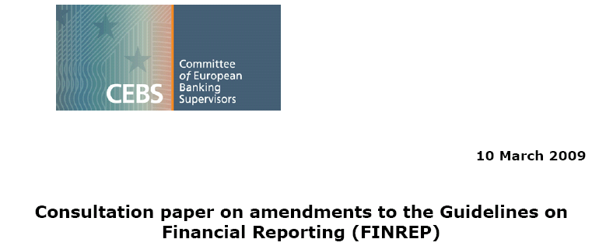
Best Practices

Slide 5
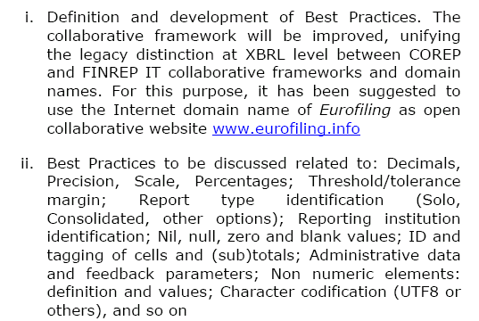
Best Practices
Responsibility of the CEBS XBRL Operational Network

Slide 6
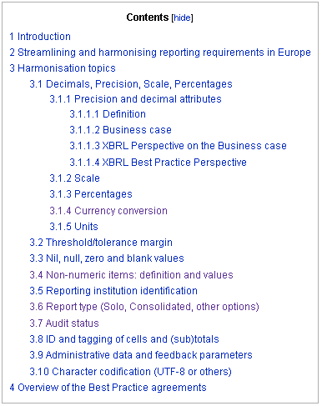
Best Practices
+ Harmonisation efforts on basis of the XBRL instances
http://www.xbrlwiki.info/index.php?title=Best_Practices_on_Data_Definitions

Slide 7
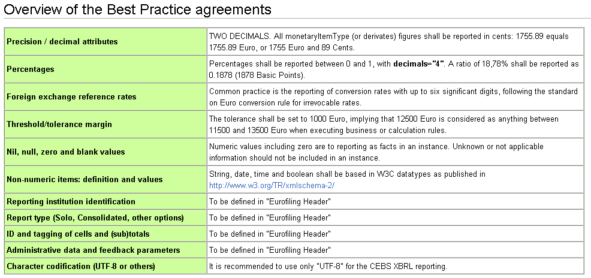
Best Practices on Data Definitions

Slide 8
Best Practices: Precision / decimal attributes
No possibility to adjusting the precision on a COREP table
All tables are going to be reported in full Euro amounts (incl. 2 decimals) → no reporting of rounded values
Overcomes the difficulties in rounding → eases the electronic reporting
Agreeing on a certain value of the decimals attribute and establishing this as a best practice for EUROFILING will help financial institutions deal with creating instance documents. From the current perspective the greater common nominator required by the European supervisors is decimals="2".

Slide 9
Best Practices: Nil, null, zero and blank values
zero value: The value of the fact is "0".
null value: The value of the fact is not known or can't be received.
not applicable information: The value is an inapplicable information.
Numeric values including zero are to reporting as facts in an instance.
Unknown or not applicable information should not be included in an instance. The according fact should be left out.
If a fact with a nil attribute is sent then the value should be treated as not existing and to be ignored.

Slide 10
Best Practices: Reporting institution identification
If available the "MFI ID code" should be used as value of the xbrli:identifier element in the instance to report on COREP and FINREP and additionally the value of the scheme attribute should refer to the ECB website: "http://www.ecb.eu/stats/money/mfi".
Example: <xbrli:identifier scheme="http://www.ecb.eu/stats/money/mfi">DE00002</xbrli:identifier>
In case that a "MFI ID code" doesn't exist, i.e. for Norway, it is recommended to use a proprietary national id code with the scheme referring to the corresponding national central bank. <xbrli:identifier scheme="http://www.kredittilsynet.no">NO12345678</xbrli:identifier>

Slide 11
Announced developments in the EU
Aggregation of the relevant supervisory data of the national supervisors
Providing information for the „Colleges of Supervisors“
establishment and maintenance of a central database for the European supervisor authorities
Current reporting… and additionally…
FSA A
FSA A
Bank X
FSA B
Database
FSA B
EBA
FSA C
FSA C

Slide 12
Article 74.2 of Omnibus Directive In order to ensure uniform application of this Directive, for the communication of these calculations by credit institutions, competent authorities shall apply, from 31 December 2012, uniform formats, frequencies and dates of reporting. In order to ensure uniform application of the directive, the EBA shall develop draft technical standards to introduce, within the European Union, uniform formats (with associated specifications), frequencies and dates of reporting before 1 January 2012. The reporting formats shall be proportionate to the nature, scale and complexity of the credit institutions’ activities.

Slide 13
Article 110.2 of Omnibus Directive In order to ensure uniform application of this Directive, EBA shall also develop draft technical standards regarding IT solutions to be applied for such reporting.

Slide 14
Possible scenario for systemic credit institutions depending on the decision of the EBA
eu-related
quality
harmonisation
cost
time
enhanced analysis
interoperability
COREP
FINREP
standard
transparency

Slide 15
www.c-ebs.org
www.eurofiling.info
Katrin Schmehl
+49 69 9566 6584
katrin.schmehl@bundesbank.de
XBRL Operational Network of the

