Slide 1
Roadmap for the implementation of the new COREP and FINREP in XBRL , 31th May 2012
Andreas Weller, Head of IT

Slide 2
Agenda
Background:
EBA Regulatory tasks
ITS Reporting-scope
ITS Reporting proportionality
ITS on Reporting – uniform implementation
ITS on Reporting and the context
Data Exchange COREP FINREP
From Datapoint Model to Taxonomy
The roadmap:
Next major steps and timeline
IT Taxonomy build roadmap for FINREP/COREP
EBA - European System of Financial Supervisors
2
2

Slide 3
EBA regulatory tasks
Common rulebook
Maximum harmonisation
...but proportionate to different financial institutions
EU Commission
Sectoral Directives
EBA to
provide advice
EU Commission
‘Implementing legislation’
EBA developing binding technical standards
3

Slide 4
ITS Reporting
Liquidity
Art 403
Own Funds
(COREP, FINREP)
Leverage
Art 95 CRR reporting
Art 417
Mortgage exposures
Art 96
Large exposures
Art 383

Slide 5
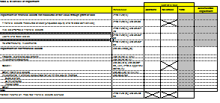
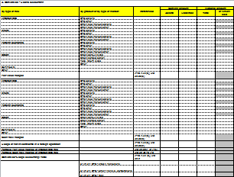
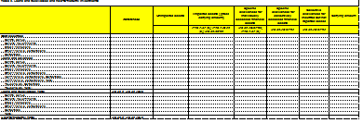
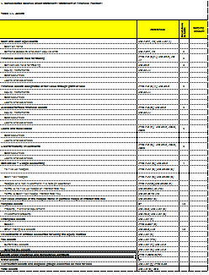
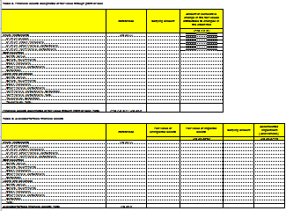
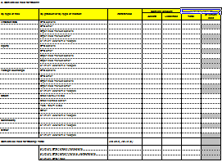
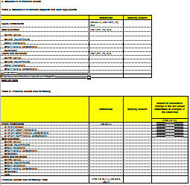
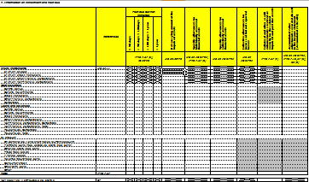
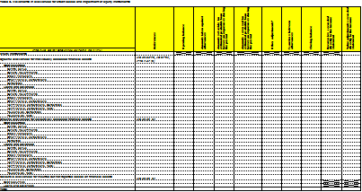
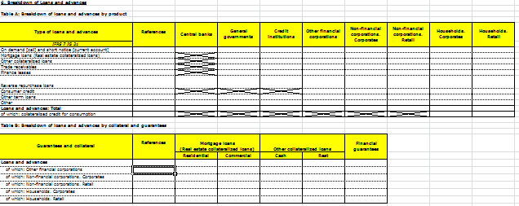
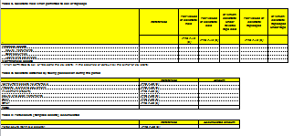
ITS on Reporting - proportionality
Proportionate to nature, scale and complexity of institutions’ activities
Frequency (Risk assessment systems, nature of information)
Thresholds (specific requirements for significant institutions, material exposures)
Reductions for small and domestic-only banks
Exemptions for certain investment firms

Slide 6
ITS on Reporting – uniform implementation
ITS features to ensure uniform implementation:
Legal references point to relevant parts of EU law (CRR, Accounting Directive, IFRS)
Data definitions included in the instructions – to further clarify legal references
Validation rules (quantitative relations between data points)
Data point model containing all the relevant technical specifications necessary for developing an IT reporting format
XBRL taxonomies to ensure unambiguous IT interpretation of the data included in the ITS (XBRL not mandatory – depending on national authority)

Slide 7
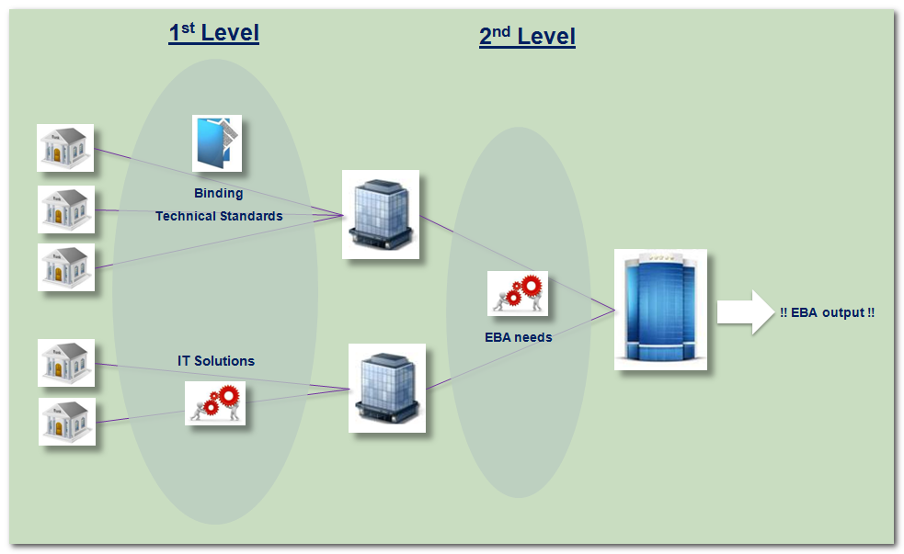
ITS Reporting and the context

Slide 8
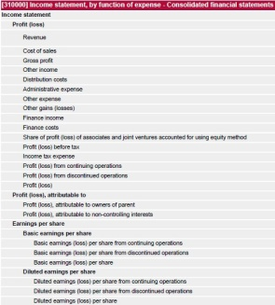
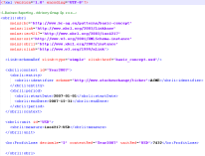
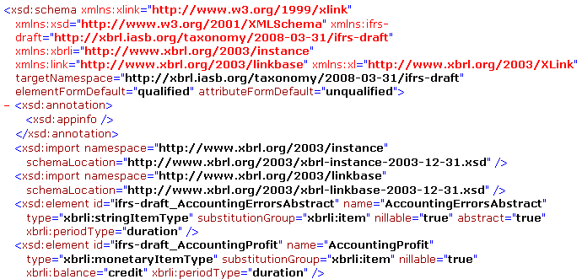
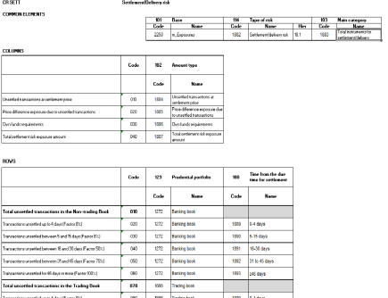
Data Exchange FINREP COREP
TAXONOMY
Catalogue of concepts, definition of exchanged information
INSTANCE DOCUMENT
Report containing facts (business data)
DPM
Catalogue of concepts, definition of meta and business related information

Slide 9
From Data Point Model to Taxonomy
Data Point Modelling
DPM concepts and method overview
Business templates analysis
DPM specification
DPM consistency checks
DPM structure checks
DPM documentation
Data Validations Specification
Template based formulas
DPM based formulas
XBRL Development
DPM translation into XBRL syntax
XBRL taxonomies tuning
XBRL validation formulas
XBRL independent review
XBRL taxonomies finalisation
FINREP team
Business experts
COREP team
IT experts
XBRL teams
IT experts
XBRL teams

Slide 10
ITS on reporting – next major steps and timeline
Dec 2011
Draft ITS for consultation (COREP, FINREP)
Consultation period 3 months
Jun 2012
Draft ITS for consultation (Leverage ratio, Liquidity)
Mar 2013
First ITS reporting reference date
May 2012
Draft DPM consultation
Adoption of ITS due to CRR changes by EU institutions
Feb 2012
July 2012
Draft ITS for consultation (LE)
Public Hearing
2nd half 2012
Final draft ITS submission to the European Commission
Final CRR
Taxonomy publication (COREP, FINREP, LE)
Final DPM

Slide 11
IT Taxonomy build roadmap for FINREP/COREP
T day
2012
Templates are finalised, Scope is approved by Board of Supervisors EBA
Finalisation of DPM is starting
D day +5 w
BoS request for public consultation
Mar 2013
Taxonomies get used for 2nd level reporting
D day + 2w
XBRL Subgroup of EBA gets consulted
Quality review according to Quality handbook
D day 2012
D day + 7w
DPM is finished
Automatic generation of taxonomy and test
D day + 10w
Public consultation on FINREP and COREP of 2 weeks
Final Taxonomies get released

Slide 12
Questions

Slide 13
Andreas Weller Head of IT EBA Chairmen of the XBRL subgroup andreas.weller@eba.europa.eu

