Slide 1
Extensible Business Reporting Language (XBRL) Update
Walter Hamscher (walter@hamscher.com)
Executive Committee, XBRL International
Consultant to PricewaterhouseCoopers

Slide 2
Topics
Standards-based Reporting with XBRL
  XBRL enabled software in the market
  XBRL implementations worldwide
  XBRL technology revealed
Value propositions
  Enterprises of all types
  Investors and analysts
  Regulators and government agencies

Slide 3
Topics
Standards-based Reporting with XBRL
  XBRL enabled software in the market
  XBRL implementations worldwide
  XBRL technology revealed
Value propositions
  Enterprises of all types
  Investors and analysts
  Regulators and government agencies

Slide 4
The business reporting supply-chain
Business
Operations
Internal
Financial
Reporting
External
Financial
Reporting
Investment,
Lending, and
Regulation
Processes
XBRL
XBRL
XBRL
Companies
Financial
Publishers
and Data
Aggregators
Investors
Participants
Trading
Partners
Management
Accountants
Auditors
Regulators
Software Vendors

Slide 5
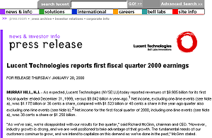
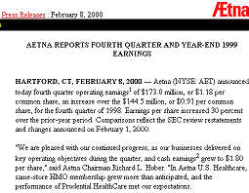
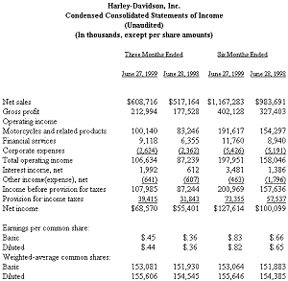
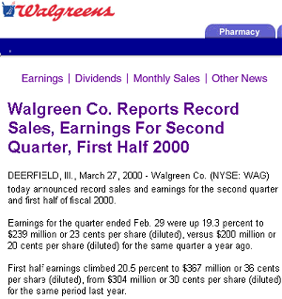

Slide 6



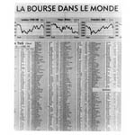


Slide 7
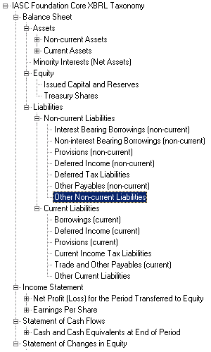

<ias:sales numericContext="rg00brl">-3181000000.</ias:sales>
<ias:sales numericContext="rg00usd">-4613000.</ias:sales>
<ias:sales numericContext="rg01brl">-3583000000.</ias:sales>
<ias:sales numericContext="rg01usd">-5196000.</ias:sales>
<ias:returns numericContext="rg00brl">0.</ias:returns>
<ias:returns numericContext="rg00usd">0.</ias:returns>
<ias:profit numericContext="ins00usd">228000.</ias:profit>
<ias:profit numericContext="ins00brl">84000.</ias:profit>
<ias:profit numericContext="ins00brl">73000.</ias:profit>
?

Slide 8
Topics
Standards-based Reporting with XBRL
  XBRL enabled software in the market
  XBRL implementations worldwide
  XBRL technology revealed
Value propositions
  Enterprises of all types
  Investors and analysts
  Regulators and government agencies

Slide 9









XBRL-enabled reporting software
Shipping
  SAP mySAP financials
  MBS Navision 3.70
  Oracle 11i FSG
  Creative Solutions
  Cognos Financials
  Hyperion Financials
Announced
  Business Objects
  PeopleSoft EFM
Custom
  CaseWare Financials
  Hitachi GEMPlanet

Slide 10







XBRL-enabled software tools
BlastRadius XMetal
DecisionSoft XBRL suite
EDGAR Online iMetrics
Fujitsu XWand
Ipedo XBRL Adapter
Rivet Software Dragon Tag
Semansys Composer
Software AG XBRL tools
UBmatrix Automator

Slide 11
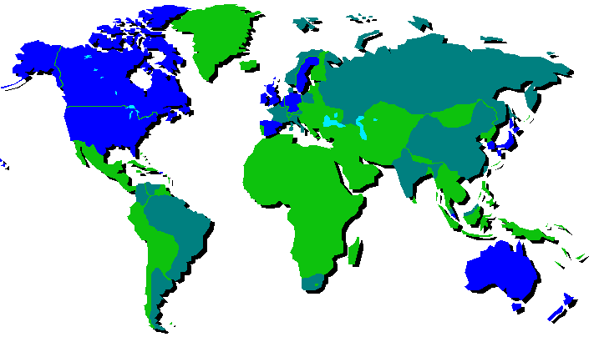
No competing XML standard for business reporting in sight
IASB
FAR
ICAI
ICAEW
CICA
IDW
AICPA
NIVRA
KASB
FASB
KICPA
JICPA
CSRC
ICPAS
SAICA
ICAA
ICANZ
Notes:
End 22:00

Slide 12
Topics
Standards-based Reporting with XBRL
  XBRL enabled software in the market
  XBRL implementations worldwide
  XBRL technology revealed
Value propositions
  Enterprises of all types
  Investors and analysts
  Regulators and government agencies

Slide 13
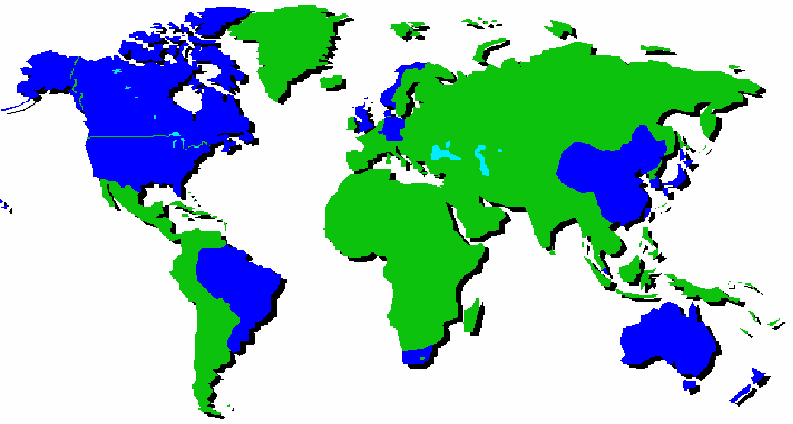
Exchanges
OBX
CSE
LSE
KSE
TSX
Deutsche
Börse
KOSDAQ
EuroNext
Tokyo
NASDAQ
Shanghai
Lux
SWX
Shenzen
Taipei
SGX
BOVESPA
JSE
ASX
NZSE
Eval
Pilot
Live

Slide 14
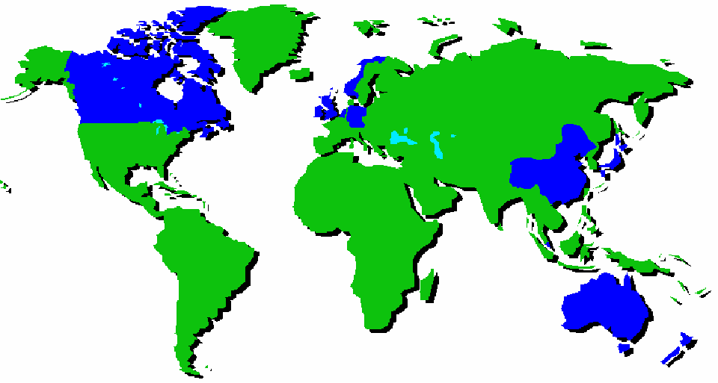
Tax Authorities
NO
CA
UK
DE
IE
NL
JP
CN
AU
NZ
Study
Committed

Slide 15
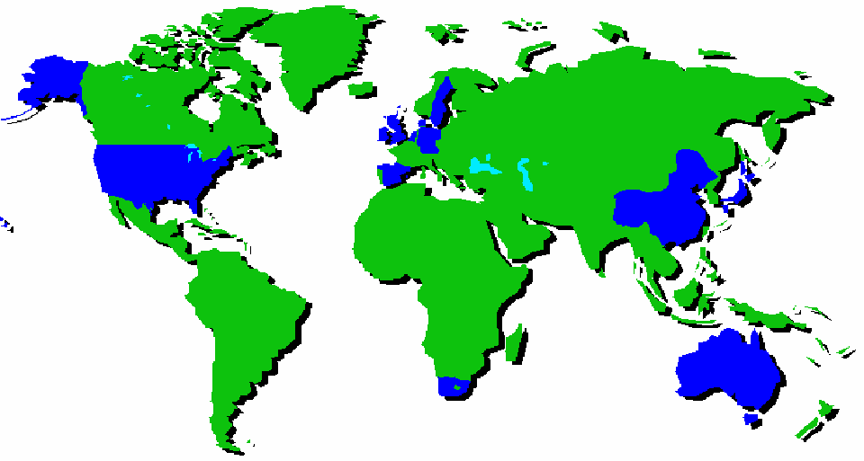
Financial Regulators
SE
UK
DK
BE
DE
NL
KR
US
JP
ES
CN
TW
SG
ZA
AU
Pilot
Committed

Slide 16
Topics
Standards-based Reporting with XBRL
  XBRL enabled software in the market
  XBRL implementations worldwide
  XBRL technology revealed
Value propositions
  Enterprises of all types
  Investors and analysts
  Regulators and government agencies

Slide 17
Ancient (Biased) History
Knowledge-based applications for financial domains don’t work until well-structured knowledge about business is easy to obtain
AI Boom and Bust; Golden Age of Knowledge Representation, etc.
XFRML
Dot Com Boom
WWW
XML
Crosby
EdgarScan
Structured Retrieval…
1990
1991
1992
1993
1994
1995
1996
1997
1998
1999

Slide 18
The business reporting supply-chain
Dec 1999
Business
Operations
Internal
Financial
Reporting
External
Financial
Reporting
Investment,
Lending, and
Regulation
Processes
XBRL
XBRL
XBRL
Companies
Financial
Publishers
and Data
Aggregators
Investors
Participants
Trading
Partners
Management
Accountants
Auditors
Regulators
Software Vendors

Slide 19
Dec 1999

Slide 20
XBRL Specification History
Increasing resources applied
Increasingly thorough
Higher standards
External
Deadline on 2.1
XML
Linking
FRIS
1.0
Boston
Mtg.
XML
Schema
Tampa
Mtg.
FRTA
1.0
XFRML
XBRL 1.0
XBRL 2.0
XBRL 2.0a
Tulip
XBRL
2.1
LRR
1.0
10/99
6/00
12/00
5/01
12/01
11/02
1/03
12/03
12/04
2000
2001
2002
2003
2004

Slide 21
XBRL 2.1 Documents
XBRL 2.1 Instance Standards 1.0 PWD
2004-11-14
Nice to
Have
FRTA 1.0
Candidate Recommendation 1
2003-12-31
Must
Have
Nice
to
Have
Link Role Registry (LRR) 1.0
PWD
2004-11-14
XBRL 2.1 Spec Primer
Internal Working Draft
2004-11-14
XBRL 2.1
Specification
2003-12-31
Recommendation
Nice to
Have
XBRL 2.1
Conformance
Suite
PWD
2003-12-31
XBRL 2.1
Schemas
2003-12-31
Must
Have
Nice
to
Have

Slide 22
XBRL 2.1 Documents
XBRL 2.1 Instance Standards 1.0 PWD
2004-11-14
Nice to
Have
FRTA 1.0
Candidate Recommendation 5
2005-01-29
Must
Have
Nice
to
Have
Link Role Registry (LRR) 1.0
CR1
2005-01-294
XBRL 2.1 Spec Primer
Internal Working Draft
2004-11-14
Nice
to Have
XBRL 2.1
Corrected
Errata
XBRL 2.1
Schemas
2003-12-31
Must
Have
XBRL 2.1 Conformance Suite
CR1
2005-01-01
Nice
to
Have
XBRL 2.1 Corrected
Errata

Slide 23
Extensibility Goals of XBRL as compared to other XML standards
Invoice
  Parties
    Identifier
    Address
  Line Item
    Item
      Identifier
      Description
    Quantities
    Amounts
    Discounts
  Taxes
  Delivery Terms
Depreciation Schedule
  Line Item
    Asset name
    Asset category*
    Value brought forward**
    Value limitation*
    Period
    Acquisition Date
    Method*
    Amount
    Limitation*
    Value carried forward**
    Etc., etc., etc.
*Meaning varies according to accounting principles appropriate to purpose of information
** Name of otherwise identical concept varies by jurisdiction, not to mention native language
Notes:
Let’s compare what the typical e-business standard has to do, compared to XBRL.
On the left is a typical standard ‘invoice’ – this has been done many, many, many times.
On the right is the kind of thing we need to do in XBRL.
Notice the variability of what might go in there.
The terms are common, but the meanings are different.
And sometimes the meanings are the same but the terms are different!

Slide 24
XBRL Fundamentals
Data (INSTANCE)
XBRL is the way that it is because business reporting concepts are extensible.
Meta Data (TAXONOMIES)
Instance
Concept
Label and language
Context
Unit
Reference
Fact
Fact
Definition
Concept
Taxonomy
Presentation Hierarchy
Unit
Calculation Hierarchy
Context
Data types, normal balance
Fact
Fact
Fact
Concept
Concept

Slide 25
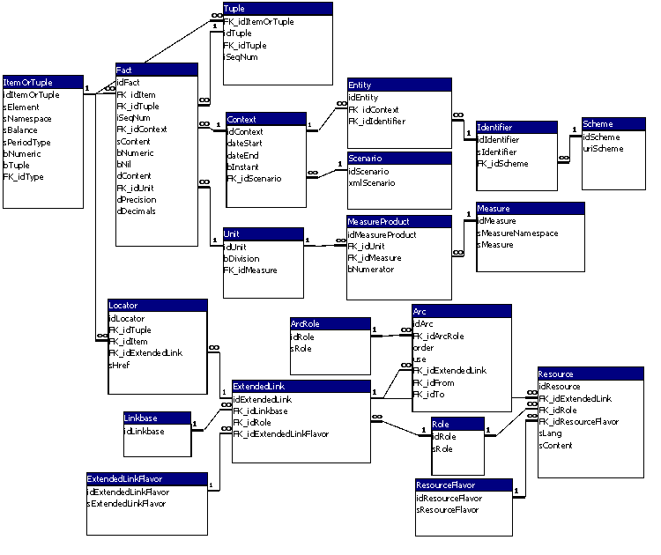
ER Representation of XBRL
Data
(instance)
Meta Data
(taxonomy)

Slide 26
XML Linking (XLink)
XLink is a W3C standard way to use XML to represent all kinds of relationships between XML elements no matter where they are.
XML Document 1
Linkbase
XML Document 2
b explains a
<P id=“c”>
<P id=“a”>
b isLike
c
<P id=“b”>

Slide 27
XBRL uses XLink to represent the relationships between concept elements
<element id=“ast.cur”>
<Label>Current Assets</Label>
Definition:
more
general
label
label
<element id=“ast.inv”>
<Label>Inventory</Label>
Presentation:
below
reference
<bk>
<ch>1</ch>
<par>5</par>
<ln>7</ln>
</bk>
<element id=“ast.wip”>

Slide 28
XLink allows customization and explicit, modular changes to reusable material
当前的财产
<element id=“ast.cur”>
<Label> </Label>
Definition:
more
general
label
label
<element id=“ast.inv”>
存货
<Label> </Label>
Presentation:
before
reference
<bk>
<ch>1</ch>
<par>5</par>
<ln>7</ln>
</bk>
<element id=“ast.wip”>

Slide 29
ValueReportingTM -- illustrating multidimensional taxonomies
Fictitious investment house
Proprietary analysis system
Researching one or more companies
A) preparing an internal briefing document on a company
B) preparing a sales forecast for a particular segment of that company

Slide 30
Sample applications an investment house’s internal briefing document
Generates customised instance document format for investment house – in this case a briefing document for high level information about a company

Slide 31
Sample applications investment house’s internal briefing document
Data in instance document automatically generated from company sources.
Clearly indicates what is reported.

Slide 32
Sample applications investment house’s internal briefing document
Data in instance document automatically generated from analyst sources.

Slide 33
Sample applications investor’s revenues forecast for a company
Instance document generated of third step in revenues forecast process – historical revenue data for particular region by distribution channel
Investment user then inputs assumptions about the future growth of revenues and could be prompted to consider issues such as upcoming product launches.

Slide 34
ValueReporting
Leveraging XBRL taxonomies
Shared taxonomies, used by both company and investor (producer and consumer)
Non-GAAP data (broker recommendations)
Single instance, multiple renderings
Multidimensional information hierarchies

Slide 35
Multidimensional Reporting Taxonomies
Geography
  Common definitions

Slide 36
Multidimensional Reporting Taxonomies
Geography
  Common definitions
Industry
  PwC Categories

Slide 37
Multidimensional Reporting Taxonomies
Geography
  Common definitions
Industry
  PwC Categories
Segment
  Company specific

Slide 38
Sample Fact and Context
(dimension member in a segment, not tuple)
<ifrs-gp:RevenueByFunction
decimals="-3" contextRef="organic02p"
unitRef="eur">81650000</ifrs-gp:RevenueByFunction>
<context id="organicjuices02p">
<entity>
<identifier scheme="dns:domain">knz.com</identifier>
<segment>
<dim:member>knz-prd:OrganicJuices</dim:member>
</segment>
</entity>
<period>
<startDate>2002-01-01</startDate>
<endDate>2002-12-31</endDate>
</period>
</context>

Slide 39
Sample Fact and Context
(segmental and geographic dimensions)
<ifrs-gp:RevenueByFunction
decimals="-3" contextRef="organicjuicesgermany02p"
unitRef="eur">3220000</ifrs-gp:RevenueByFunction>
<context id="organicjuicesgermany02p">
<entity>
<identifier scheme="dns:domain">knz.com</identifier>
<segment>
<dim:member>knz-prd:OrganicJuices</dim:member>
<dim:member>geo:Germany</dim:member>
</segment>
</entity>
<period>
<startDate>2002-01-01</startDate>
<endDate>2002-12-31</endDate>
</period>
</context>

Slide 40
<link:schemaRef xlink:type="simple" xlink:arcrole="http://www.w3.org/1999/xlink/properties/linkbase" xlink:href="hwi.xsd"/>
<baf:StrategicDirection contextRef="knz03p">Our mission is to be the soft drinks company of choice and to achieve above average market growth, by focusing on the healthy beverages sector, through growth in our existing businesses and strategic acquisition. We seek to increase the attractiveness and availability of our organic juices to meet our consumers ever demanding needs for a healthy and convenient lifestyle.
</baf:StrategicDirection>
<ifrs-gp:BasicEarningsLossPerShare decimals="2" contextRef="knz03p" unitRef="eurPerShr">2.28</ifrs-gp:BasicEarningsLossPerShare>
<ifrs-gp:BasicEarningsLossPerShare decimals="2" contextRef="knz02p" unitRef="eurPerShr">2.05</ifrs-gp:BasicEarningsLossPerShare>
<hwi:EPSgrowth decimals="4" contextRef="knz03p" unitRef="pure">.1122</hwi:EPSgrowth>
<hwi:EPSgrowth decimals="3" contextRef="knz02p" unitRef="pure">.108</hwi:EPSgrowth>
<hwi:EPSgrowthPeers decimals="4" contextRef="knz03p" unitRef="pure">.2845</hwi:EPSgrowthPeers>
<hwi:EPSgrowthPeers decimals="3" contextRef="knz02p" unitRef="pure">.256</hwi:EPSgrowthPeers>
<ifrs-gp:RevenueTotalByNature decimals="-5" contextRef="knz03p" unitRef="eur">352200000</ifrs-gp:RevenueTotalByNature>
<ifrs-gp:RevenueTotalByNature decimals="-5" contextRef="knz02p" unitRef="eur">349600000</ifrs-gp:RevenueTotalByNature>
<hwi:Gearing decimals="4" contextRef="knz03e" unitRef="pure">.0379</hwi:Gearing>
<hwi:Gearing decimals="3" contextRef="knz02e" unitRef="pure">.031</hwi:Gearing>

Slide 41
Taxonomies in Play

Slide 42
BAF (PwC)
IFRS
HWI (Analyst)
IFRS
HWI (Analyst)
IFRS
HWI (Analyst)

Slide 43
HWI
KNZ (Company)
HWI

Slide 44
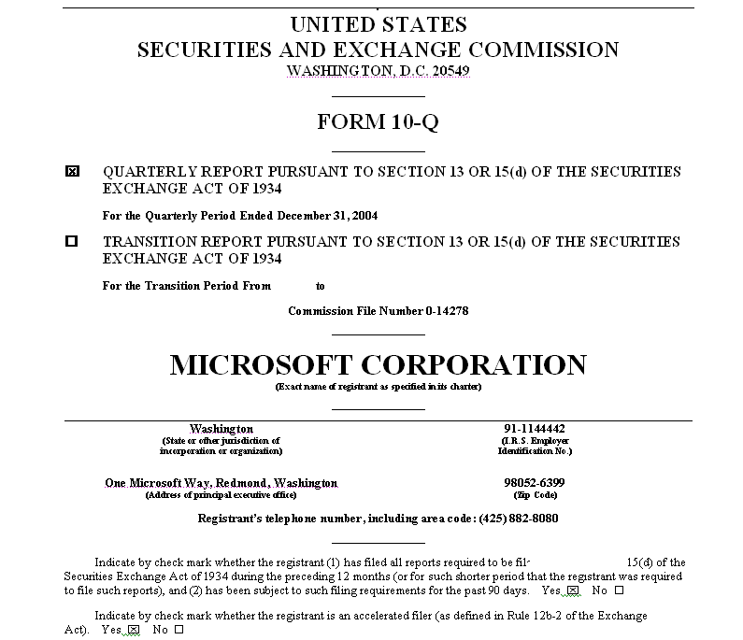
Microsoft 2Q FY05 Financials
GAAP-CI
FIN
CHN
…

Slide 45
Topics
Standards-based Reporting with XBRL
  XBRL enabled software in the market
  XBRL implementations worldwide
  XBRL technology revealed
Value propositions
  Enterprises of all types
  Investors and analysts
  Regulators and government agencies

Slide 46
Information Value and Cost
Value = Reduction of uncertainty times $$$ at risk
Cost = Produce + Structure + Distribute + Consume
  The XBRL return on investment (ROI) is that it puts information in the hands of users at lower costs (both production and consumption)
Notes:
Information = Reduction of uncertainty
Surprises
Timeliness
Comparability
Unstructured: free-form prose
Structured: multiple-choice quiz, a rolodex, number table

Slide 47
Benefits of XBRL for Preparers
Lower cost of producing information
More timely, accurate, data for decisions
Enhanced analytical capabilities
Better control environment
Tell your own story (precise & clear)
Accelerate adoption of reporting models
Enhanced functionality
Ease of use
Notes:
XBRL Benefits for Consumers
More timely, accurate, data for decisions – as demonstrated in the NASDAQ.com demo; this provides consumers with significant abilities to access and analyze the information contained with in the reports
Accelerate adoption of reporting models – Certain consumers (regulators and other governmental authorities) promote flexibility in the adjustments needed for changes in the reporting models
Lowers cost of e-filing initiatives – the re-use of reported information in a universally accepted format lowers the overall costs of supply chain participants and decreases the costs of other e-filing initiatives
Facilitates language translations – promotes the capability to have on the fly language translation of the primary statements and some (say 70%) of the more narrative disclosures.
XBRL Benefits for Preparers
More precise & clear reporting – preparer determines the structure of the information used by the consumers rather than a third party aggregator & distributor.
Enhanced functionality – The linkage of relevant resources to the document provides for a better preparation environment. Company policies, reporting resources and other relevant content is contextually available via the XBRL document.
Better controls & audit trail – As a result of the enhanced automation of the reporting process and tighter connection between underlying systems and the company report, enhanced documentation and controls are provided.

Slide 48
Benefits of XBRL for Consumers
Lower cost of consuming information
Faster access to information
More timely, accurate, data for decisions
Enhanced analytical capabilities
Enhanced functionality
More useful access to information
Ease of access to definitions enhance comparability
Facilitates language translations
Notes:
XBRL Benefits for Consumers
More timely, accurate, data for decisions – as demonstrated in the NASDAQ.com demo; this provides consumers with significant abilities to access and analyze the information contained with in the reports
Accelerate adoption of reporting models – Certain consumers (regulators and other governmental authorities) promote flexibility in the adjustments needed for changes in the reporting models
Lowers cost of e-filing initiatives – the re-use of reported information in a universally accepted format lowers the overall costs of supply chain participants and decreases the costs of other e-filing initiatives
Facilitates language translations – promotes the capability to have on the fly language translation of the primary statements and some (say 70%) of the more narrative disclosures.
XBRL Benefits for Preparers
More precise & clear reporting – preparer determines the structure of the information used by the consumers rather than a third party aggregator & distributor.
Enhanced functionality – The linkage of relevant resources to the document provides for a better preparation environment. Company policies, reporting resources and other relevant content is contextually available via the XBRL document.
Better controls & audit trail – As a result of the enhanced automation of the reporting process and tighter connection between underlying systems and the company report, enhanced documentation and controls are provided.

Slide 51
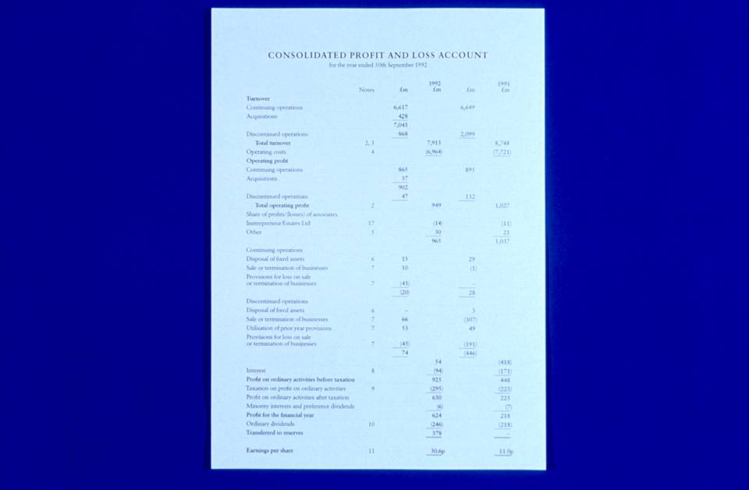
Notes:
Well, paper financial statements are pretty much like that.
There’s an awful lot of detail there

Slide 52
Consolidated Profit and Loss Account for the year ended September 30, 2001
Blah | blah | blah
Blah blah | blah | blah
Blah | blah | blah
Blah blah blah | blah | blah
Profit | 925 | 448
Blah | blah | blah
Earnings per share | 30.6 | 11.0
Notes:
But if there isn’t agreement on what each of those details mean, naturally this is what you’ll get.

Slide 53
Topics
Standards-based Reporting with XBRL
  XBRL enabled software in the market
  XBRL implementations worldwide
  XBRL technology revealed
Value propositions
  Enterprises of all types
  Investors and analysts
  Regulators and government agencies

Slide 54
XBRL in a large enterprise
Debtor Financials
Portfolio Financials
Annual and Quarterly Financials
Divisional Financials
Management Reports
Reg. Reports
Supplier and Customer Financial Reporting
Credit Assessment
Internal
Financial
Reporting
External
Financial
Reporting
Markets and
Regulators
Counterparty Financials
Business Unit Financials
Tax Filings
Joint Venture Financials
Partnership Financials

Slide 55
XBRL in a large enterprise
Debtor Financials
Business Unit Financials
Group
Annual and Quarterly Financials
Divisional Financials
Call Reports
Counterparty Financials
Management Reports
Partnership Financials
Portfolio Financials
Joint Venture Financials
Tax Filings
Supplier and Customer Financial Reporting
Credit Assessment
Internal
Reporting
External
Reporting
Markets and
Regulators
XBRL
XBRL
XBRL
XBRL

Slide 56
Topics
Standards-based Reporting with XBRL
  XBRL enabled software in the market
  XBRL implementations worldwide
  XBRL technology revealed
Value propositions
  Enterprises of all types
  Investors and analysts
  Regulators and government agencies

Slide 57
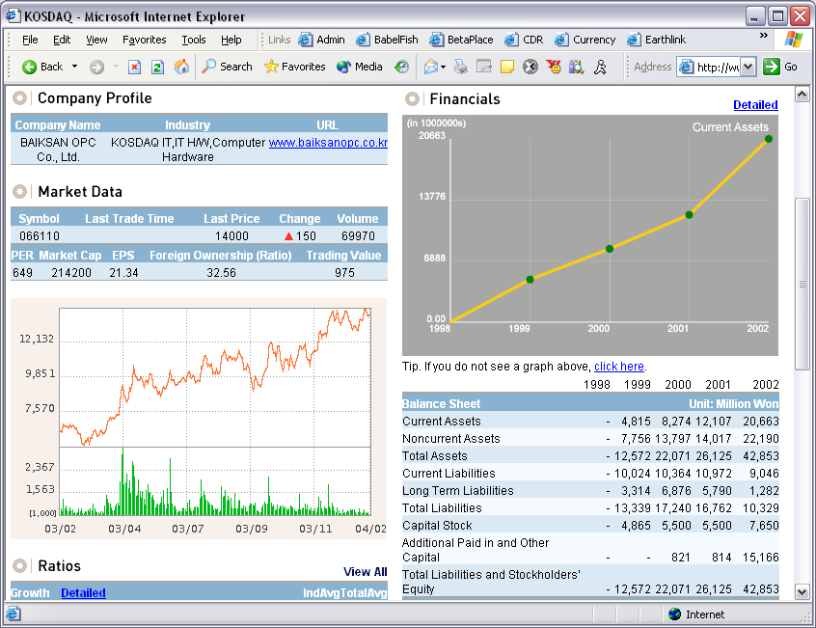


Slide 58
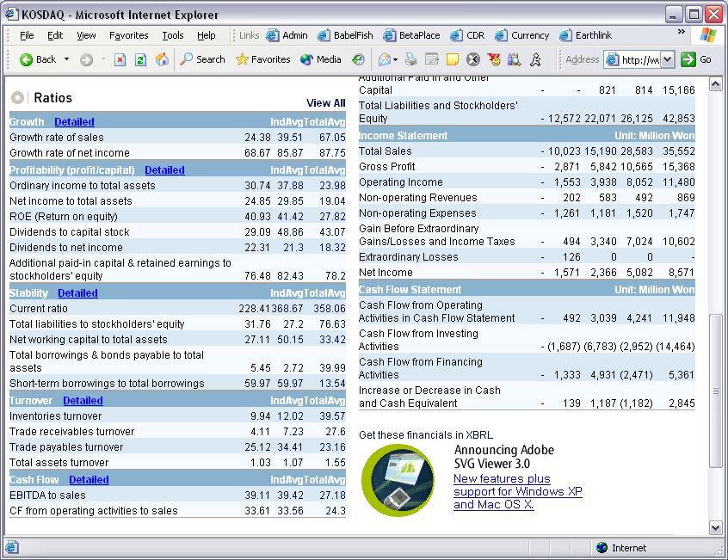

Slide 59
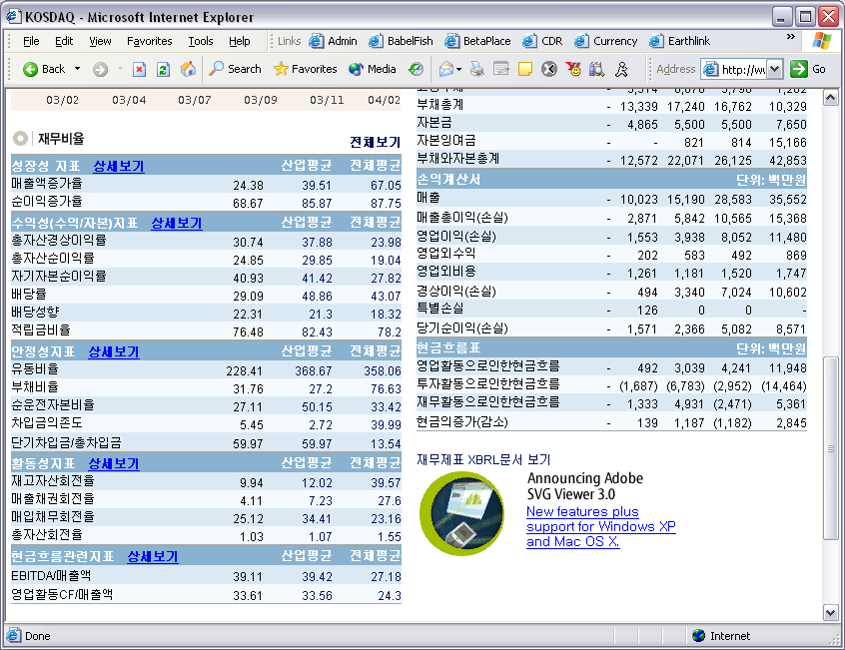

Slide 60
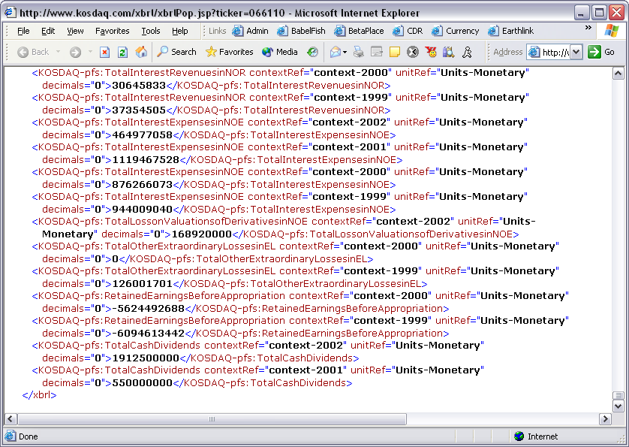

Slide 61
Home Worksheet
Analysis

Slide 62
Web Service Data
Analysis

Slide 63
Local/Web Service Data
Analysis

Slide 64
Manage Columns
Analysis

Slide 65
Charts/Graphs
Analysis

Slide 66
Financial Comparison
Analysis

Slide 67
Ratios
Analysis

Slide 68
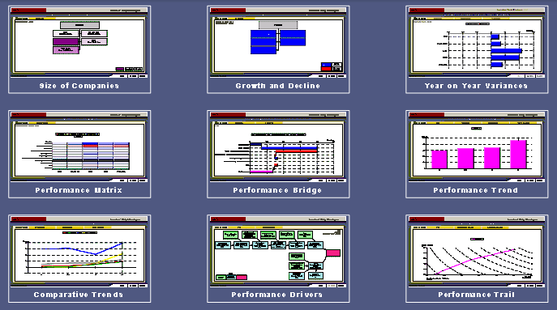
MetaPraxis’ Empower 2000
Notes:
End 12:00

Slide 69
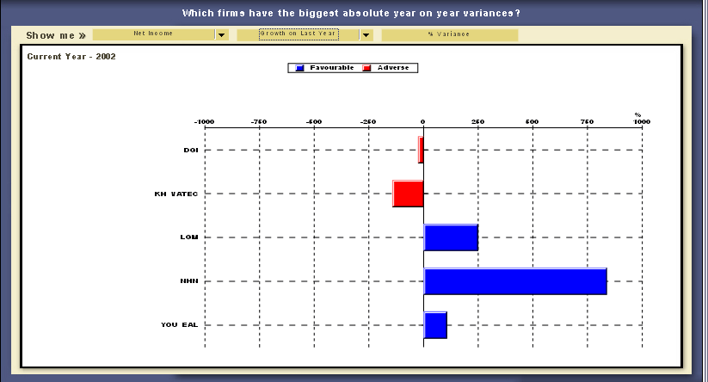
MetaPraxis’ EmPower 2000
Variance Analysis
Notes:
End 12:30

Slide 70
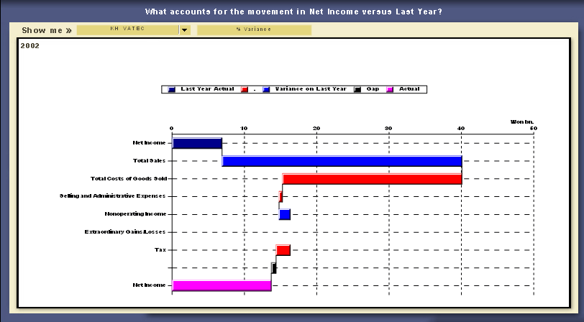
MetaPraxis’ EmPower 2000
Profit Bridge
Notes:
End 13:00

Slide 71
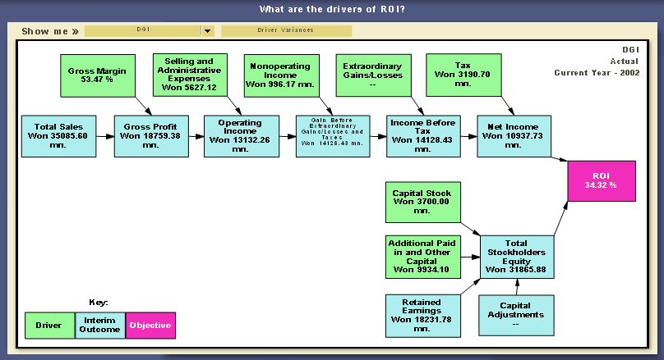
MetaPraxis’ EmPower 2000
Profit driver analysis
Notes:
End 13:30

Slide 72
Topics
Standards-based Reporting with XBRL
  XBRL enabled software in the market
  XBRL implementations worldwide
  XBRL technology revealed
Value propositions
  Enterprises of all types
  Investors and analysts
  Regulators and government agencies

Slide 73
E-filing cost reduction at the US FFIEC
FDIC
OCC
FRB
OTS
NCUA
Today
8900 Banks
FDIC
OCC
FRB
OTS
NCUA
FFIEC
Future
8900 Banks

Slide 74
Typical XBRL Regulator Use
Software
Can be any vendor product, or provided by regulator
Software
Today four different vendors with interoperable tools
Data is Shared
Deposit Insurance
--- Statistics ---
-- Comptroller --
Schedule or Form
XBRL Taxonomy
Item Types
Labels, Definitions, etc.
Instructions
XBRL
Taxonomy Software
XBRL Rule Base
Validations, Quality tests
Value-added Calculations
Create
Update
Debug
Reporting Institution Software
XBRL Version Management
Taxonomy changes
Rule changes
Result:
Adaptability
Efficiency
Faster cycle times
Import Schedule
Enter Data
Validate Data
Send Data
Meta Data
Quarterly Report
XBRL Document
Bank Performance Data
Reporting Institution Regulator

Slide 75

From http://www.fsa.uk.gov/regulatory_reporting
The Integrated Regulatory Return… will combine all of the data we request from firms into one return, helping us monitor them more effectively and reducing costs for firms and us.
…we have decided to use the Extensible Business Reporting Language (XBRL) to collect, validate and distribute the data in the Integrated Regulatory Return.

Slide 76

From http://www.fbe.be/pdf/postFSAPfinal.pdf
[T]he time is ripe for regulators to
examine, together with the banking industry if -and to what extent- they wish to promote the use of XBRL to cooperate across borders and
take advantage of such an opportunity to re-assess not just the broad principles associated with regulation but also the specific definitions of regulatory reporting concepts.

Slide 77
Extensible Business Reporting Language (XBRL) Update
Walter Hamscher (walter@hamscher.com)
Executive Committee, XBRL International
Consultant to PricewaterhouseCoopers

