Slide 1
Winner of the 2012 Zayed Future Energy Prize

Slide 2
Agenda
Introduction
Requirements
Challenges ahead

Slide 3
Thank you
BRAG

Slide 4
Carbon What?

Slide 5
Introduction – CDP
Accelerate solutions to climate change and water management by putting relevant information at the heart of business, policy and investment decisions.
Investors Signatories to the Carbon Disclosure Project
Notes:
The Carbon Disclosure Project is an investor led, voluntary, initiative requesting disclosure
of Climate Change information since 2002 to the worlds largest corporations by market
cap.
Its mission is to accelerate solutions to climate change and water management by putting
relevant information at the heart of business, policy and investment decisions.
In 3 simple words – STOP CLIMATE CHANGE

Slide 6
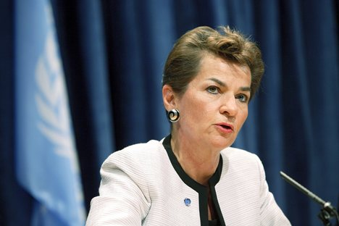
Introduction – CDP
“CDP is to the future of business what the X-ray was to the then-future of medicine — without it, we would never have seen the insides of the patient's health.”
Number of companies disclosing to CDP (Investor + Supply Chain)
Christiana Figueres
Executive Secretary of the UN Framework Convention on Climate Change (UNFCCC)
Notes:
Besides the investor programme, we also have a supply chain programme, a water investor programme and a cities programme. In the supply chain company, client companies request information about strategy, risks and opps and GHG emissions to their suppliers, as well as some supplier specific information on GHG data.
We streamline the request and with this, are able to lower the reporting burden of companies – a big concern that is always present. We support companies in their disclosure through a variety of tools – guidance, workshops, webinars, helpdesk, etc. These are reflected in the number of companies reporting to the CDP has been increasing constantly through the years – even though through the years the reporting has become more complex.
And the disclosing mechanism that CDP has set voluntary is the main source of data in the world
on corporate strategies on climate change, risks and opportunities and GHG emissions.
In the words of Christiana Figueres – executive secretary of the UN Framework convention on Climate Change - we are the X-ray of business, that allows to see what is happening inside the patient!

Slide 7
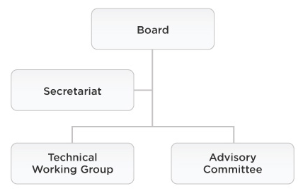
CDSB – Climate Disclosure Standards Board
Created at WEF Davos (2007), Secretariat provided by CDP
Mission: promote and advance standardized disclosure of climate change-related information in mainstream reports (Integrated Reporting)
Notes:
Because another dimension of our activity, is to drive the climate change disclosure
forward.
That is why CDP is providing the secretariat of the Climate Disclosure Standards Board and
has been one of the founding organizations of CDSB.
Let me tell you more about CDSB: it is a consortium of business and environmental
organizations integrating key stakeholders in this field: main accounting firms; professional
accounting organizations; main GHG emissions accounting players; academia; companies
and industry representatives.
It aims to be for Climate Change, what IASB is for financial accounting.
Its Mission: to promote and advance standardized disclosure of climate change‐related
information in mainstream reports
How we do it? through the development of a reporting framework designed to integrate
climate change into mainstream filings.

Slide 8
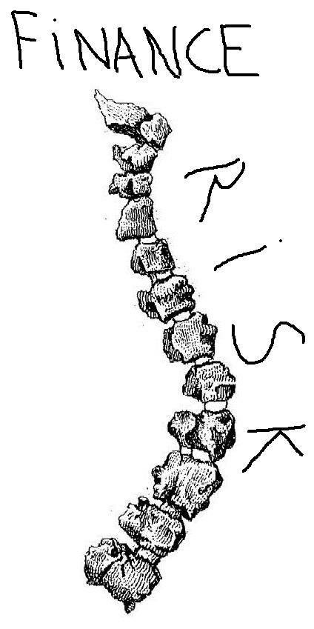
Climate Change Disclosure
Assessment and transparency of risks across the board helps to prevent systemic risks to the global financial (& economic) system
Notes:
Climate change disclosure –why does it exists and does it matter?
The case for climate change disclosure is clear:
• Assessment and transparency of risks is the backbone of the stability of financial (and
economic) system.
• Climate change risk can and will affect companies on an individual basis and will affect
them differently depending on their business models and strategies; it will affect in
different ways and in different degrees;
• But even more important, failure to assess it across the board will create a systemic risk
to the global financial & economic system – DOES THIS SOUND FAMILIAR?

Slide 9
Requirements
Compliant with:
Latest XBRL specification
ITA and Global Manual Filling
CDP + CDSB
+
minimize maintenance efforts
maximize easy of delivery for main use cases

Slide 10
Requirements
Input:
capture all climate related “high-level” concepts
document all concepts
allow linking to other taxonomies (namely financial)
be extensible

Slide 11
Requirements
Usability:
languages: English, Japanese, Chinese, Spanish, Portuguese
allow for enumeration lists to be extended (LOV&LOV+)
allow for “question pathways”

Slide 12
Requirements
Output:
validation rules
compatible with existent analytical solutions
transformable to and from current CDP XML format (transition period)
Currently documenting several use cases

Slide 13
Requirements – implementation example
(1) CDP +CDSB compliance
CDP: 12 years; web form based collection system ; structured data; detailed guidance; > 4000 instances submitted
CCRF: 2 year; standard for integrating material climate change information into mainstream fillings; principles and criteria; no detailed data structure; limited adoption;

Slide 14
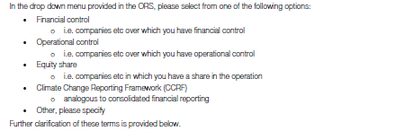
Requirements – implementation example
LOV
List of Values
Some LOV have been transformed into dimensions

Slide 15
Requirements – implementation example
CDP
CCRT

Slide 16
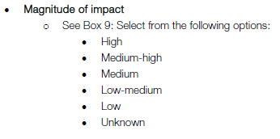
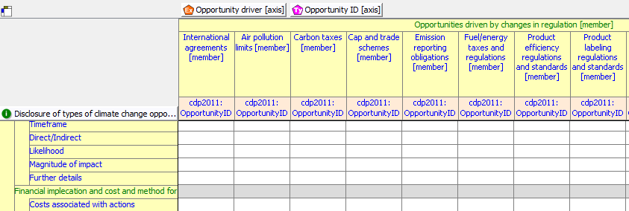
Requirements – implementation example
Other LOV are a reporting facts

Slide 17
Requirements – implementation example
For LOV that are reporting facts, we would like:
Extensibility;
Ability to provide context;
Translation capability;

Slide 18
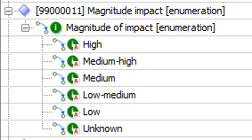
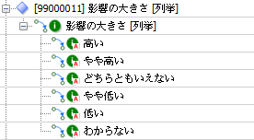
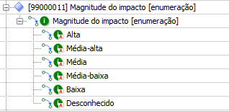
Requirements – implementation example
Proposed solution
Extension of LOV done through relationships of element definitions, like dimensions
Reporting concept must have a type Qname that have one of the concepts in the relationships
Defining an entity of type “LOV” that links to other (abstract) elements, e.g.
<Magnitude of Impact>
<High>
<Medium-High>
<Medium>
<Medium-Low>
<Low>
<Unknown>

Slide 19
Challenges ahead
How to work without mandates?

Slide 20
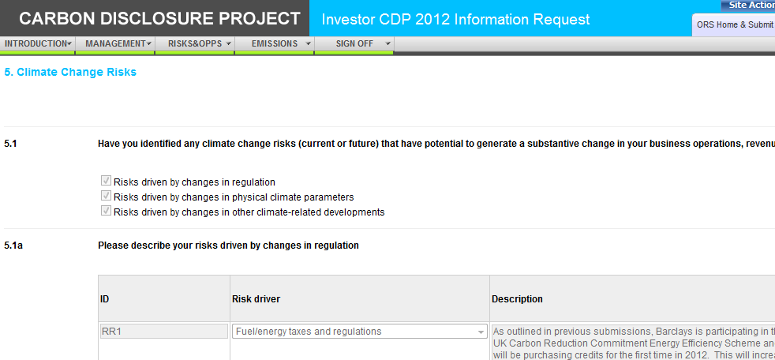
Challenges ahead
Data entry

Slide 21
Challenges ahead
Taxonomy development:
Water
Forests
Cities
Sector reporting
Integrated reporting

Slide 22
Challenges ahead
Supply chain
Taxonomy(ies)
Security
Sharing data
(re) Calculations + traceability

Slide 23
THANK YOU! pedro.faria@cdproject.net
Winner of the 2012 Zayed Future Energy Prize

