Slide 1
CEN/WS XBRL
Overview
12 December, 2012

Slide 2
CEN Workshop
The CEN Workshop is a flexible working platform open to the participation of any company or organisation, inside or outside Europe, for rapid elaboration of consensus documents (CWAs).

Slide 3
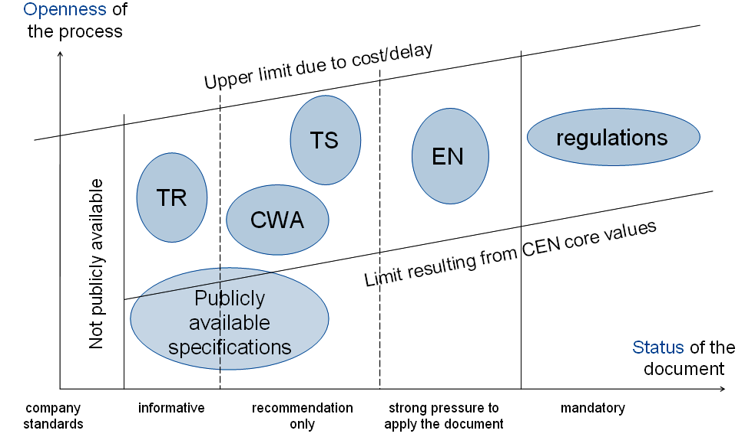
STATUS EUROPESE STANDAARDEN

Slide 4
CEN/WS XBRL Summarized
Workshop duration is 23 months
3 deliverables
Public consulatation period
Financial support from the EC (expert teams)

Slide 5
CEN/WS XBRL deliverables
CWA 1 Standardize harmonization topics
CWA 2 Metadata container and compliance tools
CWA 3 Standard regulatory roll-out package for better adoption

Slide 6
CEN WS XBRL Structure
Chair
Ignacio Boixo
Chairman Advisory Group (CAG)
Secretariat
Maarten Peelen
CEN WS XBRL Decision-making body
Project Team D Coordination across deliverables
Working Group 1 CWA 1: Harmonization topics
Katrin Heinze
Project Team A
Working Group 2 CWA 2: Metadata container
Emile Bartolé
Project Team B
Working Group 3 CWA3: Standardized regulatory roll-out package
Aitor Azcoaga
Project Team C
6

Slide 7
Timeline
Drafting
WG review
Comments resolution
Public consultation
Comments resolution
Voting
1
2
3
4
Aug 2012
Spring 2013
Jun
2013
Sep
2013
Dec
2013
Deadlines
2012-12 – Interim report to EC incl. draft CWAs
2013-06 – 3 months Public consultation & Public conference
2012-12 – Adoption of CWAs
2014-02 – Final report to EC incl. approved CWAs
1
2
3
4
Project Team input

Slide 8
CEN/WS XBRL planning
Tx | Date |  | Action 1 | Action 2
9 | sep-12 |  | PT kick-off meeting
10 | okt-12 |  | Drafting CWAs
11 | nov-12 |  | Drafting CWAs
12 | dec-12 |  | Interim report to EC | Plenary meeting
13 | jan-13 |  | Drafting CWAs | WS review?
14 | feb-13 |  | Drafting CWAs | WS review?
15 | mrt-13 |  | Drafting CWAs | WS review?
16 | apr-13 |  | Drafting CWAs | Working Group meetings
17 | mei-13 |  | Drafting CWAs
18 | jun-13 |  | Public consultation | Public conference meeting
19 | jul-13 |  | Public consultation
20 | aug-13 |  | Public consultation
21 | sep-13 |  | Comment resolution
22 | okt-13 |  | Comment resolution
23 | nov-13 |  | Comment resolution
24 | dec-13 |  | Plenary meeting + Adoption of CWAs | Satisfaction survey
25 | jan-14 |  | Preperation final report
26 | feb-14 |  | Final report to EC

Slide 9
More information
www.eurofiling.info/cen
Chair Ignacio Boixo boixo@eurofiling.info
Secretariat Maarten Peelen Netherlands Standardization institute maarten.peelen@nen.nl

