Slide 1
CEN/WS XBRL
CWA3: Standardized roll-out package
12 December, 2012
Aitor Azcoaga, EIOIPA
CWA3

Slide 2
Objectives
Standardized "roll-out package" that wraps the specifications as defined under previous deliverables.
Standard regulatory package with all taxonomies, technical assistance, conversion mechanisms, mapping components, localization components (via XBRL jurisdictions), etc., to create economies of scale and enhance adoption between Supervisors
Implementation and roll-out guide with technical documentation, instructions for proper use of XBRL and a localization bridge to a national XBRL jurisdiction
CWA3
Notes:
This CWA will include an implementation and roll-out guide with technical documentation, instructions for proper use of XBRL and a localization bridge to a national XBRL jurisdiction, if available.

Slide 3
Deliverables of CWA3
XBRL Supervisory roll-out guide
Oriented towards national regulators on how to implement, extend and manage XBRL taxonomies
XBRL Handbook for Declarers
Roll-out guide or reference handbook would help XBRL prepares(reporting entities) in getting to know XBRL
CWA3

Slide 4
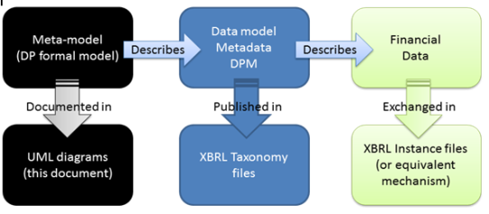
XBRL Supervisory roll-out guide
How to start with XBRL from the regulator perspective
Determining the level of XBRL adoption
Plan to preparing the reporting models
The transmission infrastructures
Adapt and review the internal information systems
Preparing the communication plan for reporting entities
How to implement and extend
taxonomies (CWA1)
XBRL Standard extension Mechanism
European framework background information
Guideline on extensions
CWA3
Notes:
The source of information for this package will be XBRL Europe, Eurofiling and others.

Slide 5
XBRL Supervisory roll-out guide
Architecture, methodology and best practises (CWA1)
Management and maintainability
Transparency
Validation
Harmonisation
Standardization
How to transmit, process and validate instances (CWA2 header and container, etc.)
CWA3
Notes:
The source of information for this package will be XBRL Europe, Eurofiling and others.

Slide 6
XBRL Handbook for Declarers
How to start with XBRL from the declarer's perspective
XML and XBRL: Introduction to its technological building blocks
XML as a markup language (Namespaces, XML Schemas, XLink, XPath, XSLT, XQuery, etc.)
XBRL Introduction:
Taxonomies
Dimensions
Formulas
Instance creation and validation
Reference documentation
CWA3

Slide 7
Thanks for your attention
Questions?
Aitor.Azcoaga@eiopa.europa.eu
CWA3
Notes:
7

