Slide 1
How to understand a DPM?
12th XBRL Europe Day & 18th EuroFiling Workshop
10-11 December 2013
CSSF Luxembourg and XBRL Luxembourg

Slide 2
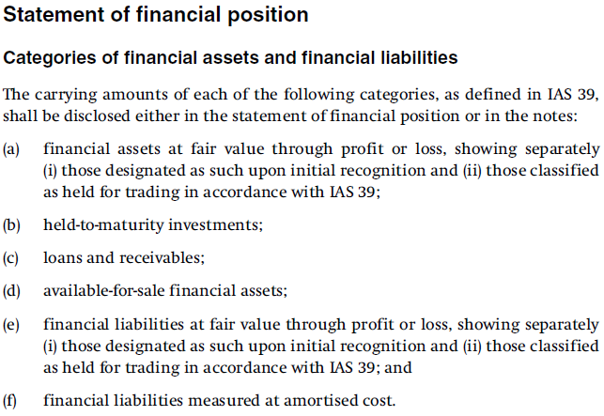
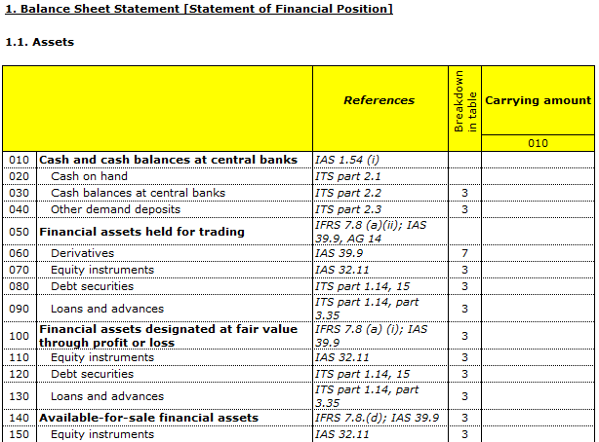
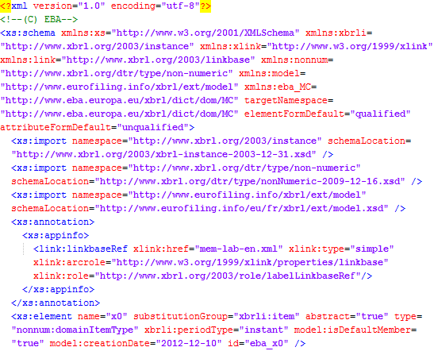
What are the questions asked by business and IT experts?
Business users
IFRS, FINREP, COREP, … - which accounting regime or standard?
What do you mean by „financial” (IAS 39/IFRS7/...)?
Where is it disclosed?
Gross or net carrying amount?
Any of it impaired or past due but not impaired yet? Or maybe it is measured at fair value? If so: which level?
Which operations is it reported for? Banking book, assets management, ...?
Is any of it portion transferred or partially derecognized?
Is it audited or unaudited, solo or consolidated (if consolidated then which method)?
…
„Financial assets”
IT
Is it a number, date, text? If a number that what is the unit of measure?
How is it related to other data – which package does it come with (frequency, types of entities)?
Does it calculate to or from anything else?
Are there any breakdowns applicable? Are they predefined or flexibly assigned by filers?
What attributes apply to this data? How is it characterised?
Which journal-entries roll-up to this value?
…

Slide 3
Business vs. IT issue is not the only challenge in EU…
Banking supervision
Insurance supervision
Capital market supervision
Country 1
Business expert
IT expert
Business expert
IT expert
Business expert
IT expert
Challenges:
Country 2
- Different sectors (i.e. Basel III vs. Solvency II)
Business expert
IT expert
- High number of countries (European vs. global initiatives)
(…)
- Frameworks (Basel vs. IFRS)
- Other (i.e. proportionality rule, solo vs. consolidated reporting, etc.)
Country 28
Business expert
IT expert

Slide 4
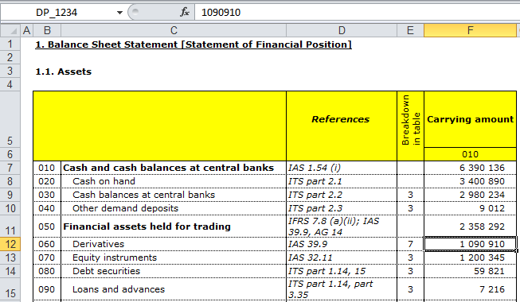
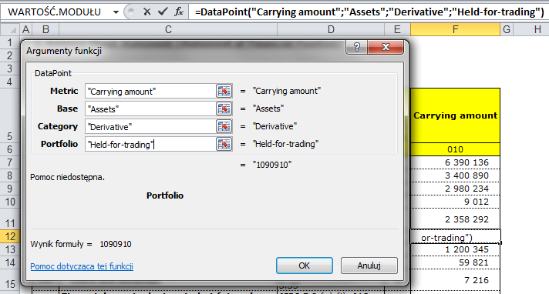
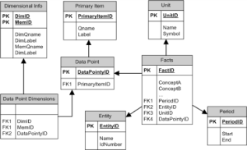
What are the options of dealing with the problem of communication?
"form centric"
based on presentation of data which conveys all semantics (interpretation in context of views)
description based on table cells (row/column code, e.g. C6 or simply by row/column title concatenation)
most common solution in projects with no input from business experts
difficult to maintain and apply e.g. for analysis
fillers map/extract to/from views (question and error prone)
 | C1 | C2
R1
R2
R3
"data centric"
explicit and consistent definition irrespective of presentation
every data cell fully described by business users with all necessary properties in order to explicitly express its meaning
resulting data model supports data exchange (explicit information for filers) and usage (e.g. in analysis)

Slide 5
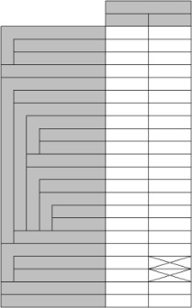
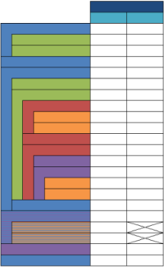
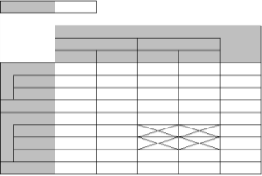
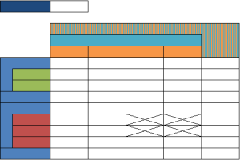
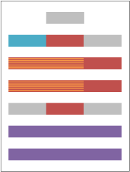
How to approach data centric modeling?
SELECT SUM(factValue)
FROM allFacts
WHERE
item=″assets″
AND
category=″loans″
AND
amount=″notional″
AND
…

Slide 6
Data point model
What DPM is?
Methodology to organize the data
What DPM is not?
Tables
Technical format
Dictionary (consistent, well structured, no overlaps, etc.)
Mechanism to describe data model (tables) with concepts from the dictionary (unique, explicit, etc.)
Must include:
„Something” to be prepared by IT experts…

Slide 7
What is the data point?
Combination of (i) a measure/metric and (ii) sets of pairs of each applicable dimension and domain members describing this measure in order to explicitly define a piece of information (e.g. a cell in a template)
Measure/metric: shall cover data type, instant vs. duration, should cover basic business meaning that could be detailed using breakdowns
Domain: consists of domain members sharing semantic nature (e.g. countries, currencies, portfolios)
Domains should not overlap (consistency of model)
Domain should have a default member identified
Domains can be divided into subdomains, which purpose can be:
- disaggregation (with ‚+’ or ‚–’ sign) of a total (e.g. counterparty sector or residence)
- indicating certain notion (property) of a base item (e.g. solo vs. CRD consolidated vs. IFRS consolidated reporting scope, …)
Domains can be explicit or typed
- typed domains are used to allow reporting of unlimited number of rows/columns/tables
Dimension: a view on a domain member (and related metric) from a certain perspective
e.g. EUR as (i) original currency of exposure or (ii) currency of collateral delivered
There can be only one domain referenced by single dimension

Slide 8
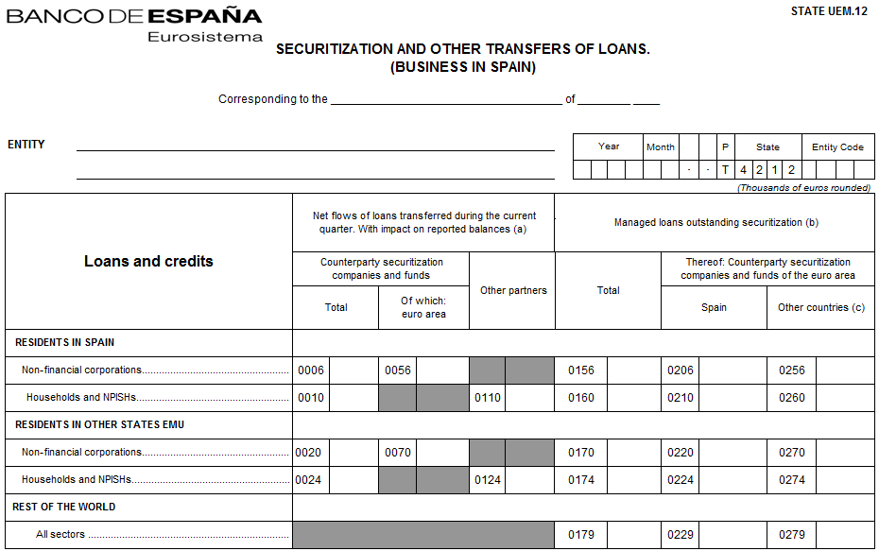
What are domains, subdomains, dimensions?
Subdomain 2:
All
EMU
Spain
Other than Spain in EMU (…)
Other than EMU (…)
Subdomain 1:
All (…)
Spain
Other than Spain
Dimensions:
Location of activity
Securitization partner residence
Counterparty residence
Domain: Geographical and political areas
- All
- EMU (…)
- Spain
- Other than Spain
- Other than Spain in EMU (...)
- Other than EMU (…)

Slide 9
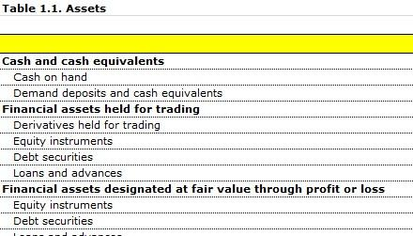
Everything is a perspective…
portfolios
Portfolio breakdown (purpose and measurement)
e.g. held for trading - „acquired or incurred principally for the purpose of selling or repurchasing it in the near term”; includes different instruments: Derivatives, Loans, Debt securities, Equity instruments, …
main categories
Instruments breakdown:
e.g. debt instrument - „contractual or written assurance to repay a debt”; can fall into different portfolios: Held-for-trading, Designated at fair value, Available for sale, …
held-for-trading
designated at fair value
loans
derivatives
available-for-sale
debt securities
assets
liabilities
income/expense
base concepts
assets: property, resources, goods, etc that a company possesses and controls, e.g. financial instruments owned by a reporting entity that shall generate economic benefits in the future
liabilities: sources of funding for company’s assets and operations, e.g. financial instruments that have been issued by a reporting entity, thus represents an obligation that needs to be settled in the future by a transfer of some assets (such as cash) from the entity
income/gains or expenses/losses:
economic benefits that occurred during the period and originated from increase/decrease in value or result on sales/purchase of a given financial instrument

Slide 10
Let’s try to define a data point for: Net carrying amount of not yet impaired but already past due (over 180 days but less than a year) debt securities held, issued in EUR by MFIs located in EMU with original maturity under one year, measured at amortised cost and relating only to business activities conduced in EU?
Locations of activities:
All / Not-applicable
EU
Other than EU (…)
Portfolios:
Total (…)
Fair value through profit or loss
Amortised cost
Impairment status:
All / Not-applicable
Impaired
Unimpaired
Time reference:
Current period end
Previous period end
Current period
Base terms:
Assets
Liabilities
Equity
Off-balance sheet
Exposures
Past due periods:
All
< 180 days
≥ 180 days < 1 year
≥ 1 year
Base term: | Assets
Category: | Debt securities
Portfolio: | Amortised cost
Original maturity:
All
< 1 year
≥ 1 year < 2 year
≥ 2 years
Categories:
Total (…)
Cash
Loans
Debt securities
Equity instruments
Tangible and intangible
Other than (…)
Amount type: | Carrying amount
Impairment status: | Unimpaired
Past due period: | ≥ 180 days < 1 year
Original currency: | EUR
Original maturity: | < 1 year
Counterparty sectors:
All / Not-applicable
MFIs
MMFs
MFIs other than MMFs
Central Administration
Other general government
Non-MFIs other than government
Counterparty sector: | MFIs
Counterparty residence: | EMU
Location of activity: | EU
Amount types (metric):
Carrying amount
Gross carrying amount
(Specific allowances)
(Collective allowances)
Time reference: | Current period end
Counterparty residences:
All / Not-applicable
EMU
Other than EMU (…)
Original currencies:
All / Not-applicable
EUR
Other than EUR

Slide 11
What is the general process of development of the DPM?
study the information requirements
analyze them by statements/disclosures (table by table, header by header according to the divide and conquer approach):
identify measures (metrics) and list them down (if a measure is already listed – reuse it) identifying type of expected value and measurement in time (instant/duration)
identify and name all breakdowns required to explicitly define each piece of information
preserve hierarchies (if applicable) with other already defined values (properties) or reuse existing values
if a value is not applicable to any existing hierarchy create a new one
review the measures and breakdowns and look for optimization (e.g. breakdowns of similar nature, functional relationships, etc.)
add other necessary characteristics
Resulting DPM shall contain:
Dictionary:
a list of measures (name, label, data and period type, …) and hierarchy of measures (if applicable)
a list of members and dimensions of each domain (name, label, item type, default member)
a subdomains of each domain (subdomain name, hierarchy and order, operators, alternative classifications)
Tables/tables coordinates referencing back to the Dictionary
purpose of information requirements in general (what is this data for?)
documentation (explanatory guidelines for information requirements and notification duties)
purpose of a statement/note/disclosure (expressed by its title, describing in general the character of information)
intersection of title and headers (of row and column) naming each piece of information
location in a hierarchy in headers of rows and headers of column (inheritance),
analysis
recursive: supporting documentation and content of other statements, notes and disclosures allowing identification of implicit information that is not explicitly expressed in an analyzed statement/disclosure
coherent breakdowns (items sharing common semantic nature)
minimizing redundancy and maximizing reusability of definitions

Slide 12
How to define the best data model?
data modelling it’s not a science!
it’s a (subjective) result of discussion...
...and agreement!

Slide 13
What are the benefits of using DPM?
DPM is template independent (data centric) - all information about data point is explicit (easy to communicate)
It is easy to trace the difference between every two data points across entire reporting framework
DPM could be a guideline how to organize the data on reporting entity side (storage and BI systems)
The quality of reporting requirements/templates is improving (consistent labeling, hierarchical structures)
Model is very stable but possible to extend if required (reusing of concepts is priority, adding/extending of concepts/hierarchies is possible as long as it doesn’t break the logic of model)

Slide 14
Sharing DPM dictionaries
ECB Statistics
FINREP
rev 2
FINREP
Comprehensive income
Transfer
Amount interval
Fair value level
Controling/ Non-controlling
Market
Loan type
Minimum reserve
…
Main categories
Amount type
Portfolio
Currency
Collateral
Portfolio
Risk type
Percentage Intervals
Impairment
Geographical areas
Sector
Entity code
Time intervals
Line of business
Exposure type
Approach/Model used
Securitization type
Type of business
Approach/Model used
Diversification
…
Type of contract
COREP
Change in basic own funds
Type of claim
…
SOLVENCY II

Slide 15
Synthetic comparison of existing DPMs
 |  |  |  | Frameworks
 |  |  |  | BSI-MIR (BdE) | SOLVENCY2 (EIOPA), HD version | CRD4/CRR (EBA)
Components of DPM | Dictionary | Most important domains (bold for metric) | Amount | Outstanding amount, Revaluation adjustments, etc. | Solvency II value, Statutory account, etc. | Carrying amount, Notional amount, etc.
 |  |  | Base concept | Assets, Liabilities, etc. | Assets, Liabilities, etc. | Assets, Liabilities, etc.
 |  |  | Main categories | Debt securities, Equity instruments, etc. | Debt securities, Equity instruments, etc. | Debt securities, Equity instruments, etc.
 |  |  | Data type | Not required (incorporated into Base concept) | Monetary, String, etc. | Not required (incorporated into Amount)
 |  | Unstructured lists (domains) and hierarchies (subdomains) in single .xls worksheets |  | False | True | False
 | Referring back the tables from dictionary |  |  | DataPointStructure (referencing the dictionary datapoint by datapoint) | Annotated templates | Annotated DPM Table Layout and Data Point Categorisation
Format of DPM |  |  |  | Excel, XBRL | Excel, XBRL | Excel, XBRL, Access database
Dropdown lists |  |  |  | Not used | Dimension with predefined domain members from existing subdomain | Metrics with predefined values (domain members from existing subdomain)

Slide 16
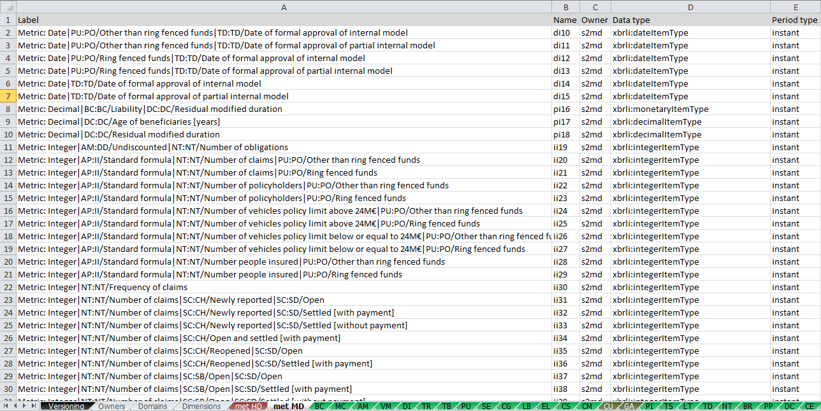
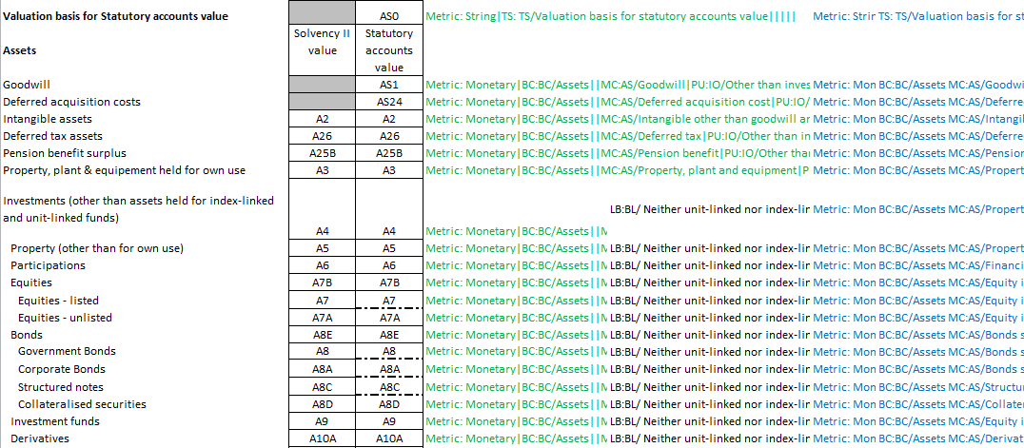
Let’s see some DPMs

Slide 17
Thank you
Michal Skopowski
michal.skopowski@br-ag.eu
http://www.br-ag.eu

