Slide 1
XBRL Validations with Databases
Herm Fischer
Eurofiling Roma 5/5/14

Slide 2
Evolving nature of validations
Original instances one-by-one and in-memory
Taxonomy-related validations
Formula validations
Authority validations (e.g., EFM, GFM…)
Large instances and big sets of instances
Databases now host large sets of instances
DPM-database-based validation (EIOPA)
Exploring SEC filings DB-hosted validation
inline XBRL validations

Slide 3
Large Instances
Formula design for all-in-memory processing:
Fallback values are intrinsic and fundamental
Missing values predicates
Each predicate applied across whole instance
Large instance is not visible all at once
Different validation strategies apply
Alternate technologies apply

Slide 4
Where does the instance live?
Most often, just in an XML document
For EIOPA only in a SQLite database
For SEC, databases are now available
Source information originates from databases
Bank of Indonesia large instances produced from database, XBRL re-shredded into database

Slide 5
Validation technology available
Instance in XML
XBRL formula, Sphinx
Schematron, XQuery
Custom coding (with XBRL processors, with XML)
Instance in database
Query languages (SQL, JSONiq)
Custom coding (expression interpreter, DPM DB)
Custom coding (with database interface)

Slide 6
XBRL Database Architectures
DPM database
Based on table and breakdown structure
Fact keys exploit short concept names
XBRL-US public database, SEC IDAP
Reflects XBRL syntax, complete for XBRL-US filings
Abstract Model database (Arelle)
Reflects semantics, US, UK, JP filings (so far)
Multiproduct (PG, MySQL, MSSQL, Oracle, SQLite)

Slide 7
DPM database

Slide 8
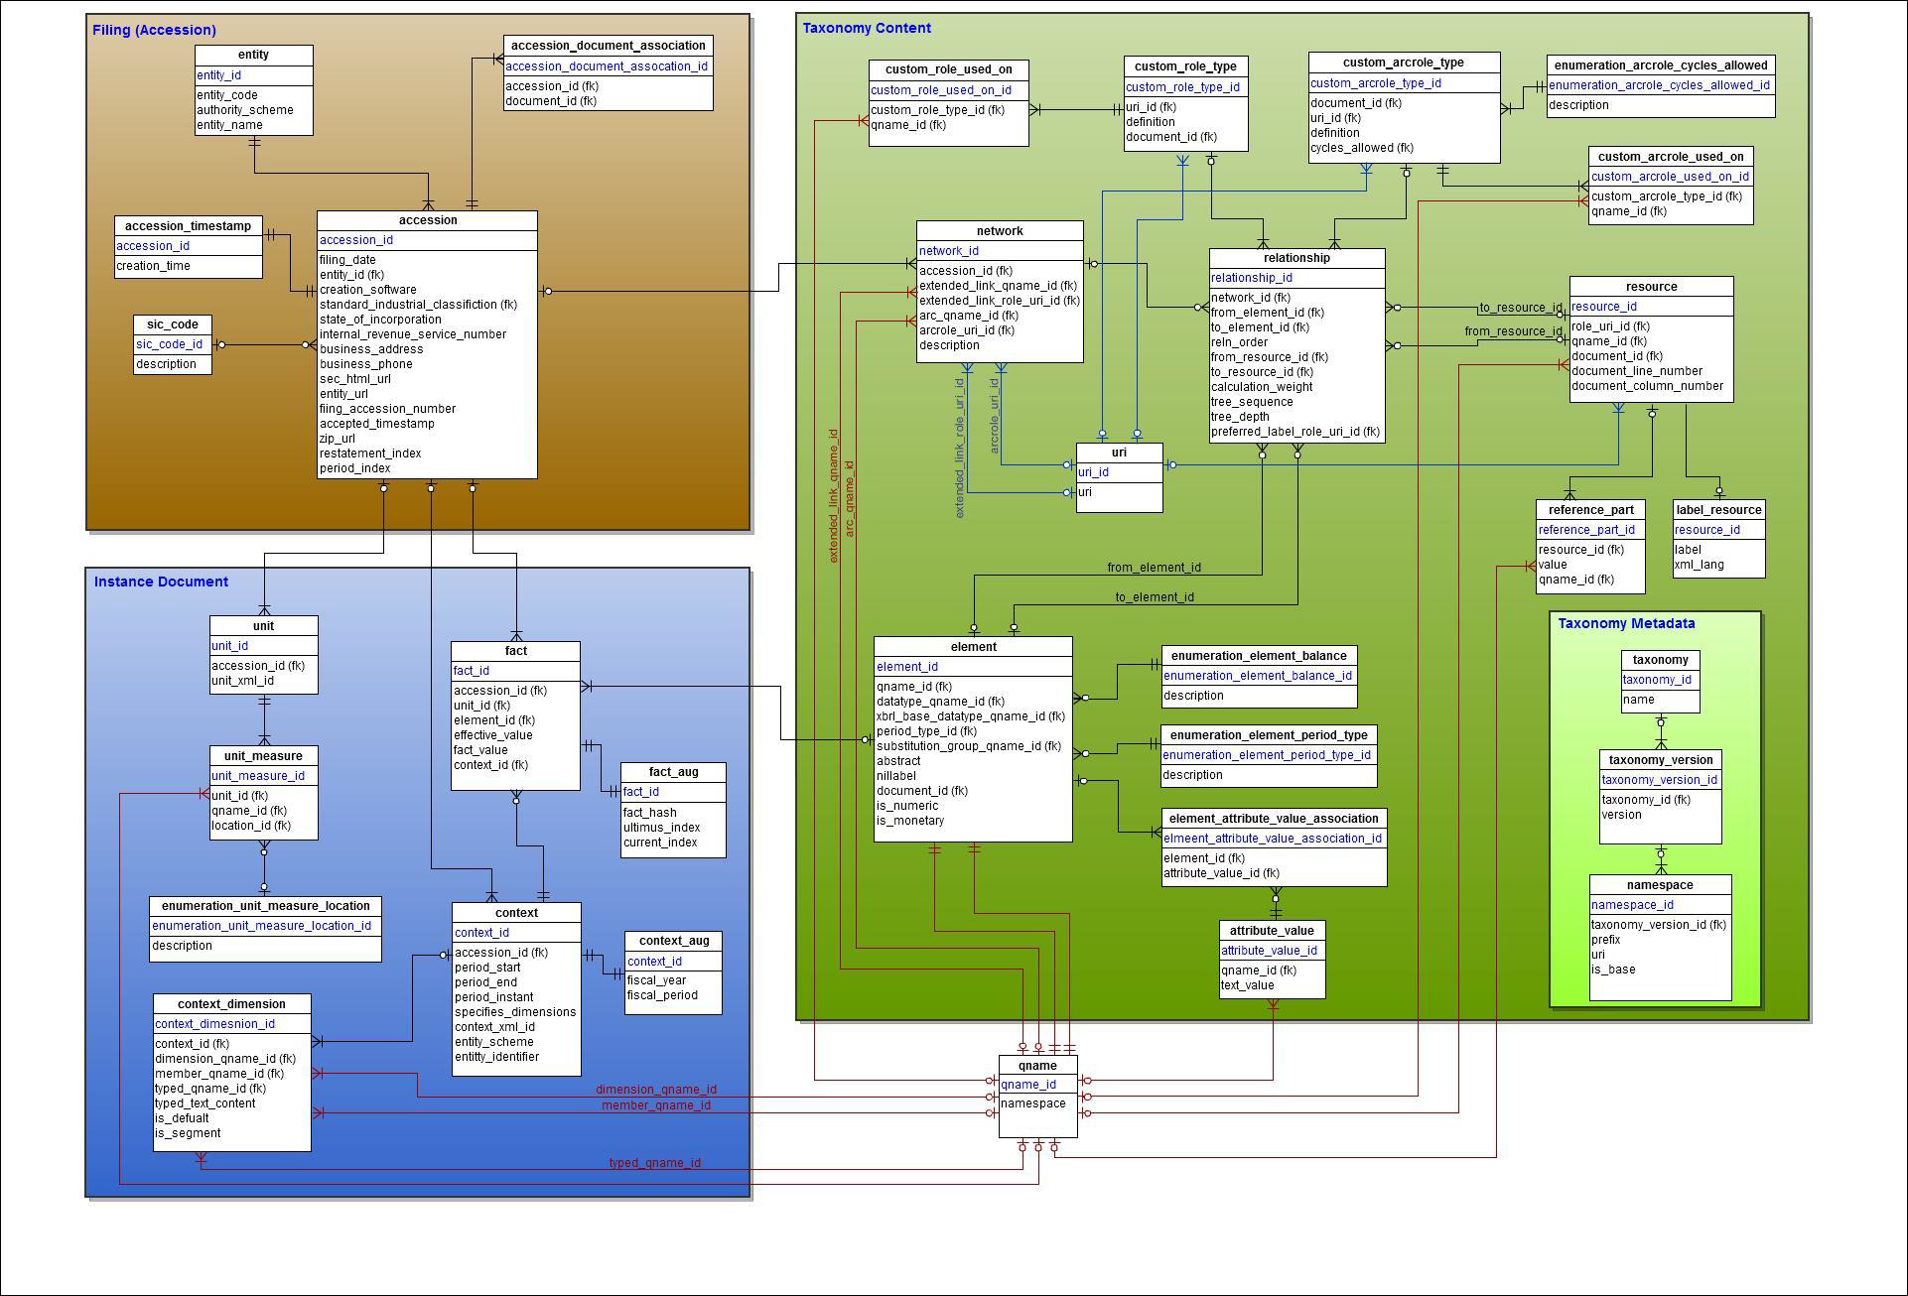
XBRL-US Public Database

Slide 9
Abstract Model Database

Slide 10
DPM database-hosted validations
Table-based expressions
Captured in SQL table-oriented database
Interpreted within SQL environment

Slide 11
DPM validation

Slide 12
SEC database-hosted validations
Example SQL to find shares outstanding being dimensioned but not on stock axis:
select f.filing_number, f.entity_name, f.form_type, count(avs.mem_name)
from filing f
join report r on r.filing_id = f.filing_id
and substr(f.form_type,1,4) in ('10-K', '10-Q', '20-F', '40-F')
join data_point d on d.report_id = r.report_id
join aspect a on a.aspect_id = d.aspect_id and a.name = 'EntityCommonStockSharesOutstanding'
and d.aspect_value_selections_id is not null
left join (select avs.aspect_value_selection_id, mem.name as mem_name
from aspect_value_selection avs, aspect dim, aspect mem
where dim.aspect_id = avs.aspect_id and dim.name = 'StatementClassOfStockAxis'
and avs.aspect_value_id = mem.aspect_id
) as avs on avs.aspect_value_selection_id = d.aspect_value_selections_id
group by f.filing_number, f.entity_name, f.form_type having count(avs.mem_name) = 0

Slide 13
Database embedded validation
Embedded processing within query engines
Postgres and Google DB extensions
Equivalent to formula variable binding logic
Filter logic be within SQL binding
Multi-expression common binding optimizations

Slide 14
Inline XBRL validation
Browser-hosted validation before submission
(Goal of SEC inline contract)
Browser security model (sandbox, no host access)
Chrome V8 engine (compiled Javascript)
How much of validation can be local
(Complete XBRL processor and formula?)

Slide 15
Conclusions
XBRL’s XML-hosted validation straining
For large instances, large formula sets
Database hosted validations beginning
DPM database and others
Emerging technologies
DB hosted variable binding, filtering
Inline browser hosted validation

