Slide 1
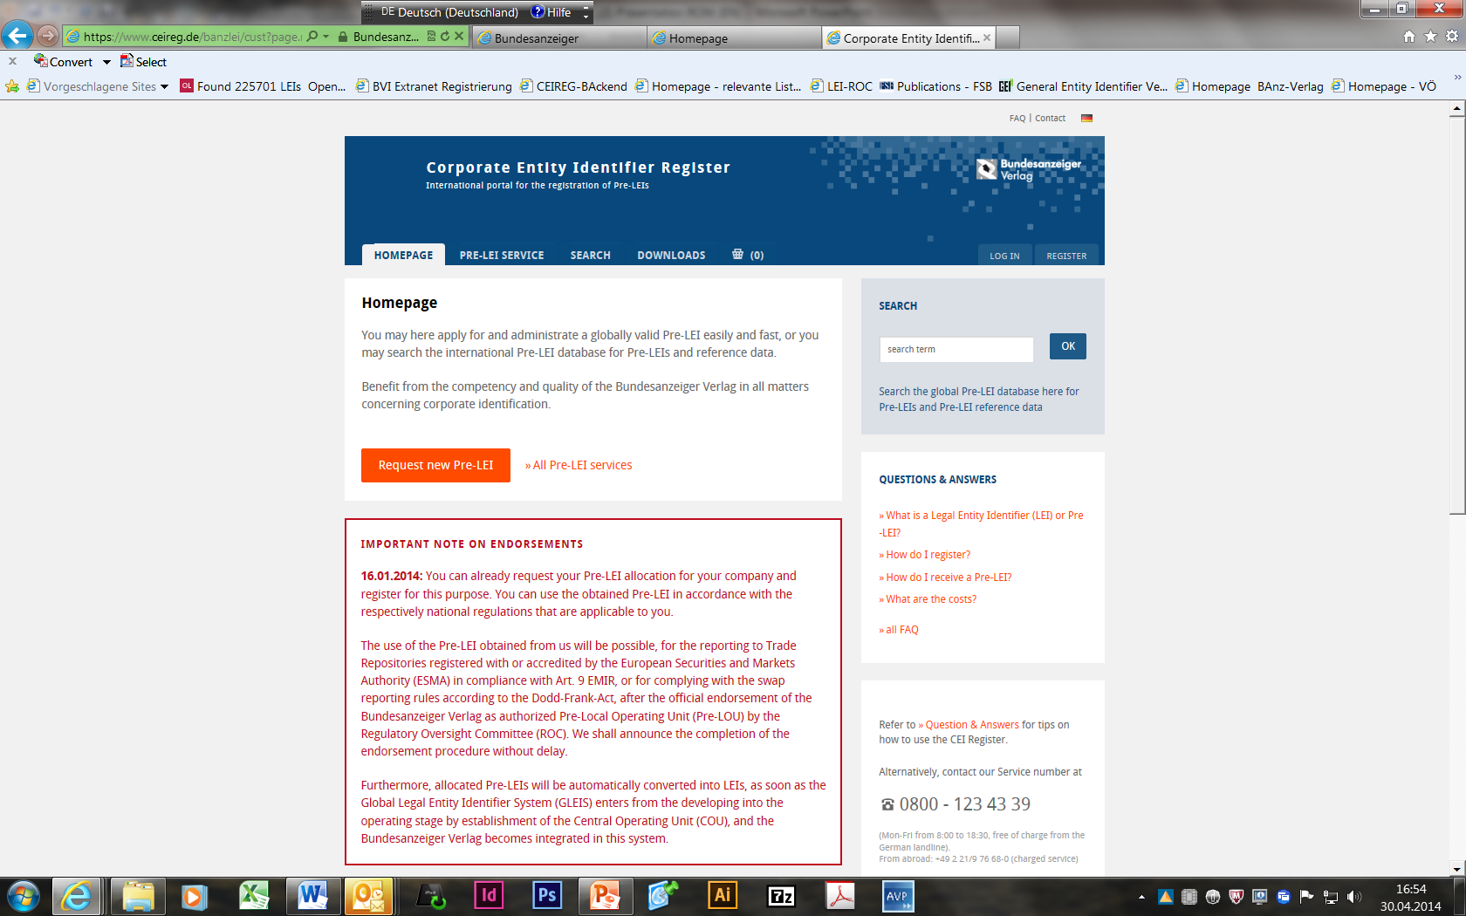
Corporate Entity Identifier Register
CEIReg – www.ceireg.de
The Pre-LEI (Legal Entity Identifier) application in the German Bundesanzeiger Publishing House
6. 5. 2014
Martin Jäger

Slide 2
CEIReg – Pre-LEI application in Bundesanzeiger Publishing House
What is a Legal Entity Identifier (LEI) or Pre-LEI?
G-20 mandated the Financial Stability Board (FSB) to implement
a Global Legal Entity Identifier System (GLEIS) that will uniquely identify parties to financial transactions.
Globally unique identification code for independent legal entities in the financial market
used to uniquely identify every contract partner and every financial transaction worldwide.
Notes:
What is a LEI?
G-20 mandated the Financial Stability Board (FSB) to implement
a Global Legal Entity Identifier System (GLEIS) that will uniquely identify parties to financial transactions.
A Legal Entity Identifier (acronym: LEI) is a globally unique identification code for independent legal entities in the financial market, used to uniquely identify every contract partner and every financial transaction worldwide.

Slide 3
CEIReg – Pre-LEI application in Bundesanzeiger Publishing House
  Why do we need a LEI?
Realisation due to the financial crisis:
  deficient data on financial transactions
  risks and the interlacing of the financial institutions
  → demonstrates the need for an interstate regulation.
Committement of G-20-Nations to
  reduce systemic risk in the financial market
  make trading with financial derivatives in the OTC market more transparent
  raise the quality of financial data
  narrow down market abuse and financial fraud
  clearly identify counterparties in transactions under a uniform reference code
Notes:
Why do we need a LEI?
The deficient data on financial transactions as well as the risks and the interlacing of the financial institutions determined during the financial crisis, demonstrate the need for an interstate regulation.
For this reason, the G-20 commit to reduce the systemic risk in the financial market and to improve the transparency of the OTC derivative markets.
The aim is to make it easier for the regulators to early recognise possible arising systemic risks by a simplified aggregation.
Besides better risk assessment and more efficient analysis, the new system also provides more transparency for investors, the operative costs can be reduced and the market efficiency increases.

Slide 4
CEIReg – Pre-LEI application in Bundesanzeiger Publishing House
  What are the legal requirements?
First requirements for a Pre-LEI can be found in EMIR (European Markets Infrastructure Regulation)
Since 12. February 2014 all OTC-derivatives have to report to Transaction Registers.
Details to this reporting, the regulatory and implementing technical standards are published by ESMA
www.esma.europa.eu/page/Trade-reporting
Further regulations (MIFID/MiFIR, EBA) will follow.
Notes:
Legal requirements
First requirements for a Pre-LEI can be found in EMIR (European Markets Infrastructure Regulation)
Since 12. February 2014 all OTC-derivatives have to be reported to transaction registers.
Details to this reporting are published by ESMA
Further regulations (e.g. MIFID/MiFIR) will follow.
MiFID (Markets in Financial Instruments Directive)
Objectives are: improved protection of investors, Harmonization oft he european financial market.
MiFIR (Markets in Financial Instruments Regulation)
MiFIR is engaged with the implementation of specifications by MiFID II looking to more transparency and expands the specifications for pre- and post-trade transparency to special financial instruments

Slide 5
CEIReg – Pre-LEI application in Bundesanzeiger Publishing House
  Who needs a LEI?
First addressees are financials counterparties:
Banks / credit institutions
Insurance companies
securities-related services enterprises
Investment funds
In the future, the nonfinancial counterparties (= all the other entities of the real economy) will be addressees.

Slide 6
CEIReg – Pre-LEI application in Bundesanzeiger Publishing House
The FSB recommends a three-tier structure for the GLEIS
Status: Developing stage
Complete roll-out engrosses month
Board of GLEI-Foundation is named
Foundation will be established in 2014
ROC is established
COU operative within 2014/2015?
ROC
(Regulatory Oversight Committee)
COU
(Central Operating Unit)
(Pre)-LOU
Pre-Local Operating Unit
(Pre)-LOU
Pre-Local Operating Unit
(Pre)-LOU
Pre-Local Operating Unit
Bundesanzeiger Verlag
Irish Stock Exchange
London Stock Exchange
…
Notes:
The FSB recommends a three-tier structure for the global LEI system to meet the broad objectives
Regulatory Oversight Committee (ROC). The ROC will have the ultimate responsibility for the governance of the global LEI system. It would comprise authorities which support the core principles and purposes of the system (as set out in the High Level Principles) and that are committed to support the governance in the public interest.
Central Operating Unit (COU). The Central Operating Unit is the pivotal operational arm of the global LEI system and has responsibility for delivering high quality operations. In particular, the COU has responsibility for ensuring the application of uniform global operational standards and protocols that deliver: global uniqueness of the LEI; seamless, open access to the global LEI and to high quality reference data for users
The COU will be a legal entity in the form of a not for profit foundation or body of equivalent legal form that will rely on broad industry participation, expertise and knowledge to identify and develop the most technologically, financially and legally sound methods to implement the global LEI system in line with the standards and framework defined by the ROC.
Local Operating Units (LOU). Local Operating Units will provide the primary interface for entities wishing to register for an LEI. They will be the local implementers of the global system. LOUs will offer facilities such as local registration, validation, and maintenance of reference data; protection of information that must be stored locally; and will facilitate the use of local languages and organisation types.
Status of the GLEIS
ROC: founded 1/2013: BaFin und Bundesbank are members representing Germany
COU: founded 3/2013 but not operative; Pre-LOUs prefixes: 25; 14 operational, 13 endorsed
Allocated Pre-LEIs will be automatically converted into LEIs, as soon as the Global Legal Entity Identifier System (GLEIS) enters from the developing into the operating stage by establishment of the Central Operating Unit (COU), and the Bundesanzeiger Publishing House with its CEIReg-Portal becomes integrated in this system.

Slide 7
CEIReg – Pre-LEI application in Bundesanzeiger Publishing House
  What are the Underlying principles?
Every entity worldwide can request a Pre-LEI
Self-registration by the entity
Operation of the Pre-LOU on non-profit costrecovery basis
Portability
Uniqueness and Exclusivity.
Open Access to Intellectual Property (IP)
Notes:
What are the underlying principles of the GLEIS?
Here you can see some of the several principles, given by ROC
Every entity worldwide can request a Pre-LEI
But: Private Persons as well as dependent entities don’t need and don’t get a LEI
Self-registration
The entity interested in obtaining a pre-LEI (or its authorized agent) must be the only one performing the application process
.
Market participants may personally register via the CEIReg-Portal.
Following successful registration, the market participant submits proof, e.g. by mail, of the company's identity to CEIReg as well as the power of attorney of the authorised contact person.
The participants’ individualized password protected account (access) for (pre-)LEI applications is thereafter activated. The registered entity also has the right to create sub-accounts.
Larger companies will have the possibility to define individual (password protected) access for different employees. This will avoid password sharing within the company.
Operation of the Pre-LOU on costrecovery basis
An important objective in the system design is to ensure that the global LEI system has a self-sustaining funding model. The model must ensure that the system is based on non-profit cost recovery and that there are no monopoly rents accruing to service providers. The proposed steady state funding system has two components: a local discretionary charge; and a common fee for support of central functions of the COU and ROC. The cost of obtaining an LEI should be modest and not a barrier to acquisition.
Portability
Participants may at all times request free transfer of their Pre-LOU administrated (pre-)LEI to another (pre-)LOU by filling out a form in the administration section of the CEIReg website. The (pre-)LEI status will then be set to TRANSFER_PENDING until transfer is complete. After receiving the transfer-request from the receiving (pre-)LOU, the status of the (pre-)LEI will be set to TRANSFERRED and will be deleted from our public accessible database after a reasonable period.
Uniqueness and Exclusivity
No pre-LEI code should be duplicated (uniqueness), and no entity should have more than one pre-LEI (exclusivity). The entity is responsible therfore.
Open Access to Intellectual Property (IP)
The (pre-)LEIs and corresponding referenced data will be open to the public as open-source data, unrestricted by licence or other rights.
The (pre-)LEI platform CEIReg will strictly offer everyone public access to the (pre-)LEI reference data at all times.
The (pre-)LEIs and associated referenced data are made publicly accessible via the (pre-)LEI platform CEIReg:
Searches via (pre-)LEIs and reference data
Option to download the current database in various data formats (XML, Excel/CSV) without prior registration

Slide 8
CEIReg – Pre-LEI application in Bundesanzeiger Publishing House
  Syntax of the LEI
20 character alphanumeric code as per ISO standard 17442.
Code: XXXX XX XXXXXXXXXXXX XX
XXXX: 4-digit Prefix, idents the Pre-LOU,
3912 for Bundesanzeiger Publishing House
XX: 2 reserved digits
XXXXXXXXXXXX: 12-digit Entity-Identification (random)
XX: 2 digits for validation
Unique and exclusive to each entity
Notes:
Technically, the LEI code developed by the FSB, will be a coincidental 20 character alphanumeric code as per ISO standard 1
A 4-digit prefix idents the issuing Pre-LOU
3912 for BAnz

Slide 9
CEIReg – Pre-LEI application in Bundesanzeiger Publishing House
  Wich relevant information is recorded with the LEI?
Official name of the legal entity / of the fund manager
Register number and name of the register
Legal domicile of the administrative office / of the fund manager
ISO country code (e.g. DE)
Date of the first LEI registration
Date of the last information update
Date of and reason for LEI expiration
Additional fields and information may be added

Slide 10
CEIReg – Pre-LEI application in Bundesanzeiger Publishing House
  What are the tasks of the CEIReg acting as a Pre-LOU?
Validation / authentication of the entity during the first registration and application for a LEI – and again after one year
  Completeness / actuality of the data
  Authorization of applicant through its function as e.g.
    manager,
    agent of the participant to be registered or
    representative with power of attorny
  → checking of commercial registers, company registers, data bases
  Prevent duplication of a LEI
  Assignment of a (pre-)LEI to a participant
  Checking Challenges and data changes aside from registrations
Notes:
Tasks of the CEIReg acting as a Pre-LOU
The GLEIS can only meet its obligations if exclusively authorized market participants are issued (pre-)LEIs and if such (pre-)LEIs may only be applied for by their authorised persons.
At CEIReg, we have to validate / authenticate the entity during the first registration and application for a LEI – and again after one year because records will be validated on an annual basis to ensure the actuality and accuracy of the information.
The applicant must meet the following requirements either:
Be authorized through its function (e.g. manager) at the time of the application;
or
Be an agent of the participant to be registered or the entity controlling the registered unit (e.g. fund). Market participants commissioning third parties to apply for a (pre-)LEI must give power of attorney. The authorised third party shall submit such power of attorney to the LOU-Candidate.
With each application for a (pre-)LEI by a market participant, the following shall, in addition, be checked:
Are the provided data consistent and do they agree with data in the corresponding register of companies?
Is the applicant authorised to apply for a (pre-)LEI on behalf of this market participant? (e.g. by comparison with trade register ).
The following sources are referred to for checking customer data on registration and on application for (pre-)LEIs:
German commercial register;
German register of companies;
Foreign registers of companies; and
BaFin lists
To ensure that a market participant is not allocated several (pre-)LEIs, each application for a (pre-)LEI is checked to ensure that another (pre-)LOU has not already assigned a (pre-)LEI to this applicant.
Published data of the other (pre-)LOUs are furthermore imported regularly and checked for (pre-)LEIs which may have been erroneously issued with the LOU-Candidate prefix. These checks are done automatically by matching the imported (pre-)LEI data with the existing data in the system.
The control system informs the CEIReg staff as soon as a violation of the exclusivity principle is identified, whereafter they will contact the relevant (pre-)LOU to remedy the conflict.
Should the database of another (pre-)LOU contain a company with the same name or the same registry data in the same country, then the entry of the other (pre-)LOU is first checked for a transfer request.
If no transfer request has been issued by the participant, he will be contacted by CEIReg staff and, as the case may be, requested to arrange for transfer of the (pre-)LEI at the responsible (pre-)LOU.
In case of doubt, CEIReg’s staff will contact the participant.
If the CEIReg system or staff detect a duplicate an already issued (pre-)LEI or cannot verify inaccurate information to the full satisfaction, no (new) (pre-)LEI will be issued and the participants will be contacted personally or via mail immediately explaining the reason for the denial.
The assignment of a (pre-)LEI to a participant will only be published until the validation of the submitted information
Aside from registrations, CEIReg’s staff also checks challenges and data changes. For challenges to (pre-)LEIs administrated by the LOU-Candidate, the participant is offered a form linked to the relevant (pre-)LEI dataset on the CEIREG-Portal. The CEIReg thereupon will verify the transmitted challenge as they would a first (pre-)LEI request.

Slide 11
CEIReg – Pre-LEI application in Bundesanzeiger Publishing House
  Current state of Corporate Entity Identifier Register - CEIReg
CEIReg operational since 17. 1. 2014 and issues Pre-LEIs
Apply for and administrate a globally valid Pre-LEI
Search the international Pre-LEI database for Pre-LEIs and reference data
Waiting for the endorsement as authorized Pre-LOU by the ROC
After official endorsement use of the Pre-LEI obtained from us will be possible:
for the reporting to Trade Repositories registered with or accredited by the (ESMA) in compliance with Art. 9 EMIR,
or for complying with the swap reporting rules according to the
Dodd-Frank-Act.
Notes:
Current state of Corporate Entity Identifier Register – CEIReg
CEIReg operational since 17. 1. 2014 and we issue Pre-LEIs
You may here apply for and administrate a globally valid Pre-LEI easily and fast, or you may search the international Pre-LEI database for Pre-LEIs and reference data
We are waiting for the endorsement as authorized Pre-LOU by the ROC
The use of the Pre-LEI obtained from us will be possible, for the reporting to Trade Repositories registered with or accredited by the European Securities and Markets Authority (ESMA) in compliance with Art. 9 EMIR, or for complying with the swap reporting rules according to the Dodd-Frank-Act, after the official endorsement of the Bundesanzeiger Verlag as authorized Pre-Local Operating Unit (Pre-LOU) by the Regulatory Oversight Committee (ROC).

Slide 12
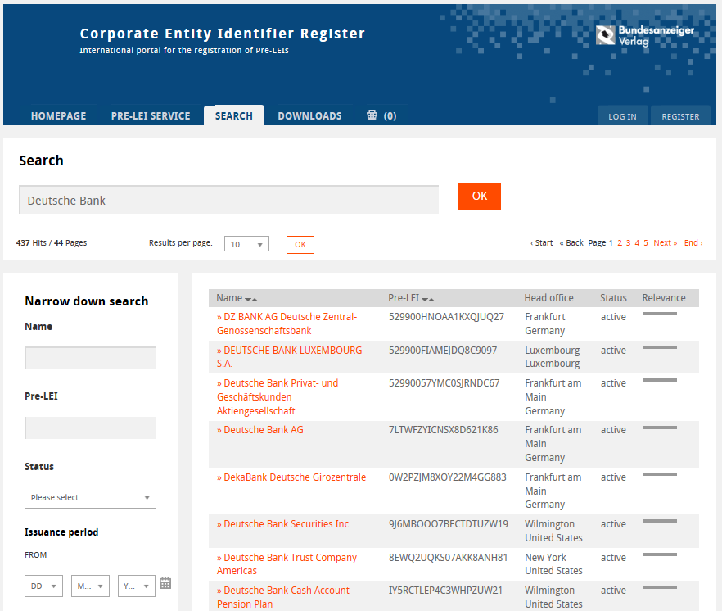
CEIReg – Pre-LEI application in Bundesanzeiger Publishing House
  CEIReg
Our plattform can be found on www.ceireg.de or www.ceireg.com

Slide 13
CEIReg – Pre-LEI application in Bundesanzeiger Publishing House
  Thank you for your attention!
  Martin Jäger
  Deputy Head - Division Legal Publications
  Bundesanzeiger Publishing House
  martin.jaeger@bundesanzeiger.de

