Slide 1
13th XBRL Europe Day
The Directive for
the Interconnection of Business Registers
Vito
Giannella

Slide 2


The Directive for the Interconnection of BRs – the genesis
1998 – EBR EEIG, the network between some Business Registers in Europe
2006 – 2009 BRITE - Business Register Interoperability Throughout Europe
November 2009 – EC Green Paper on the Interconnection of Business Registers
February 2011 – EC proposal for a Directive
June 2012 – Directive 2012/17/EU

Slide 3
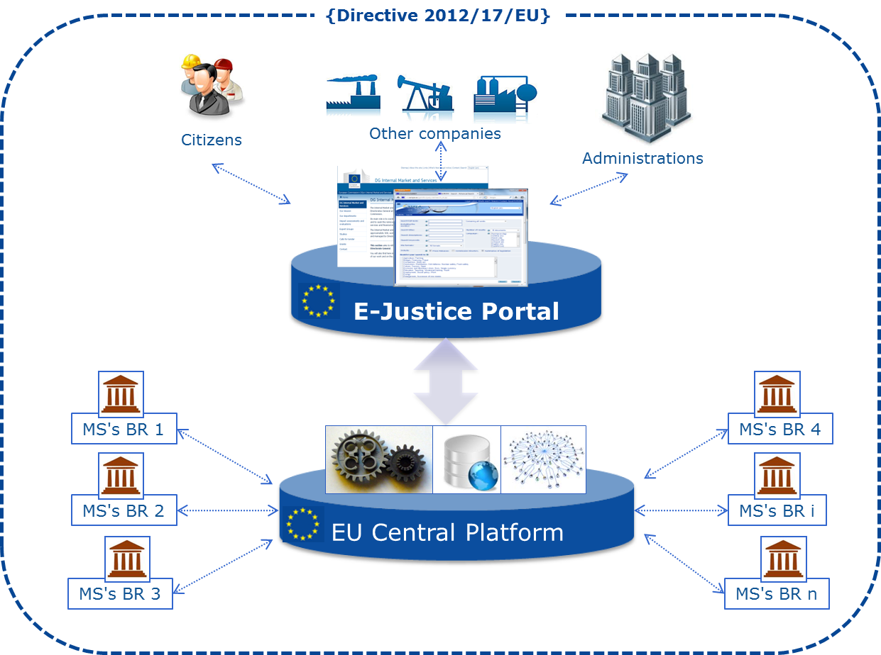
The Directive 2012/17/EU – the objectives 1/2
Single point of access
                Limited liability companies
                (Art. 1 of Dir. 2009/101)
                EEA countries

Slide 4
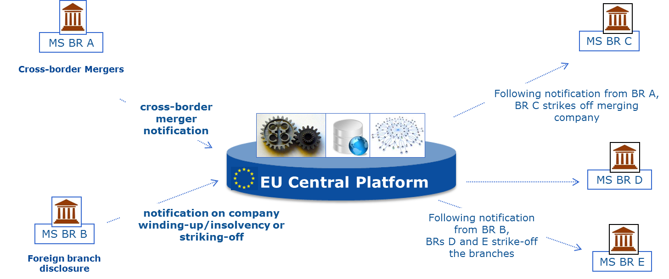
The Directive 2012/17/EU – the objectives 2/2
BR2BR notifications

Slide 5
The CLEG
The European Commission, with the support from the Member States (CLEG – Company Law Experts Group), is now working for the preparation of the Delegated Acts to be published by July 2015
The Directive implementation is foreseen by July 2017

Slide 6
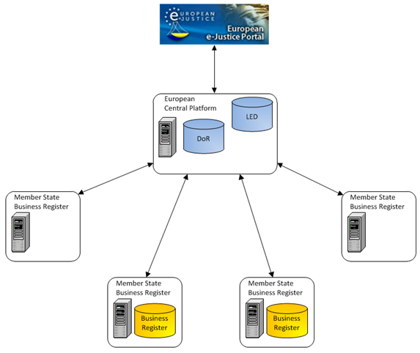

Architecture alternative 4
ViThe proposed architecturen Document
  Centralised system with hybrid access to the common set of three data
DoR containing the identification data of the business register of the MSs
One Central LED only for those Member States that support centralising a copy of the common set of free data
A Local LED in the MS that do not want a copy of their data on the ECP
A central "Subscription List" with the EUID of the parent companies that are of the interest to the business registers where branches of those companies are registered.
Subscription
List

Slide 7
Current activities 1/5
The European Commission is currently performing a study in order :
  To identify existing initiatives (pilots, projects) that have dealt with needs and requirements similar to the ones described in the Directive 2012/17/EU
  To understand how these initiatives implemented their requirements and thus solved their needs
  To assess which parts of these projects could be re-used in BRIS.

Slide 8
Current activities 2/5
Titolo del paragrafo
  Criteria used to assess each project / system :
  Its re-usability, i.e. whether it can be used as-is or not, while keeping in mind that re-using a project/system seldom comes at no-cost (integration of re-used components often requires some connection/adaptation tasks)
  The lowest impact on the MSs and COM, at organizational and technical level
  Its degree of standardisation: whether they are based on international open standards and specifications and are largely used or not
  Its flexibility in terms of configuration, adaptability/customisation, and extensibility

Slide 9
Current activities 3/5
Titolo del paragrafo
  Back-office systems:
  IRI, the Insolvency Register Interconnection (COM)
  EBR, the European Business Register (EBR EEIG)
  IMI, the Internal Market Information system (COM)
  RESPER, 'RESeau PERmis de conduire' (COM)
  ERRU, European Register for Road transport Undertakings (COM)

Slide 10
Current activities 4/5
Titolo del paragrafo
  E-delivery platforms:
  EBR, the European Business Register (BDS pilot)
  e-Codex, Large Scale Pilot to improve the cross-border access of citizens and businesses to legal means in Europe as well as to improve interoperability between legal authorities within the EU
  e-Trustex and CIPA, COM general purpose e-Delivery infrastructures (COM)
  CCN/CSI, Common Communications Network/Common Systems Interface - value added network to provide common services to exchange taxation, excise and customs information with agility, security and continuity.

Slide 11
Current activities 5/5
Titolo del paragrafo
  Business semantics was also considered a relevant aspect to study. The following specifications will be assessed in the study:
  crXML, Commerce Register XML (developed by the European Commerce Register Forum, ECRF)
  ebrXML, currently used by the MS belonging to EBR. Based on the EBR ontology
  xEBR, an XBRL-based taxonomy (xEBR is an XBRL Europe Business Registers Working Group)
  RegOrg, originally known as Core Business Vocabulary, developed by the Commission's ISA programme, and currently being maintained by W3C.

Slide 12
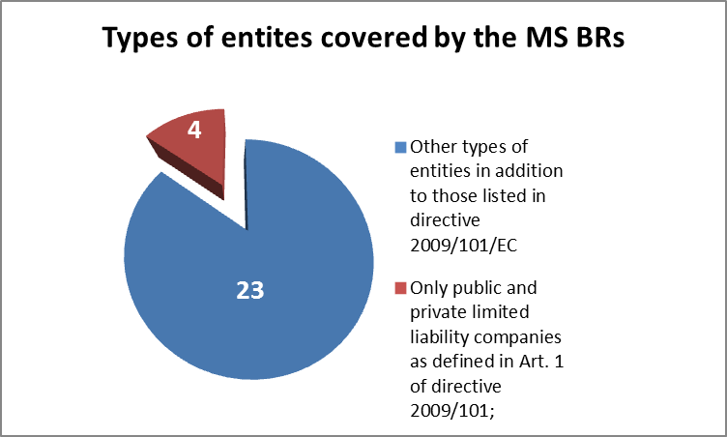
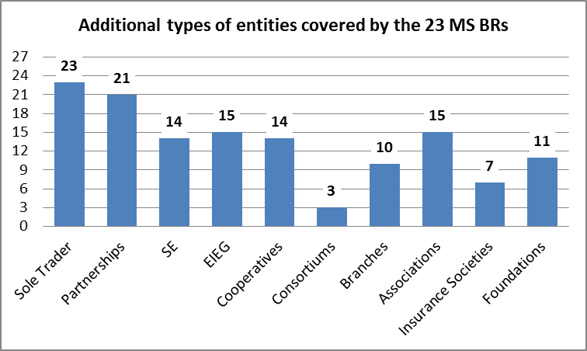
What types of entities are covered by the business registers in your State?
23 MSs state that they keep information on other types of entities in addition to Limited Liability Companies.
The additional types of entities are mainly the following ones:
Directive Compliance
Limited Liability Companies, as defined in the Directive are currently being registered by all MS BRs.

Slide 13
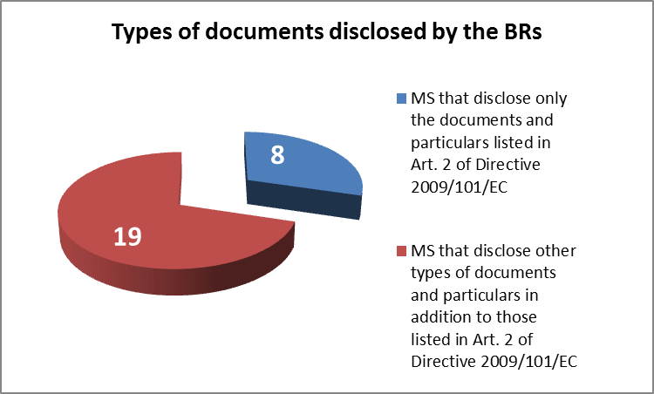
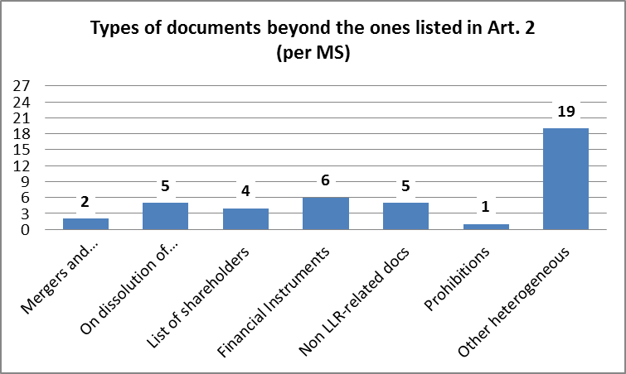
What documents and particulars are disclosed by your registers?
19 (70%) MSs disclose a rich range of other documents and information beyond those required by Directive 2009/101/EC.
Some of the documents and particulars specified by the MS (some of them common to a reduced number of MS) are the following ones:
Directive Compliance
All MS publish the whole set of documents and particulars specified by the Directive.

Slide 14
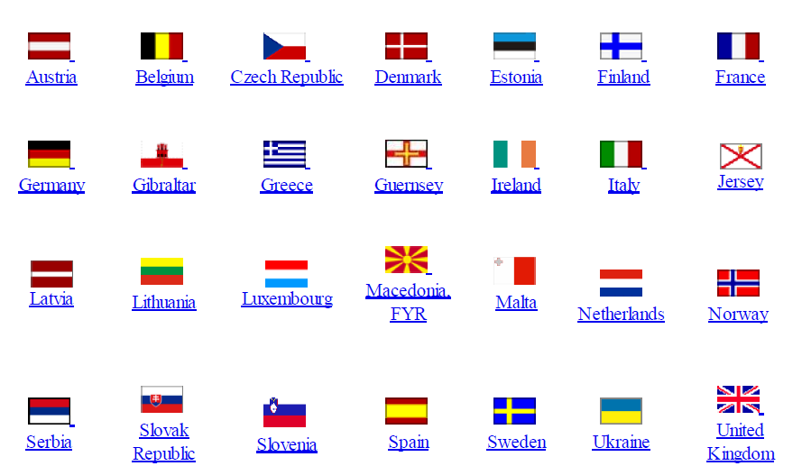
Current EBR network
Implementing acts to be published by end of 2014

Slide 15
Thank you for your attention.
vito.giannella@infocamere.it

