Slide 1
Newbie's technical introduction to XBRL
Part 2
15th Eurofiling Workshop
30 May 2012
Madrid, Spain

Slide 2


Objectives
The goal of this introduction is to:
introduce XBRL terminology,
present overview of XBRL architecture including taxonomy modeling and components of instance documents and their relation to a taxonomy.
XBRL

Slide 3




Application of
initial requirements:
standard of describing business concepts in order to…
…transfer information between different systems
new requirements:
advanced validation (mathematical and logical rules)
visualization/rendering of reports (e.g. tax forms, reports, …)
versioning of concepts’ definitions (dictionaries) in time and space
„drill-down” of information (XBRL GL)
Δ

Slide 4
XBRL Taxonomies and Instance documents
EIOPA,
development
of base taxonomies,
Taxonomy
Taxonomy
Taxonomy
Adaptation?
Complement?
Report
Report
Report
Report
Report
Report
Report
Report
Report
Report
Undertaking
Production
of reports
Supervisor (NSA)
Validation/Storage/
Processing/Analysis of Reports

Slide 5

Chain of dependence
XML specification and other derived from it
World Wide Web Consortium (W3C)
XBRL specification
XBRL International (XII)
XBRL taxonomy
XBRL jurisdiction
XBRL Instance
Regulators
Reporting entities
Reporting entities
  General syntax
  Syntax and semantics specific for business reporting
  Catalogues of business concepts
  Reports containing business facts
XML Specifications
Extensible Markup Language (XML) 1.0 (Fourth Edition)
  W3C Recommendation 16 August 2006, edited in place 29 September 2006
  http://www.w3.org/TR/2006/REC-xml-20060816/
  XBRL initially built on second edition
Extensible Markup Language (XML) 1.1 (Second Edition)
  W3C Recommendation 16 August 2006, edited in place 29 September 2006
  http://www.w3.org/TR/2006/REC-xml11-20060816/
XML Schema Specifications
XML Schema Part 0: Primer - http://www.w3.org/TR/xmlschema-0/
XML Schema Part 1: Structures - http://www.w3.org/TR/xmlschema-1/
XML Schema Part 2: Datatypes - http://www.w3.org/TR/xmlschema-2/

Slide 6
XBRL Specification 2.1
recommendation: 2003-12-31 + Corrected Errata of 2008-07-02
http://www.xbrl.org/Specification/XBRL-RECOMMENDATION-2003-12-31+Corrected-Errata-2008-07-02.htm
technical files:
XBRL 2.1 Conformance Suite 1.0 - Candidate Recommendation 4: 2008-07-02
  hundreds of tests to verify that applications process XBRL 2.1 documents correctly
  http://www.xbrl.org/2008/XBRL-CONF-CR4-2008-07-02.htm
syntax for XBRL instances and concept definitions in XBRL Schemas
e.g. data types, financial attributes, context information structures
XBRL simple and extended link schema constructs
e.g. referencing files, XBRL-specific arcs and resources (labels and references) elements and attributes, extended links
general rules on arcs and resources (XLink)
general XLink attributes specification
xbrl-instance-2003-12-31.xsd
  xbrl-linkbase-2003-12-31.xsd
xl-2003-12-31.xsd
xlink-2003-12-31.xsd
XBRL 2.1
XBRL Dimensions 1.0 Specification
Dimensions 1.0
recommendation: 2006-09-18
http://www.xbrl.org/Specification/XDT-REC-2006-09-18+Corrected-Errata-2009-09-07.htm
modular extension to XBRL Specification 2.1 (backwards comparability)
technical files: xbrldt-2005.xsd and xbrldi-2006.xsd (syntax for defining dimensional constructs in taxonomies and instance documents)
Dimensions 1.0 Conformance Suite Candidate Recommendation (2009-10-06): http://www.xbrl.org/Specification/XDT-CONF-CR4-2009-10-06.htm

Slide 7
Other XBRL Specifications + Conformance Suits
recommendations:
  Generic Links 1.0 – 2009-06-22
  Formula Specification 1.0 – 2009-06-22
  (Functions) Registry Specification – 2009-06-22
  Inline XBRL Specification 1.0 – 2010-04-20 + Transformations
proposed/candidate recommendations and public working drafts:
  Formula Extension Modules – 2011-03-16
  Versioning
internal/working group working drafts:
  Rendering Link (requirements)

Slide 8
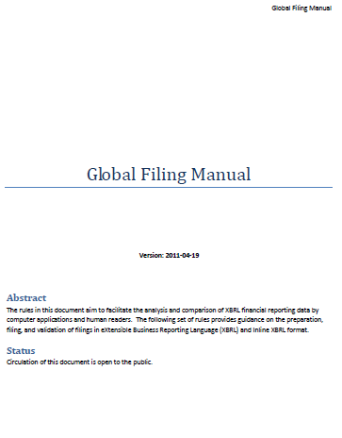
Best practice documents and other
FRTA - Financial Reporting Taxonomy Architecture
  guidelines on best practices for financial reporting taxonomies
  version 1.0: 2005-04-25, version 1.5 (PWD): 2011-05-16
FRIS - Financial Reporting Instance Standards
  best practices on instance documents
  2004-11-14
registries: (data types, units, etc)
Global Filing Manual (alignment of GAAP Taxonomies)
comprehensive guidance for users including:
  taxonomy architecture explanation
  extensions development and reports creation rules
  implementation guidance for software
  assurance guidance
designed for financial reporting domain
based on:
    Edgar Filer Manual from SEC
    EDINET CETCG from Japan FSA
    IFRS Taxonomy Guide from IFRS Foundation
    HMRC CT Inline XBRL Style Guide
    XBRL UK Preparer’s and Developer’s Guide
    FRIS from XBRL International
audience: XBRL-savvy people
last version dated on 2011-04-19
Global Filing Manual
„The manual contains a set of rules which provide guidance on the preparation, filing and validation of XBRL filings created using the IFRS Taxonomy, the EDINET (Electronic Disclosure for Investors’ NETwork) Taxonomy or the U.S. GAAP Taxonomy.”
„The ITA project is aiming at achieving the convergence of the XBRL frameworks (i.e. architectures) of the IFRS, EDINET and the U.S. GAAP Taxonomies. It is hoped that this architectural convergence will support the analysis and comparison of financial data reported in XBRL format, by enabling software vendors to develop applications for IFRS, Japanese GAAP and U.S. GAAP reporting based on a single XBRL architecture.”

Slide 9
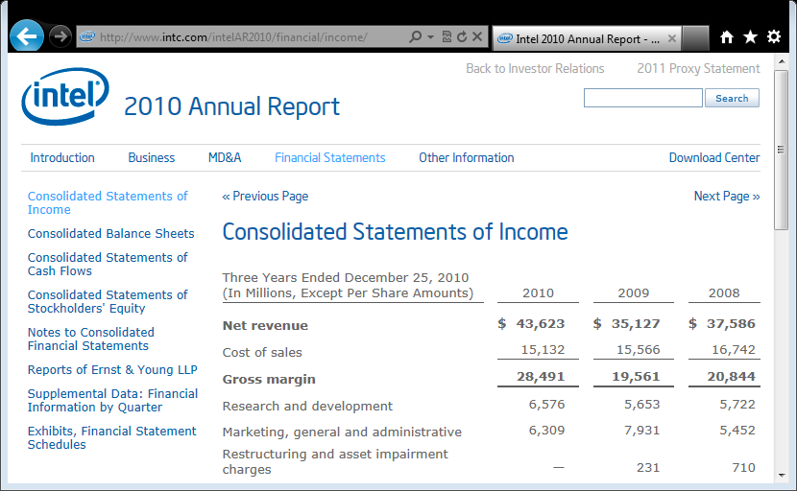


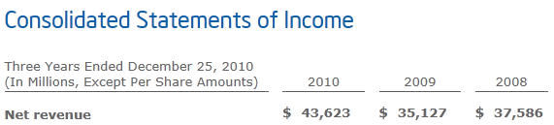
XBRL Instance Document
XBRL Taxonomy
value
a business term (financial concept) and all its properties
entity
context
unit

Slide 10
Taxonomy
XBRL reports
XML schema
Linkbases
Presentation
<?XML?>
<?XML?>
Label
<?XML?>
Definition
Reference
Calculation
Dimensions
Formula
(generic
linkbase)
Facts (data)
Concepts
Complements
(relationships)

Slide 11
List of business terms:
XBRL Schema
There is a business term defined in the IFRSs that represents Inventories. Inventories are reported as of a particular day as a monetary amount (a number referring to a currency).
Accounting balance nature of inventories is debit.
Additional information on business terms:
Linkbases
Inventories are translated into Polish as „Zapasy”.
Inventories are reported in Statement of financial position in a group of Current Assets and in notes in Disclosures of current assets.
Measurement method of inventories as defined by IFRSs is described by IAS 2, paragraph 9.
Inventories are sum of Raw materials, Merchandise, Production supplies, Work in progress, Finished goods and Other inventories.
Inventories must be reported in the breakdown for domestic/foreign market and segments on which company operates.
Companies must disclose their operations split according to operating segments
Each group of inventories must be disclosed with their value according to LIFO or FIFO valuation method
Companies must disclose their operations separately for domestic and foreign market.

Slide 12
XBRL Schema – Declaration of:
Items, Tuples, Domain members and Dimensions
There is a business term defined in the IFRSs that represents Inventories. Inventories are reported as of a particular day as a monetary amount (a number referring to a currency).
Accounting balance nature of inventories is debit.
Company must disclose their operations for domestic and foreign markets
Each group of inventories must be disclosed with their value according to LIFO or FIFO valuation method
Declaring business terms:
Company must split their operations according to operating segments
item: financial term that represents a simple fact, i.e. a fact carrying a value, e.g. Inventories = 1.234.567 USD
tuple: represents compound facts i.e. a group of pieces of information, e.g. Inventories Valuation is a tuple comprising of the following items: Group of inventories, Valuation method, Value of a group of inventories reported sequentially as many times as needed (tables with unknown number of rows or columns)
dimensions a certain breakdown or a property that may consist of explicit list of members or implicit (typed) domain e.g.
  Geographical areas dimension with explicit members Total areas, Domestic and Foreign
  Operating segments dimension with typed domain SegmentName

Slide 13
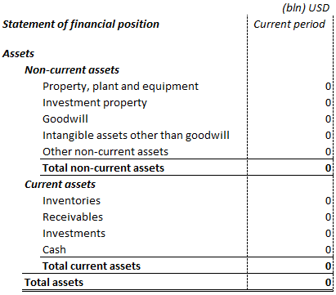
Items
item (not tuple or dimensional contruct):
a simple fact containing a value
unique identification (for computers not humans) of each item for reference from instance document or other files
expected value:
monetary (number referring to a currency ISO code)
decimal or integer (including min and max range)
text (certain length, enumerated list, pattern for post code, etc)
date (plus time interval)
etc
instant = stock (for particular date), e.g. assets, liabilities, …
duration = flow (for period), e.g. revenues, costs, expenses, …
needed for allowing different time periods within a report (e.g. revenues for last year and last quarter)
<xsd:element
substitutionGroup="xbrli:item"
name="Inventories"
id="ifrs_Inventories"
type="xbrli:monetaryItemType"
xbrli:periodType="instant"
xbrli:balance="debit"
abstract= "false"
(other attributes)/>
reportable term or a header (abstract= "true")
accounting balance nature (credit/debit) indicating the required sign, e.g.
costs are ″debit″ = reported as a positive figure (and subtracted from revenues),
credit are ″credit″ = reported as a negative figure (and added to revenues),
Important for items such as „adjustment of …”

Slide 14
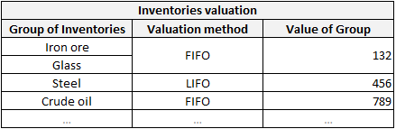
Tuples
tuple declaration
referenced items or (nested) tuples
compound fact
<xsd:element name ="GroupOfInventories" substitutionGroup="xbrli:item" (…)>
<xsd:element name ="ValuationMethod" substitutionGroup="xbrli:item" (…)>
<xsd:element name ="ValueOfGroupOfInventories" substitutionGroup="xbrli:item" (…)>
<xsd:element id="InventoriesValuaton" name="InventoriesValuation" substitutionGroup="xbrli:tuple">
<xsd:complexType>
<xsd:complexContent>
<xsd:restriction base="anyType">
<xsd:sequence>
<xsd:element ref="GroupOfInventories" maxOccurs="unbounded"/>
<xsd:element ref="ValuationMethod" minOccurs="0"/>
<xsd:element ref="ValueOfGroupOfInventories"/>
</xsd:sequence>
<xsd:attribute name="id" type="ID" use="optional"/>
</xsd:restriction>
</xsd:complexContent>
</xsd:complexType>
</xsd:element>
attributes determinate how many times an item or a nested tuple element can appear within one occurrence of a tuple element in an instance document; by default once and only once
sequence (order matters), choice (any of listed items), all (order unimportant)

Slide 15
Dimensions, members and domains
<xsd:element
substitutionGroup="xbrldt:dimensionItem"
name="GeographicalAreas" (…) />
<xsd:element
substitutionGroup="xbrli:item"
type="nonnum:domainItemType"
name="TotalAreas" (…) />
<xsd:element
substitutionGroup="xbrli:item"
type="nonnum:domainItemType"
name="Domestic" (…) />
<xsd:element
substitutionGroup="xbrli:item"
type="nonnum:domainItemType"
name="Foreign" (…) />
<xsd:element id="SegmentName" name="SegmentName"
type="xsd:string"/>
<xsd:element
substitutionGroup="xbrldt:dimensionItem"
name="OperatingSegments"
xbrldt:typedDomainRef="#SegmentName" (…) />
explicit dimension
item – a fact containing a value
members (abstract items)
Areas | Segments | Inventories
Total | … | 500
 | … | 400
 | … | 100
Domestic | … | 270
 | … | 200
 | … | 70
Foreign | … | 230
 | … | 200
 | … | 30
value of implicit domain
implicit dimension

Slide 16
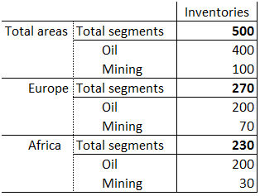
Hypercube
<xsd:element
substitutionGroup="xbrldt:hypecubeItem"
name="ByGeographicalAreasAndOperatingSegments" (…) />
hypercube
By geographical area and operating segment and …
Africa
…
Europe
…
Hypercube
abstract concept allowing to create an ordered list of dimensions which Cartesian product of members is reportable or is prohibited for an item
All
…
Geographical areas
…
„All”
„Oil”
„Mining”
Operating segments
item: inventories
contextual information: entity, period, unit

Slide 17
Relation between XBRL Schema and Linkbases
XBRL Schema
Linkbases
Documentation of concepts (resources, e.g. labels, references, …)
Concepts (items, tuples, dimensions, members)
and their characteristics
Different kinds of relations between concepts (presentation, aggregations, similar items, …)
Additional information relating to a variety of concepts and their combinations, etc (e.g. business rules)

Slide 18
Technology and syntax behind linkbases
Example
linkbases make use of XML technologies:
XLink (XML Linking Languages) which enables creating hyperlinks in XML documents - xlink:href
XPointer (XML Pointing Languages) which is used for finding fragments inside of XML and XBRL documents (e.g. element definitions in XBRL Schema files), e.g. #Assets
<xsd:element id="Assets" (…)/>
<xsd:element id="CurrentAssets" (…)/>
locator: points to an element defined in XBRL Schema and assigns it with a local name (label)
<loc (…) xlink:href="schema.xsd#Assets"
xlink:label="Assets_Locator"/>
<loc (…) xlink:href="schema.xsd#CurrentAssets"
xlink:label="CurrentAssets_Locator"/>
<(…)Arc (…) xlink:arcrole="(…)"
xlink:from="Assets_Locator" xlink:to="CurrentAssets_Locator"/>
relations in linkbases
<loc (…) xlink:href="schema.xsd#CurrentAssets"
xlink:label="CurrentAssets_Locator"/>
<label (…) xlink:role="(…)"
xlink:label="CurrentAssets_Label" xml:lang="en">Current Assets</label>
<(…)Arc (…) xlink:arcrole="(…)"
xlink:from="CurrentAssets_Locator" xlink:to="CurrentAssets_Label"/>
arc linking locators and/or resources and defining the type of relation
resource (e.g.label or reference)

Slide 19
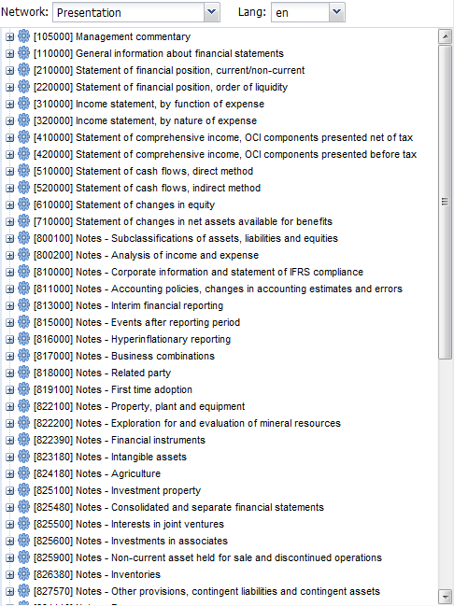
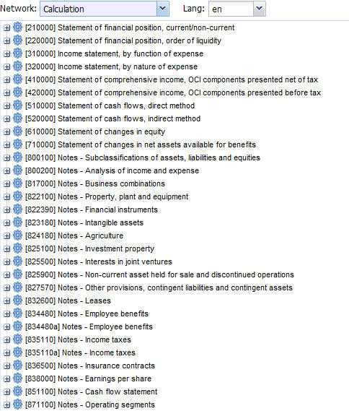
Names of sets of relations - ELRs
(extended)
links
presentation
calculation
definition
label
reference
generic
Profit and loss statement (by nature)
 | Gross profit (loss)
 | + | Revenue from sales
 | - | Operating costs
Extended Link Role
splitting linkbases in sections
gathering relations that have something in common
e.g.:
  hierarchy of concepts in Income statement
  labels to be used for concepts in Balance sheet
  set of business rules applicable for a particular table (e.g. CR-SA)
  …
XLink in XBRL results in graphs
Profit and loss statement (by function)
 | Gross profit (loss)
 | + | Profit (loss) on sales
 | - | Costs of sales
 | - | Costs of administration

Slide 20
Label linkbase
(extended)
links
presentation
calculation
definition
label
reference
generic
human readable description of an XBRL element
elements’ names can be effective for consuming applications but unreadable for the taxonomy users, e.g.:
  StatementThatFinancialStatementsAndCorrespondingFiguresForPreviousPeriodsHaveBeenRestatedForChangesInPurchasingPower
  or codes
  mi20
XBRL enables assigning many different labels for each one element:
  depending on context (type of relationship and placement of an element in a financial statement)
  depending on language used
  containing documentation

Slide 21
Reference linkbase
(extended)
links
presentation
calculation
definition
label
reference
generic
legal basis for concepts defined by a taxonomy (concepts without legal basis should not be created e.g. their meaning may be unclear for filers)
examples
  IFRS taxonomy refers to IFRS Bound Volume (book)
  COREP taxonomy refers to
    EU Directive (in the CEBS version)
    local regulations (in national extensions of COREP)
reference linkbase does not contain text of the regulations but only the reference to their structure (paragraph, clause, point …) [but: text of the regulation can be embedded in label linkbase as documentation]

Slide 22
Presentation Linkbase
(extended)
links
presentation
calculation
definition
label
reference
generic
facilitates browsing of taxonomy content
hierarchical dependencies between concepts (graphs/trees)
indicates reportable information (informative, no validation)
it is NOT a visualization of a report however it is quite often used for this purpose

Slide 23
Example of presentation links
<loc xlink:type="locator"
xlink:href="schema.xsd#Assets"
xlink:label="Assets_Locator"/>
<loc xlink:type="locator"
xlink:href="schema.xsd#CurrentAssets"
xlink:label="CurrentAssets_Locator"/>
<presentationArc xlink:type="arc"
xlink:arcrole="http://www.xbrl.org/2003/arcrole/parent-child"
xlink:from="Assets_Locator" xlink:to="CurrentAssets_Locator"
order="1"
use="optional"/>
Statement of financial position
 | Assets
 |  | Non-Current Assets |  |  |  | X
 |  |  | Intangible Assets |  |  | X
 |  |  | Property, Plant and Equipment
 |  |  |  | Land and Buildings |  | X
 |  |  |  | Motor Vehicles |  | X
 |  |  |  | Furniture |  | X
 |  |  |  | Property, Plant and Equitpment, Total |  | X
 |  |  | …
 |  | Current Assets |  |  |  | X
 |  |  | Inventories |  |  | X
 |  |  | Receivables |  |  | X
 |  |  | …
 |  | Assets, Total |  |  |  | X
 | …
Statement of financial position [abstract]
1.
...
Assets [abstract]
1.
2.
Non-Current Assets
3.
Current Assets
Assets, Total
1.
2.
1.
2.
Intangible Assets
Property, Plant
and Equipment
...
Inventories
Receivables
...
1.
2.
3.
4.
Land and Buildings
Motor Vehicles
Furniture
Property, Plant
and Equipment, Total

Slide 24
Calculation linkbase
(extended)
links
presentation
calculation
definition
label
reference
generic
defines validity checks to be performed on the content of reports
created in a 'tree-like' fashion according to the rule: subelements multiplied by a weight are summed-up in order to check validity of the value of the parent element: X = multiplication factor ×Y, e.g. Tax = 0,19 × Income)
only numeric items for a single entity/period/dimension/unit
limited application:
  Cr + Cr, Cr - Dt, Dt - Cr, Dt + Dt
  no cross-period (stock + flow)
  no cross-unit (EUR, shares, …)
formula linkbase far more powerful:
  fallback values
  cross-entity/period/dimension/unit
  creation of new facts from reported data

Slide 25
Example of calculation link
Presentation
Property, Plant and Equipment
 | Land and Buildings
 | Motor Vehicles
 | Furniture
 | Property, Plant and Equipment, Total
Statement of financial position
 | Assets
 |  | Non-Current Assets |  |  |  | X
 |  |  | Intangible Assets |  |  | X
 |  |  | Property, Plant and Equipment
 |  |  |  | Land and Buildings |  | X
 |  |  |  | Motor Vehicles |  | X
 |  |  |  | Furniture |  | X
 |  |  |  | Property, Plant and Equipment, Total |  | X
 |  |  | …
 |  | Current Assets |  |  |  | X
 |  |  | Inventories |  |  | X
 |  |  | Receivables |  |  | X
 |  |  | …
 |  | Assets, Total |  |  |  | X
 | …
Calculation
Property, Plant and Equipment, Total
 | Land and Buildings | +1
 | Motor Vehicles | +1
 | Furniture
+1
Assets, Total
+1
Non-Current Assets, Total
Current Assets, Total
+1
+1
+1
+1
Inventories
...
Intangible Assets
Property, Plant
and Equipment, Total
...
Receivables
+1
+1
+1
Land and
Buildings
Motor Vehicles
Furniture

Slide 26
Definition linkbase
(extended)
links
presentation
calculation
definition
label
reference
generic
four standard types (roles) of relationships defined by XBRL Spec 2.1 rarely used in XBRL taxonomies:
  general-special
  essence-alias
  requires-element
  similar-tuples
linkbase where dimensional information is assigned to concepts

Slide 27
Terminology (1) - Constructs
primary item, measure
basic financial/accounting terms that can be reported with dimensional information in context in instance document
Assets, Liabilities, Revenues…
domain
list of financial instruments, list of economy sectors, list of continents/countries/cities, time intervals, …
complete breakdown of a certain type
domain member
Instruments total, Equity instruments, Debt securities, …
each enumeration of a domain
All sectors, Central banks, Governments, …
dimension
Instrument held, Instrument issued, Original maturity, Remaining maturity, Counterparty sector, …
a view on a breakdown (resulting in dimensional context for a measure)
hypercube
abstract concept allowing to create an ordered list of dimensions which Cartesian product of members constitutes (or is prohibited for) a base item
By instrument held and issuing counterparty sector, …

Slide 28
Terminology (2) – Relations
concept (primary item)
hypercube
domain-member
all
Assets, Liabilities, …
notAll
By instrument held and issuing counterparty sector, Exclusion of debt securities from households, …
hypercube-dimension
dimension
dimension
Financial instruments held
Sectors
dimension-domain
domain
domain
list of financial instruments
list of economy sectors
domain-member
domain-member
domain member
domain member
domain-member
Instruments total, Equity instruments, debt securities, …
All sectors, Central banks, Governments, …

Slide 29
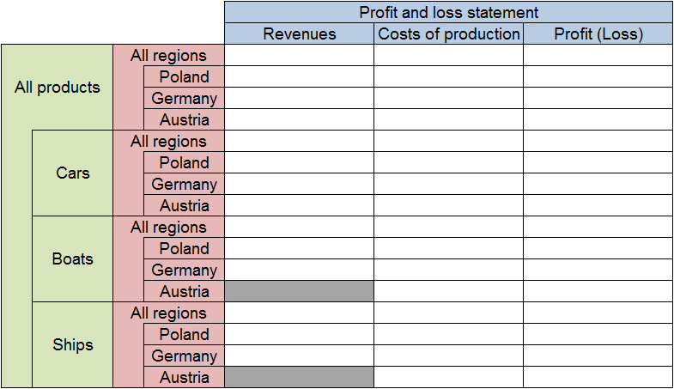
Explicit dimension - Example

Slide 30
Explicit dimensions example
Taxonomy architecture and content
T: role:ExclusionBoatsShipsAustria
P: role:ProfitAndLossStatement
DG: Geographical breakdown
abstract dimension item
P: Profit and loss statement
dimension-domain
abstract item
hpercube-dimension
DG: Austria
domain-member
P: Revenue
notAll
targetRole:ExclusionBoatsShipsAustria
(abstract) item
all
P: Costs of production
T: Exclusion of boats and ships in Austria
By products breakdown
P: Profit (Loss)
abstract dimension item
monetary items
abstract hypercube item
dimension-domain
T: Geographical and by products breakdown
Boats
abstract hypercube item
Ships
(abstract) items
hypercube-dimension
targetRole: ByProductsBreakdown
hypercube-dimension
targetRole: GeographicalBreakdown
DP: By products breakdown
DG: Geographical breakdown
abstract dimension item
abstract dimension item
dimension-domain
dimension-domain
DP: All products
DG: All regions
(abstract) item
(abstract) item
domain-member
DP: Cars
DG: Poland
DP: Boats
domain-member
DG: Germany
DP: Ships
DG: Austria
(abstract) items
(abstract) items
DP: role:ByProductsBreakdown
DG: role:GeographicalBreakdown

Slide 31
Generic Link
(extended)
links
presentation
calculation
definition
label
reference
generic
flexible solution allowing to even more customize sets and types of relation (additional semantics)
support from software needed
  syntax (base)
  semantics
base for new functionalities:
  formula linkbase
  rendering linkbase
  …

Slide 32
Basic components of XBRL Formula
XBRL Instance Document
XBRL Taxonomy
Querying and checking reported data (XPath, XQuery, XBRL Functions)
Declaration of rules
(resources and arcs according to Generic Link)
formula
value
assertion
consistency
existence

Slide 33
XBRL instance data
ABC Corporation
In thousands USD
2010 2011
Non-current Assets
Current Assets
Assets, Total
400 | 500
300 | 100
700 | 600
concept
value
context, unit
Taxonomy
Instance document

Slide 34
Context(s)’
definition
Unit(s)’ definition
Facts
Ma Petite Entreprise – Paris – Bilan 2005
Actif 500 000€
Actifs circulants 300 000€
Actifs immobilisés 200 000€
Passif 500 000€
Dettes 230 000€
Capitaux propres 270 000€

Slide 35
Taxonomy and instance document linkage
(XBRL 2.1)
XBRL Instance document
Context
<context id="ABC_20100101_20101231">
<entity>
<identifier
scheme="http://nasdaq.com/ticker">
ABC
</identifier>
</entity>
<period>
<startDate>2010-01-01</startDate>
<endDate>2010-12-31</endDate>
</period>
</context>
Taxonomy
Element's definition:
<element
id="ifrs_ProfitLoss"
name="ProfitLoss" type="xbrli:monetaryItemType" substitutionGroup="xbrli:item" xbrli:periodType="duration" xbrli:balance="credit" nillable="true" />
Unit
<unit id="U-USD">
<measure>iso4217:USD</measure>
</unit>
Fact
<ifrs:ProfitLoss
contextRef="ABC_20100101_20101231" unitRef="U-USD"
decimals="0">
6611000
</ ifrs:ProfitLoss >

Slide 36
Examples of contexts
Containing an entity subdivision (segment)
Related to an instant
Related to a duration
Containing a scenario
Forever

Slide 37
Examples of units

Slide 38
Footnotes
XLink extended link
(switchboard)
XBRL Report
…
<EnterpriseName …>…
<TotalAssets …>…
<CurrentAssets …>…
<NonCurrentAssets …>…
<TotalLiabilitiesAndEquity…>…
<TotalLiabilities …>…
<TotalEquity …>…
…
"Footnotes links"
from
to
loc
arc
resource xml:lang="fr"
arc
Incluant les effets de l'acquisition de
la société Applinx.
loc
resource xml:lang="en"
loc
Including the effects of the acquisition
of the Applinx company.
XLink locators
(to entities outside of the link, in the same document,
or not)
XLink arc(s)
(m-n connection)
XLink resources
(entities in the link)
Facts (data)
Footnotes

Slide 39
XBRL report and XBRL schema
XBRL reports
…
<link:schemaRef
xlink:href="myTaxonomy.xsd"
xlink:type="simple">
<EnterpriseName …>…
<TotalAssets …>…
<CurrentAssets …>…
<NonCurrentAssets …>…
<TotalLiabilitiesAndEquity…>…
<TotalLiabilities …>…
<TotalEquity …>…
…
XML schema
Extension:
periodType="instant" ou "duration"
<schema …
<element name="EnterpriseName"
type="xbrli:stringItemType"
substitutionGroup="xbrli:item"
xbrli:periodType="instant"/>
<element name="TotalAssets"
id="ci-TotalAssets"
type="xbrli:monetaryItemType"
substitutionGroup="xbrli:item"
xbrli:periodType="instant"
xbrli:balance=“debit"/>
<element name="CurrentAssets" …
<element name="NonCurrentotalAssets" …
<element name="TotalLiabilitiesAndEquity" …
<element name="TotalLiabilities" …
<element name="TotalEquity" …
…
Extension for currency items:
balance="credit" ou "debit"
Best practice:
XML schemas are
flat (structures and
relationships are
expressed in
XLink linkbases)
Facts (data)
Concepts

Slide 40
XBRL report and XBRL schema + labels
XBRL report
XML schema
Label linkbase
…
<EnterpriseName …>…
<TotalAssets …>…
<CurrentAssets …>…
<NonCurrentAssets …>…
<TotalLiabilitiesAndEquity…>…
<TotalLiabilities …>…
<TotalEquity …>…
…
id ="ci-EnterpriseName" …
id ="ci-TotalAssets" …
id="ci-CurrentAssets" …
id="ci-NonCurrentotalAssets" …
id ="ci-TotalLiabilitiesAndEquity" …
id ="ci-TotalLiabilities" …
id ="ci-TotalEquity" …
…
loc
arc
ressource xml:lang="fr"
arc
Nom de l'entreprise
from
to
ressource xml:lang="en"
Enterprise name
loc
arc
ressource xml:lang="fr"
arc
Actifs
loc
arc
ressource xml:lang="fr"
arc
Actifs circulants
loc
arc
ressource xml:lang="fr"
arc
Actifs immobilisés
loc
arc
ressource xml:lang="fr"
arc
Passif
loc
arc
ressource xml:lang="fr"
arc
Dettes
loc
arc
ressource xml:lang="fr"
arc
Capitaux propres
Facts (data)
Concepts
Labels

Slide 41
XBRL report and XBRL schema + references
XBRL report
XML schema
Reference linkbase
…
<EnterpriseName …>…
<TotalAssets …>…
<CurrentAssets …>…
<NonCurrentAssets …>…
<TotalLiabilitiesAndEquity…>…
<TotalLiabilities …>…
<TotalEquity …>…
…
id ="ci-EnterpriseName" …
id ="ci-TotalAssets" …
id="ci-CurrentAssets" …
id="ci-NonCurrentotalAssets" …
id ="ci-TotalLiabilitiesAndEquity" …
id ="ci-TotalLiabilities" …
id ="ci-TotalEquity" …
…
loc
arc
resource
arc
Reference
from
to
loc
arc
resource
arc
Reference
loc
arc
resource
arc
Reference
loc
arc
resource
arc
Reference
loc
arc
resource
arc
Reference
loc
arc
resource
arc
Reference
loc
arc
resource
arc
Reference
from
to
Facts (data)
Concepts
References

Slide 42
XBRL report and XBRL schema + presentation
XBRL report
XML schema
Presentation linkbase
…
<EnterpriseName …>…
<TotalAssets …>…
<CurrentAssets …>…
<NonCurrentAssets …>…
<TotalLiabilitiesAndEquity…>…
<TotalLiabilities …>…
<TotalEquity …>…
…
id ="ci-EnterpriseName" …
id ="ci-TotalAssets" …
id="ci-CurrentAssets" …
id="ci-NonCurrentotalAssets" …
id ="ci-TotalLiabilitiesAndEquity" …
id ="ci-TotalLiabilities" …
id ="ci-TotalEquity" …
…
loc
from
arc
order="2"
from
arc
order="1"
to
2
to
1
loc
from
1
arc
order="2"
from
arc
order="1"
1.2
1.1
loc
1.1
1.2
loc
loc
from
2
arc
order="2"
from
arc
order="1"
2.2
2.1
loc
2.1
2.2
loc
Faits (données)
Concepts
Presentation hierarchy

Slide 43
XBRL report and XBRL schema + calculation
XBRL calculation
XML schema
Report XBRL
Calculation linkbase
…
<EnterpriseName …>…
<TotalAssets …>…
<CurrentAssets …>…
<NonCurrentAssets …>…
<TotalLiabilitiesAndEquity…>…
<TotalLiabilities …>…
<TotalEquity …>…
…
id ="ci-EnterpriseName" …
id ="ci-TotalAssets" …
id="ci-CurrentAssets" …
id="ci-NonCurrentotalAssets" …
id ="ci-TotalLiabilitiesAndEquity" …
id ="ci-TotalLiabilities" …
id ="ci-TotalEquity" …
…
Ma Petite Entreprise
loc
from
Actif 500 000€
arc
weight="1"
from
arc
weight="1"
to
1.2
Actifs circulants 300 000€
loc
to
1.1
1.1
Actifs immobilisés 300 000€
loc
1.2
loc
from
Passif 500 000€
arc
weight="1"
from
arc
weight="1"
to
2.2
2.1
2.1
Dettes 230 000€
loc
to
2.2
Capitaux propres 270 000€
loc
Faits (données)
Concepts
Calculations (aggregation checks)

Slide 44
Dimensional information in instance documents
Example
<xbrli:context id="Year2011_RegionsAll_Oil">
<xbrli:entity>
<xbrli:identifier scheme="http://www.stockexchange/ticker">ACME</xbrli:identifier>
<xbrli:segment>
<xbrldi:explicitMember dimension="d-g:GeographicalBreakdown">d-g:RegionsAll</xbrldi:explicitMember>
<xbrldi:typedMember dimension="d-s:OperatingSegments">
<d-s:Segment>Oil</d-s:Segment>
</xbrldi:typedMember>
</xbrli:segment>
</xbrli:entity>
<xbrli:period>
<xbrli:startDate>2011-01-01</xbrli:startDate>
<xbrli:endDate>2011-12-31</xbrli:endDate>
</xbrli:period>
</xbrli:context>
<p:Revenues contextRef="Year2011_RegionsAll_Oil" (…) >120</p:Revenues>
QName of explicit dimension definition
QName of explicit dimension member
QName of typed dimension definition
Domain (XML) element of typed dimension
String value of typed domain

Slide 45







Inline XBRL – Application
XBRL
Taxonomy
validation
XBRL
Instance
XBRL
Instance
discussion
analysis
XHTML
(iXBRL)
reporting entity
supervisor
Primary use cases
financials for filing with a regulator
annual reports (layout matters for stressing some figures)
comparative corporate information on a website (presentation + dynamic analysis)
predefined forms (companies registrar, taxation)
internal consolidation – reports (posted to intranet and Internet)

Slide 46
Inline-XBRL
Example
inline-XBRL
<td class="rightalign">
<ix:nonFraction name="ifrs:Revenue"
contextRef="e2010" precision="5" unitRef="USD" scale="6" format="ixt:numcommadot”><ix:exclude>$</ix:exclude>43,623</ix:nonFraction>
</td>
resulting XBRL
<ifrs:Revenue contextRef="e2010" unitRef="USD" precision="5">43623000000</ifrs:Revenue>

Slide 47


Application of XBRL
XBRL is not off-the-shelf, out-of-the-box solution!
XBRL is a flexible tool that can address various requirements depending on application scenario
XBRL is a double edge sword that can cut the Gordian Knot but if used improperly can hurt yourself and others

Slide 48
Requirements and Applications
prudential reporting
  clear definitions, fixed content
  COREP, FINREP, FDIC, …
exchange of financial statements
  flexible content
  IFRS, US-GAAP, EDINET
SBR projects
  harmonization, normalization, standardization
  SBR-NL, SBR-AU
different requirements
=
different taxonomy architectures

Slide 49
Thank you

