Slide 1
Introduction to XBRL
Newcomers’ Session
XBRL Week in Madrid
31 May 2012

Slide 2
Welcome to XBRL In Euopre Conference in Madrid!
Agenda for the Newcomer’s Session
  What XII is and its history, who is working to further XII's mission, and where you will find participants and adoption - around the world
  The terminology of XBRL: what words and phrases will you be hearing all week; Specification and Best Practices documents
  How you can make the most of the event, participate and gain additional value from taking an active role in moving forward the vision and tactics of XII, Eurofiling and XBRL in Europe

Slide 3


Introduction and Disclaimer
Who I am
What I am about to share does not necessarily reflect the opinions of …

Slide 4



Slide 5
XII
The Business Reporting Supply Chain
The History of Our Language
  From XFRML to XBRL
XII organizationally
  Leadership
  Working Groups

Slide 6
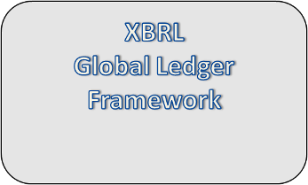
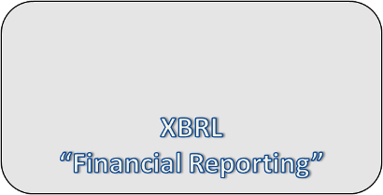





Business Reporting Supply Chain
Processes
Financial Reporting
Tax
Sustainability
Other compliance reporting
Risks
Business
Operations
Internal
Business
Reporting
External
Business
Reporting
Investment,
Lending,
Regulation
Economic Policymaking
Participants
Companies
Financial
Publishers
and Data
Aggregators
Investors
Central
Banks
Trading
Partners
Management
Accountants
Internal
Auditors
External
Auditors
Regulators and Administrators
Software Vendors and Service Providers
Notes:
6

Slide 7

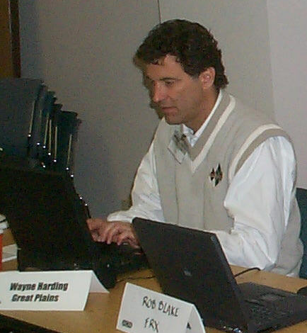

What has become XBRL – the Extensible Business Reporting Language – began with the passion of a CPA and the potential of XML.
What began as using XML tags for financial statements grew to all business reporting data, processes, rules and more.
Wayne Harding
The Story of Our New Language
Personalities, cultures, and politics combine to create a common, global language for business
http://www.aicpa.org/InterestAreas/FRC/AccountingFinancialReporting/XBRL/DownloadableDocuments/XBRL_09_web_final.pdf
Charlie Hoffman
Financial Statements
Eric E. Cohen
Detailed data

Slide 8
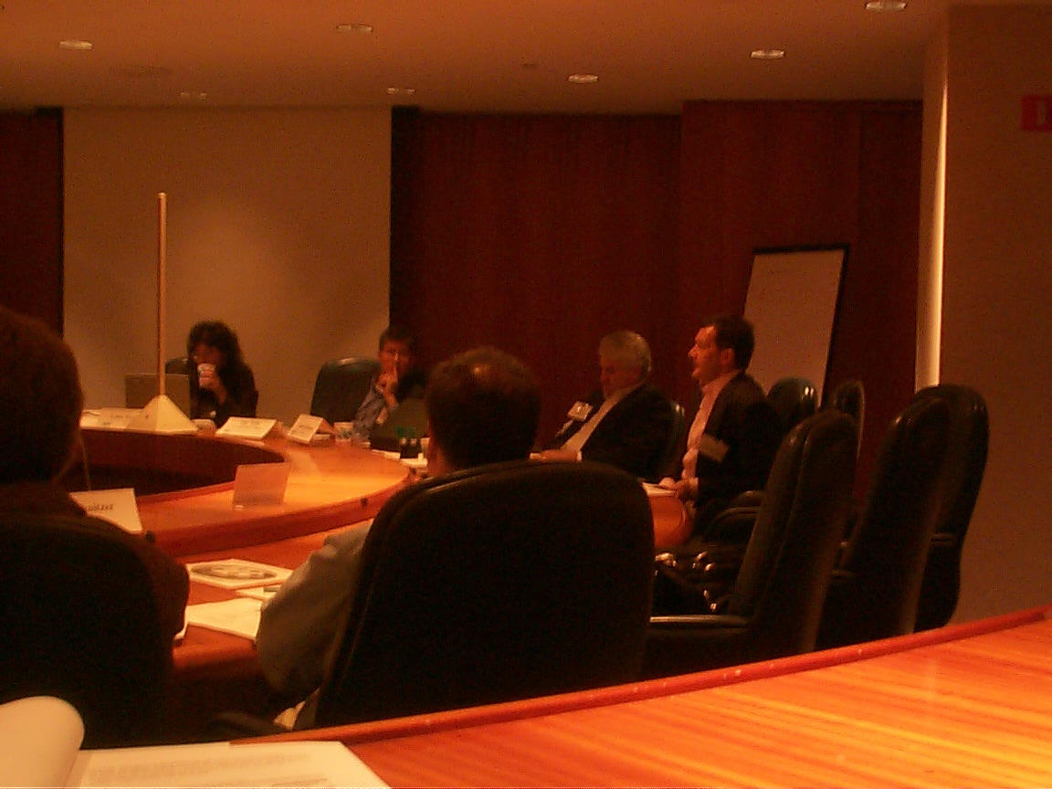

The work begins under the AICPA – October 2009
Louis Matherne
Karyn Waller, Louis Matherne, Mike Willis, Charlie Hoffman

Slide 9

Original Plans Looked Deeper
From “Highlights” of Initial XFRML Steering Committee, 10/14/99
  “[XFRML] should have its roots in the "Audit Supply Chain." XFRML as technical standard for seamless process of exchange across all audit processes.
  Our opportunity is to address things internationally at the level below the financial reporting level since there is more commonality at that level.”
  This is still the place of XBRL’s Global Ledger Taxonomy Framework – the detailed information found in ERP systems.

Slide 10

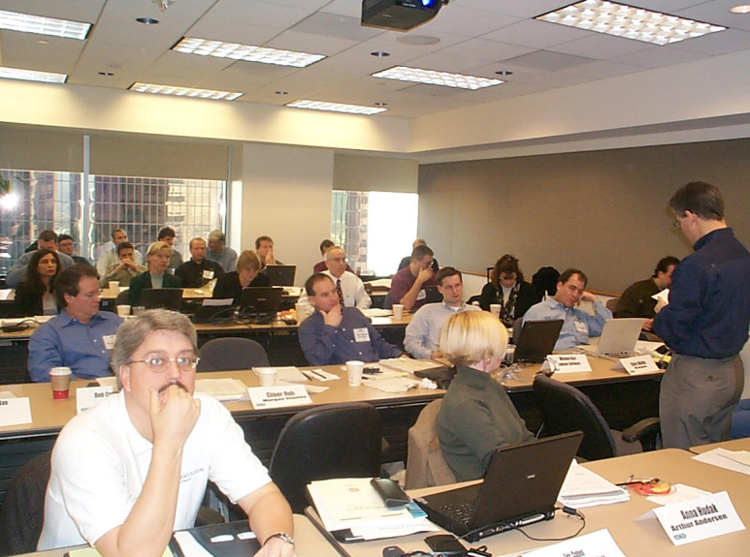

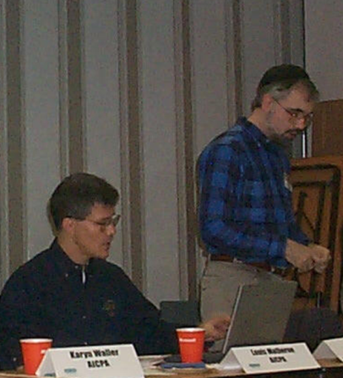
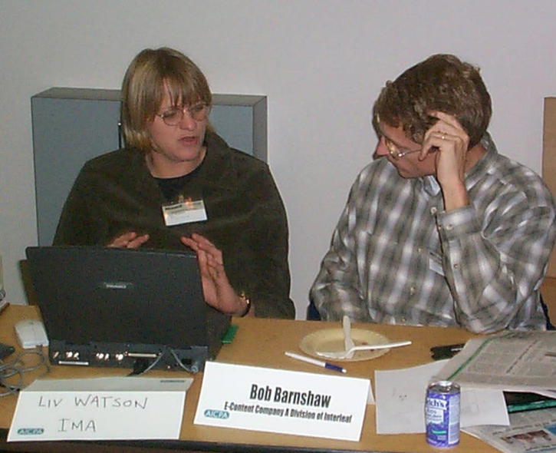
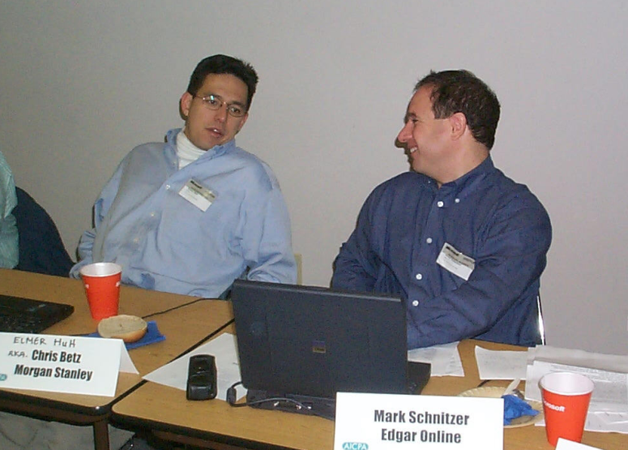
Practicality led to a focus on US GAAP financial statements. We met in NYC, in Chicago, Seattle, Denver, Los Angeles, Washington DC*, Tampa to accomplish something exceptional. We brought our knowledge, our IP, our visions.
* Meeting interrupted by the President of the USA.

Slide 11
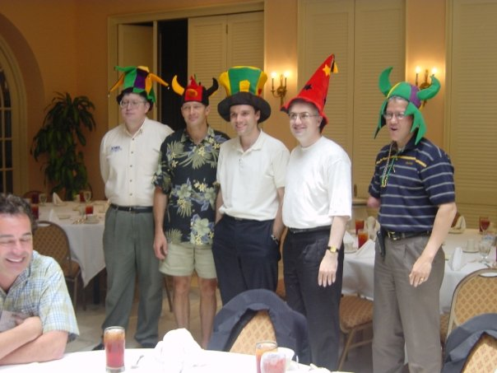
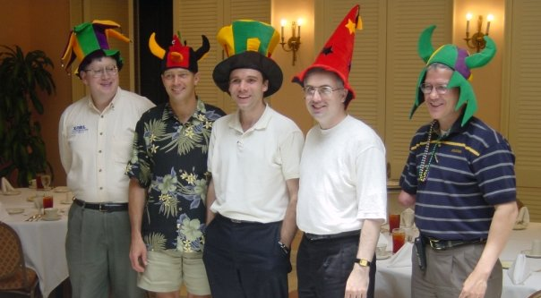

And the wizards and jesters alike of XBRL brought together their ideas to create the new vision – from XML-based Financial Reporting Markup Language to XBRL.
Extensible: so we can start with shared knowledge and extend to tell our own story
Business Reporting: So we are improving all business information flow not just financial statements, not just efiling
Language: So we can all benefit and communicate.
Louis, Charlie and Eric, along with David vun Kannon and Zach Coffin, both at the time with KPMG, co-author of the Specification and leading XBRL global evangelist, respectively.
<-

Slide 12
Specification Working Group:
High Priorities and Low Priorities
How it works
Exchange between software applications
  1. Creating documents from databases (“Export”)
  2. Extraction of information from documents (“Import”)
  3. Integration of information from multiple sources for comparison (“Compare”)
So hard that it requires a whole consortium
Future oriented
Exchange between applications and humans
  1. Displaying reports on screen (“Rendering”)
  2. Creating WYSIWYG reports (“Editing”)
  3. Viewing raw report data (“Human Readability”)
So easy that it can be done by individuals
Past oriented
From April 2000 presentation

Slide 13
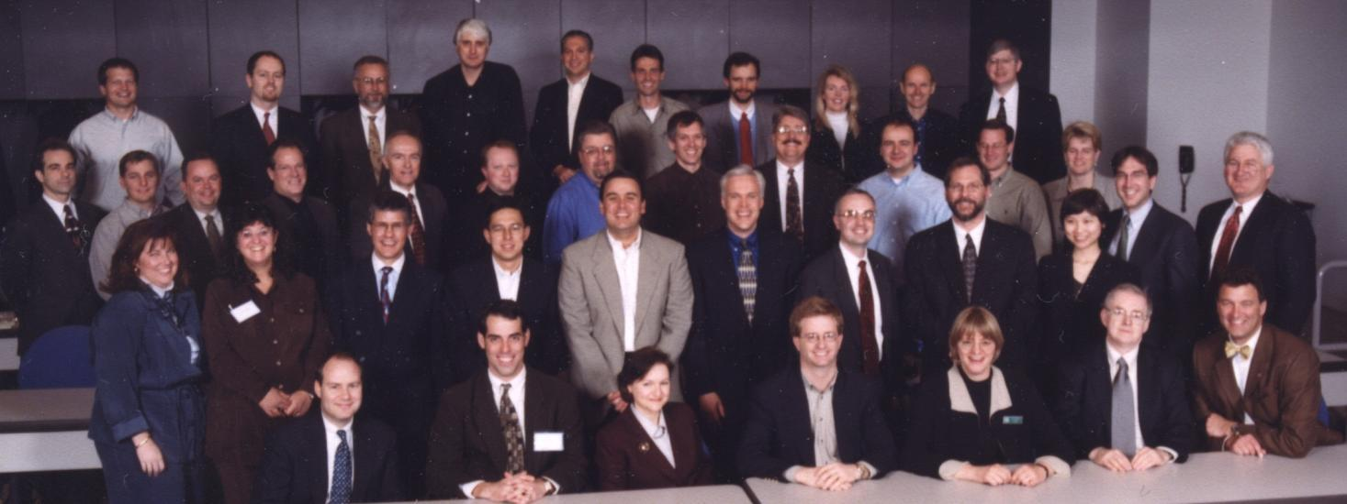
XBRL 1.0
Version 1.0 of the Specification and the first taxonomy, the US GAAP Commercial and Industrial Taxonomy were shown in draft in NYC in April 2000 and release a few months later.

Slide 14
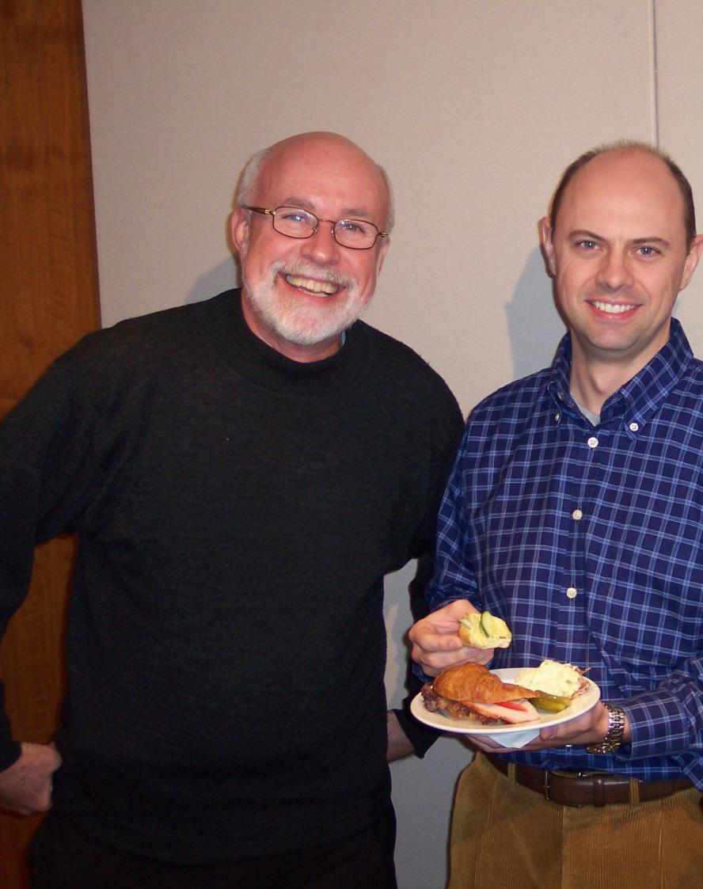
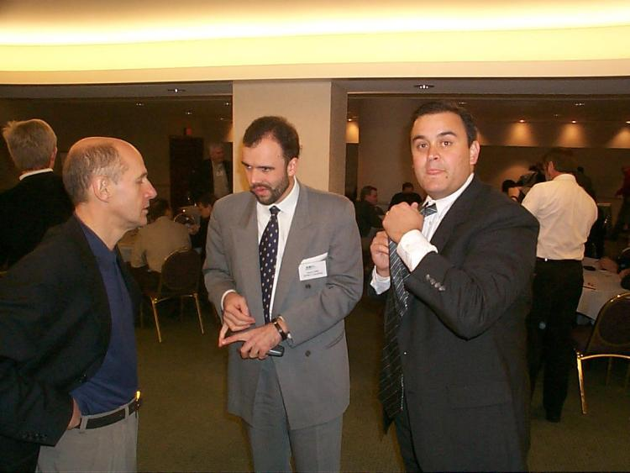
And efforts to roll XBRL out from the US began. Canada invited us in. The IFRS Foundation became engaged and showed its first draft taxonomy in London at XII “I”.
Bill Swirsky, David Prather

Slide 15
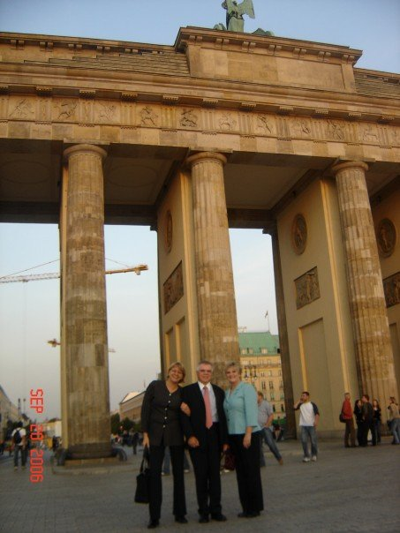
2001
1 London
2 New Orleans
3 Sydney
2002
4 Berlin
5 Toronto
6 Tokyo (1)
2003
7 Amsterdam
8 Seattle
2004
9 Aukland, NZ
10 Brussels (1)
2005
11 Boston
12 Tokyo (2)
2006
13 Madrid
14 Philadelphia
2007
15 Munich
16 Vancouver
2008
17 Eindhoven
18 Washington, DC
2009
19 Paris
2010
20 Rome
21 Beijing
2011
22 Brussels (2)
23 Montreal
2012
24 Abu Dhabi
25 Tokyo (3)
And the net widened. The world came together to build XBRL.

Slide 16
Jurisdictions
IASB/IFRS
Australia
Belgium
Canada
Switzerland (CH)
China
Denmark
Direct Members
XBRL Europe
France
Germany
India
Ireland
Italy
Japan
Korea
Luxembourg
Netherlands
OCEG
Romania
South Africa
Spain
Sweden
UAE
United States
United Kingdom

Slide 17
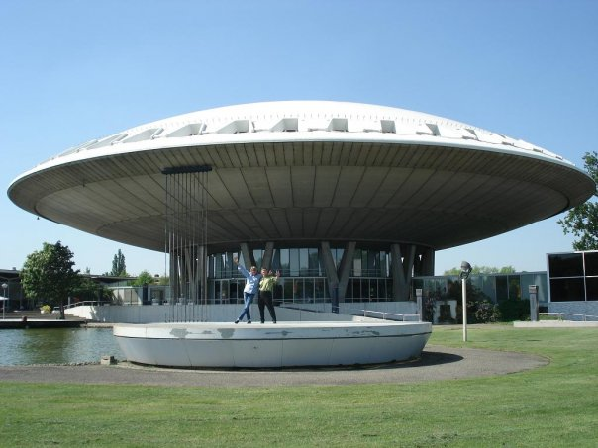
And XBRL prepared to take off for the future.
(XBRL XVII with NTP/SBR conference, Eindhoven)

Slide 18










Milestones on the Road to
Oct. 98: Wayne invites Eric E. Cohen to get involved in the effort. Brings vision for XML and accounting detailed data.
Apr. 98: Charlie Hoffman uses XML to help a client. Has vision for XML and FR.
Pre-XBRL
Feb. 98: XML becomes W3C Recommendation.
Jul. 98: Charlie works with Wayne Harding, chair of AICPA High Tech Task Force. He was a Great Plains VP.
Jan. – Jul. 99: Business plan presented, funding approved by AICPA.
Aug. 99 – Mar. 00: XFRML group works to develop v.1, starting with 13 corporate members
Feb 2001: XBRL expands beyond the Americas. Now 85 Members.
Mar 02: XII, Berlin; GL 1.0 Recommended, Microsoft reports in XBRL.
Infancy
April – July 2000: Preview and release of XBRL 1.0 and first US GAAP Taxonomy with 30 members incl. IMA.
Oct 2001: Australia’s APRA is first major regulator; many jurisdictions formed.
Dec 02: Spec 2.1
2007:
XII CEO
XUS CEO
SEC $6M taxonomies
Structure:
XBRL Standards Board
Working Groups
Membership:
Over 800 members globally.
Taxonomies:
US GAAP
IFRS
XBRL GL
Many regional
Software support:
Taxonomies, Instances, Consolidation products
Major projects:
SEC
FDIC
Dutch NTP
SEBS
Youth
SBR

Slide 19

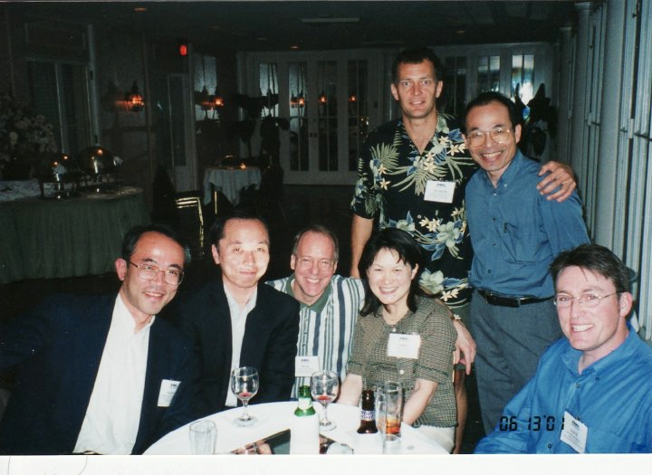








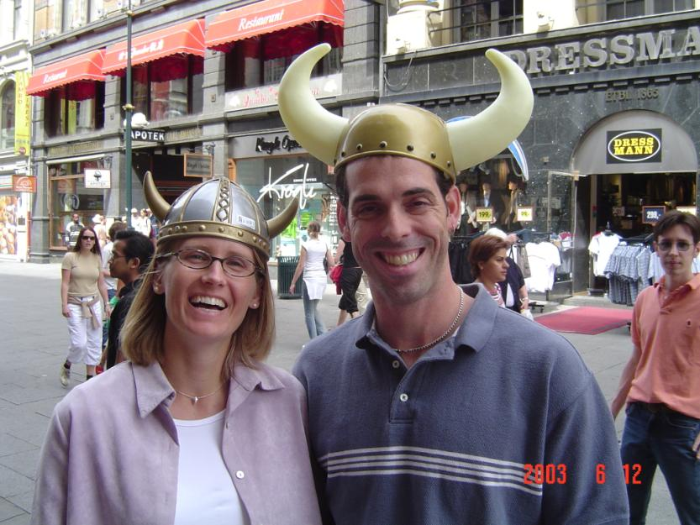
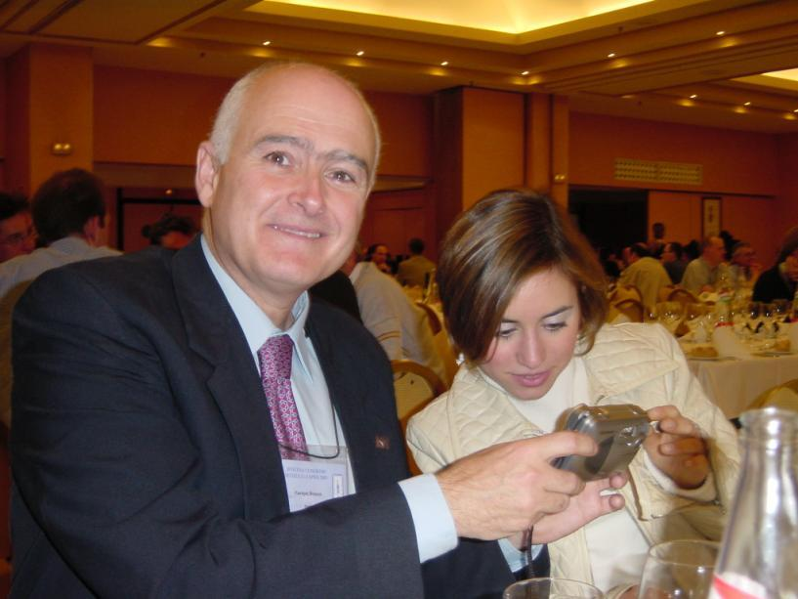






Many faces of XBRL.

Slide 20







LEADERSHIP: Chairs of the International Steering Committee and later the Board of Directors.
Mike Willis
Louis Matherne
Arlene Thomas
Walter Hamscher
Kurt Ramin
Michael Ohata

Slide 21
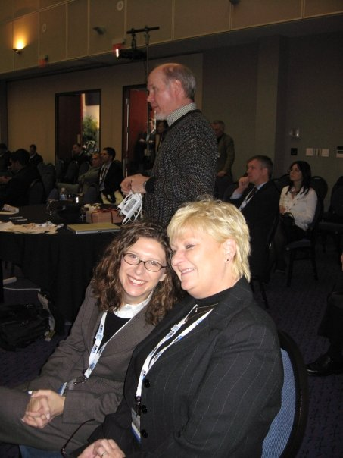
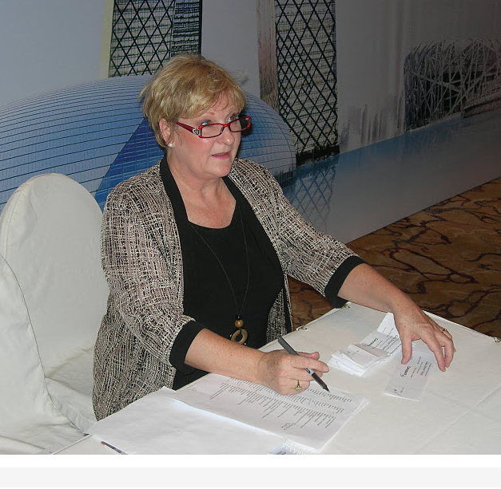


XBRL International Staff
Tony Fragnito
Cheryl Neal
Angela Rose
Dave Nitchman

Slide 22
Working Groups
Base Specification and Maintenance
GL
Formula
Rendering
Versioning
Taxonomy Architecture
Abstract Modeling Task Force
Project Listing Database Task Force
Taxonomy Architecture WG
Taxonomy Recognition Task Force
Standards Board
Best Practices Board

Slide 23

Other Areas
Assurance Committee
International Conference Committee
Membership Development Committee

Slide 24
Terminology of XBRL

Slide 25


Do You Speak XBRL?
The Global Language for Business Reporting
Taler du XBRL?
Spreekt u XBRL?
Parlez-vous XBRL?
Sprechen Sie XBRL?
Parla XBRL?
XBRL Hol Dajatlh'e'?
Czy mówi Pan po XBRL?
Вы говорите по-XBRL?
¿Habla usted XBRL?

Slide 26
Why Do We Need Standardized Syntax for Business Reporting?
Format, syntax, semantics
Written instructions: “Give 5,000 dollars to the person to your right on 08-11-09.”
Alvin, a US-based banker
Charlie, a Canadian banker
Arnie, an Australian banker
Sam, a banker in Sweden
Freddie, a banker in Fiji
CSV?

Slide 27
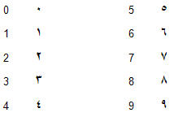

Enter XML:
Technical Agreement on Information Descriptions
XML Recommendations
  XML
  XML Namespaces
  XML Schema
  XLink
Dates: 09/08/08
Numbers: 5.000
Facts in a CSV file: 400,200
XBRL is XML optimized for Business Reporting

Slide 28
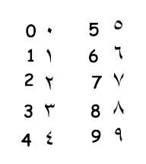

Why We Need an XML-Based Standard
Attributes of “standard” formats | XML | HTML | ASCII Fixed | CSV | Excel | DBF | EDI
Variable length fields | Yes | Yes | No | Yes | Yes | Yes | No
No field size limitations | Yes | Yes | Yes | Yes | No | No | Yes
Extensible | Yes | * | No | No | * | * | No
Includes context or field names (“rip and read”) | Yes | No | No | No | Yes | Yes | No
Cross-platform, non-proprietary, “universal” | Yes | Yes | Yes | Yes | No | No | Yes
Validation of files | Yes | No | No | No | * | * | No
Groups collaborating on definition and interoperability | Yes | No | No | No | No | No | Yes
Selective digital signatures | Yes | * | No | No | No | No | No
Selective encryption | Yes | * | No | No | No | No | No
Standard Office import/export | Yes | Yes | Yes | Yes | Yes | Yes | No
Not verbose, smaller file sizes | * | * | * | * | * | * | *
“12-12-12” … oops
“06-07-08”
June 7, 2008
6 July 2008
July 8, 2006
5.000
Five?
Five thousand?
weakness
workaround
strength

Slide 29

XML
Syntax agreement
  Key digital representation (unlike CSV)
  Numeric formats (like digits, decimals)
  Date formats and codes for languages (ISO)
But not full agreement to everything
  Semantics

Slide 30
XML + Agreed Upon Dictionaries = Communication
Metadata
<chair_info>
  <name>Gianluca Garbellotto</name>
  <address>
    <street>Mockingbird Lane</street>
    <house_number>1313</house_number>
    <city>MHieghts</city> <state>VA</state>
    <postal_code>22182</postal_code>
    <country>USA</country>
  </address>
  <telephone><area_code>703</area_code>
  <number>6293487</number> <country>1</country>
  </telephone>
  <birthdate>1971-07-05</birthdate>
  </chair_info>
Gianluca Garbellotto
1313 Mockingbird Lane
Mockingbird Heights, VA 22182
1 703 629 3487
Birthdate: ##/##/##
ISO 8601
Just plain, ordinary information
Metadata: information about information

Slide 31
What is XBRL
International supply chain standardization effort
XBRL
  Designed specifically to address pervasive process problems
    “A piece of business information” …
  “Bar Code” for Business Information supply chain
    Adds structure (meaning) to company disclosures
    Enhances information processing, reuse, analysis and reporting
    Disclosure neutral
    Taxonomies available for: US/IFRS GAAP, other statutory GAAP, MD&A, CSR, GRI, Proxy, Corp Actions, ERP/operational data, other non-financial
  Applicable to business information, related business rules, formulas, controls, processes, resources, etc. - not just for external reports
  Process enhancements are available and being realized

Slide 32
The business reporting supply chain
Accounting
software
ISO 20022
UBL
ACORD
MISMO
Others
SCOA
Payables
Receivables
Fixed Assets
Payroll
Others
US GAAP
IFRS
SBR
FDIC/FFIEC
Sustainability/GRI
Transaction
Layer
XBRL Global
Ledger
XBRL External Reporting
Business
Operations
Internal
Business
Reporting
External
Business
Reporting
Investment,
Lending,
Regulation
Economic Policymaking
Processes
Governance: Risks, controls, tests of controls
Audit documentation/workpapers

Slide 33

XBRL – More Than Just Tagging Business Information
Presentations
Is a child of Liquid Assets
Liquid Assets is a child of Current Assets
…
Labels – Multiple purposes
Documentation
Definition
Disclosure
…
Definitions
Related to Liquid Assets
Custom Presentations
Custom Definition
  Multi-dimensional business and financial data representations
  Flexibility of business reporting vocabularies (i.e. taxonomies)
  Mathematical relationships between concepts
  Flexibility about how to present information to users
Custom Labels
References
GAAP I.2.(a)
Instructions
Ad Hoc disclosures
Labels – Multiple languages
Cash in Bank
Гроші та їх еквіваленти
現金及び現金等価物
XBRL
<cash>
“200”
Custom References
Custom Labels
Formulas
Cash ≥ 0
If Cash in Unit X > 0 then…
Calculations
Cash = Currency + Deposits
Contexts/Units
IBM
US $X
FY2009
Budgeted
USD
Custom Formulas
Custom Calculation
Defined in Instance
Key:
Data Standardization
Data Validation
Custom Taxonomy

Slide 34


I’m having trouble deciding between XML and XBRL.
That’s not really the choice you need to make.
What do you mean?
XBRL IS XML. You don’t have to choose between them/
So what am I choosing between?
A proprietary approach using XML
XBRL, a standardized approach
Another “standardized” use
I thought I was deciding between “easy” XML and “complex” XBRL!
For every complex problem there is an answer that is clear, simple, and wrong.*
* (H L Mencken)

Slide 35


But XML and XML Schema ARE standards!
Yes … for building representational languages. But you need much more for reporting.
Like what?
XBRL formalizes many things you can do with XML that are important for reporting..
Human readable labels
Human readable definitions
Links to authoritative references
Formulas, calculations, and other validation rules
Presentation guidance
XML doesn’t do that?
No. XBRL knows XML and the business reporting supply chain from 12 years of experience.
XBRL uses the XML family of specifications?
XBRL is based on World Wide Web Consortium’s XML recommendations.
Software developers are on board
XML
XLink
Analysts are on board
XML Namespaces
Regulators are on board
Academics are on board
XML Schema
Accountants are on board

Slide 36



My tech guys and consultants say we should just build XML schemas.
Many people take that approach, but then have to recreate the wheel – and wind up with inconsistent, unsupported XML.
How do you encourage reuse, consistency and comparability?
How do you choose between elements and attributes?
How do you standardize on what XML doesn’t standardize?
How do you make sure that applications will understand your schemas and instances?
Are you ready to document and maintain
Are you thinking about a holistic solution or a quick fix?
Would you like to leverage the knowledge and experience of others?
What about other standards? Like ebXML or UBL?
The right tool for the right job. Are you exchanging invoices or purchase orders? Use UBL. Are you exchanging business reports?
Use

Slide 37

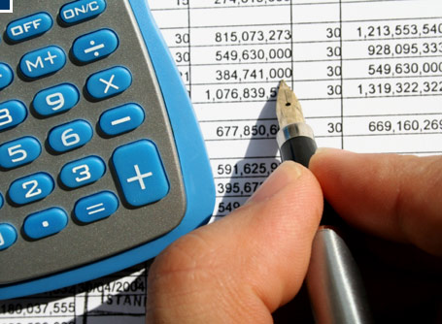

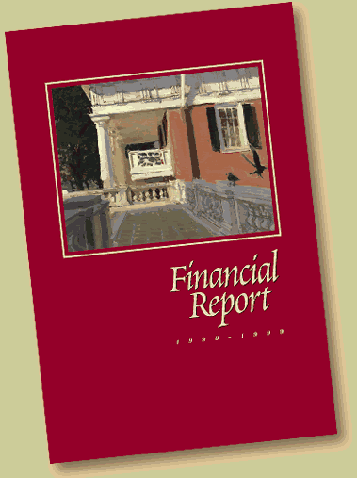

OLAP?
Why a Data Warehouse is like a

Slide 38




OLAP
Transactions and business events
“Source documents”
DIMENSIONS
XBRL “FR”
Financial Reporter (and other end reports)
Tax
Statutory
Statistical
Sustainability
(XBRL GL SRCD)
XBRL’s Global Ledger Framework (XBRL GL)

Slide 39
Electronic Data
“Standardized” Electronic Data – format
Standardized Electronic Data – XBRL (format)
Standardized Electronic Data – XBRL GL (fields, structure)
Standardized Electronic Data – XBRL GL and XBRL GL Profiles
“Standardized” Electronic Data – fields, structure
Standardized Electronic Data - Framework

Slide 40

Key Pieces to the XBRL Puzzle
XBRL Taxonomy
XBRL Instance Document
Defined in the XBRL Specification 1.0

Slide 41
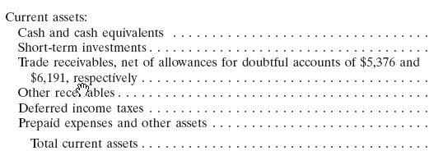
Taxonomy
Defines the business reporting concepts to be reported
Provides a vocabulary of agreed-upon business concepts
A set of attributes for each business reporting fact
Created using the XBRL Specification and modular extensions
Taxonomy concepts can be added or prohibited – extended, depending on local regulation and implementation.

Slide 42
<xsd:element id="ifrs_DescriptionOfDetailsOfDefaultsDuringPeriodOfPrincipalInterestSinkingFundOrRedemptionTermsOfLoansPayable" name="DescriptionOfDetailsOfDefaultsDuringPeriodOfPrincipalInterestSinkingFundOrRedemptionTermsOfLoansPayable" nillable="true" substitutionGroup="xbrli:item" type="xbrli:stringItemType" xbrli:periodType="duration"/>
<xsd:element id="ifrs_DescriptionOfDifficultiesStructuredEntityExperiencedInFinancingItsActivities" name="DescriptionOfDifficultiesStructuredEntityExperiencedInFinancingItsActivities" nillable="true" substitutionGroup="xbrli:item" type="xbrli:stringItemType" xbrli:periodType="duration"/>
<xsd:element id="ifrs_DescriptionOfDiscountRatesAppliedToCashFlowProjections" name="DescriptionOfDiscountRatesAppliedToCashFlowProjections" nillable="true" substitutionGroup="xbrli:item" type="num:percentItemType" xbrli:periodType="instant"/>
<xsd:element id="ifrs_DescriptionOfDiscountRatesUsedInCurrentEstimateOfValueInUse" name="DescriptionOfDiscountRatesUsedInCurrentEstimateOfValueInUse" nillable="true" substitutionGroup="xbrli:item" type="num:percentItemType" xbrli:periodType="instant"/>
<xsd:element id="ifrs_DescriptionOfDiscountRatesUsedInPreviousEstimateOfValueInUse" name="DescriptionOfDiscountRatesUsedInPreviousEstimateOfValueInUse" nillable="true" substitutionGroup="xbrli:item" type="num:percentItemType" xbrli:periodType="instant"/>
<xsd:element id="ifrs_DescriptionOfEffectOfChangingBusinessModelForManagingFinancialAssetsOnFinancialStatements" name="DescriptionOfEffectOfChangingBusinessModelForManagingFinancialAssetsOnFinancialStatements" nillable="true" substitutionGroup="xbrli:item" type="xbrli:stringItemType" xbrli:periodType="duration"/>
<xsd:element id="ifrs_DescriptionOfEffectOfRegulatoryFrameworkOnPlan" name="DescriptionOfEffectOfRegulatoryFrameworkOnPlan" nillable="true" substitutionGroup="xbrli:item" type="xbrli:stringItemType" xbrli:periodType="duration"/>
<xsd:element id="ifrs_DescriptionOfEffectiveInterestRateDeterminedOnDateOfReclassification" name="DescriptionOfEffectiveInterestRateDeterminedOnDateOfReclassification" nillable="true" substitutionGroup="xbrli:item" type="num:percentItemType" xbrli:periodType="instant"/>
<xsd:element id="ifrs_DescriptionOfEndOfReportingPeriodOfFinancialStatementsOfAssociates" name="DescriptionOfEndOfReportingPeriodOfFinancialStatementsOfAssociates" nillable="true" substitutionGroup="xbrli:item" type="xbrli:dateItemType" xbrli:periodType="instant"/>
<xsd:element id="ifrs_DescriptionOfEstimateOfRangeOfOutcomesFromContingentConsiderationArrangementsAndIndemnificationAssets" name="DescriptionOfEstimateOfRangeOfOutcomesFromContingentConsiderationArrangementsAndIndemnificationAssets" nillable="true" substitutionGroup="xbrli:item" type="xbrli:stringItemType" xbrli:periodType="duration"/>
<xsd:element id="ifrs_DescriptionOfEventOrChangeInCircumstancesThatCausedRecognitionOfDeferredTaxBenefitsAcquiredInBusinessCombinationAfterAcquisitionDate" name="DescriptionOfEventOrChangeInCircumstancesThatCausedRecognitionOfDeferredTaxBenefitsAcquiredInBusinessCombinationAfterAcquisitionDate" nillable="true" substitutionGroup="xbrli:item" type="xbrli:stringItemType" xbrli:periodType="duration"/>
<xsd:element id="ifrs_DescriptionOfExistenceOfRestrictionsOnTitlePropertyPlantAndEquipment" name="DescriptionOfExistenceOfRestrictionsOnTitlePropertyPlantAndEquipment" nillable="true" substitutionGroup="xbrli:item" type="xbrli:stringItemType" xbrli:periodType="duration"/>
As a preparer or analyst you don’t need to view or read these files.

Slide 43
What Goes Into a Taxonomy?
L
Stuff for humans
  Labels (role, language)
  Definitions
  Authoritative references
  Instructions for machines on a default hierarchy for presentation
  Enumerations
Stuff for machines/validation
  Element name (unique)
  ID (unique)
  Data types 5.1.1.3
  Substitution groups
  Abstract
  Instructions for how concepts relate with addition and subtraction
  Nillable
  Instructions for how items relate to each other abstractly and DIMENSIONALITY
  Formulas/Rules
  Balance 5.1.1.2
  periodType 5.1.1
2.0a
R
P
C
D
F

Slide 44
Taxonomies
Financial reporting
  US GAAP, IFRS, Canadian, Japanese, German
Statutory filings
  US FDIC/FFIEC, Eurofiling Basel II, Solvency II
Tax filings
  HMRC and …
Pan-governmental reporting
  SBR: Netherlands, Australia
Internal integration and reporting
  XBRL’s Global Ledger Framework
Sustainability
  GRI G3 and G3.1

Slide 45
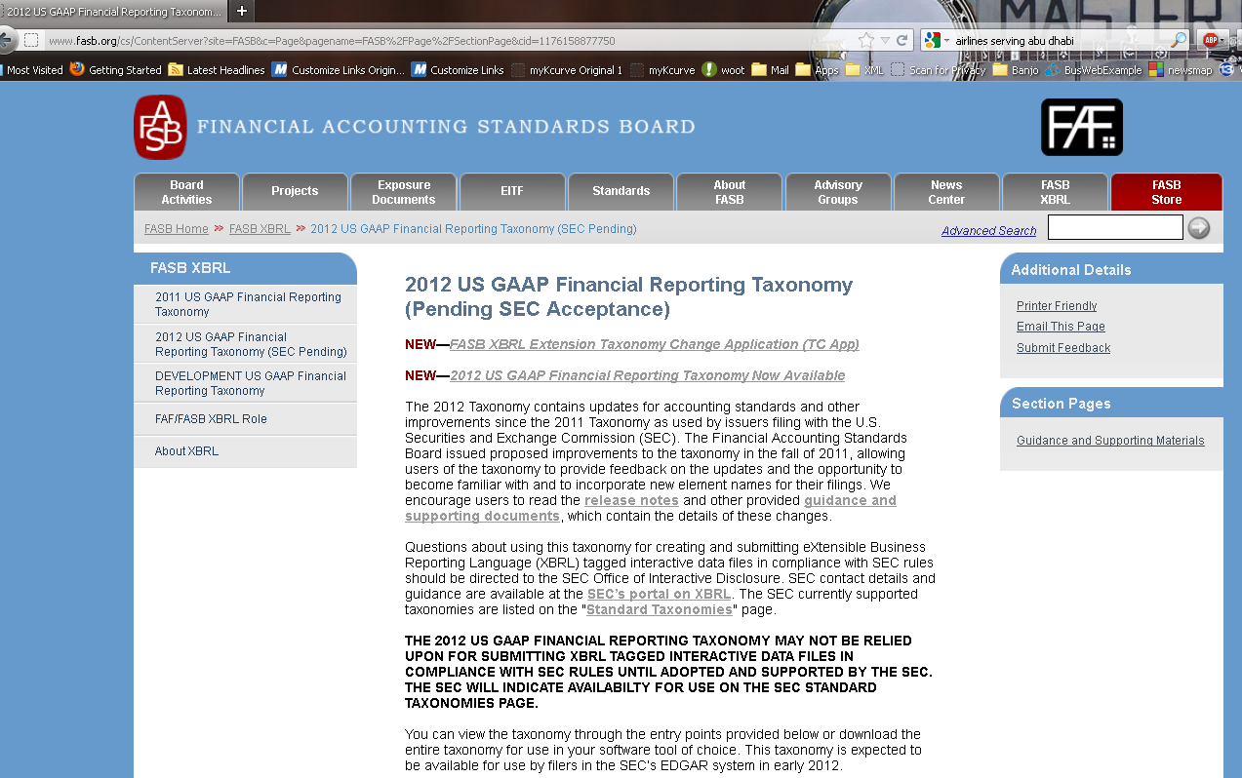
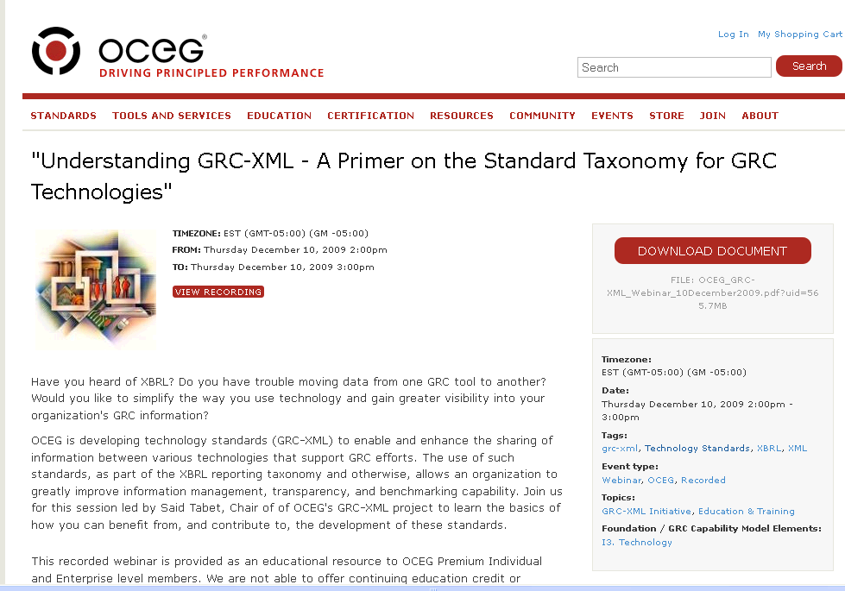
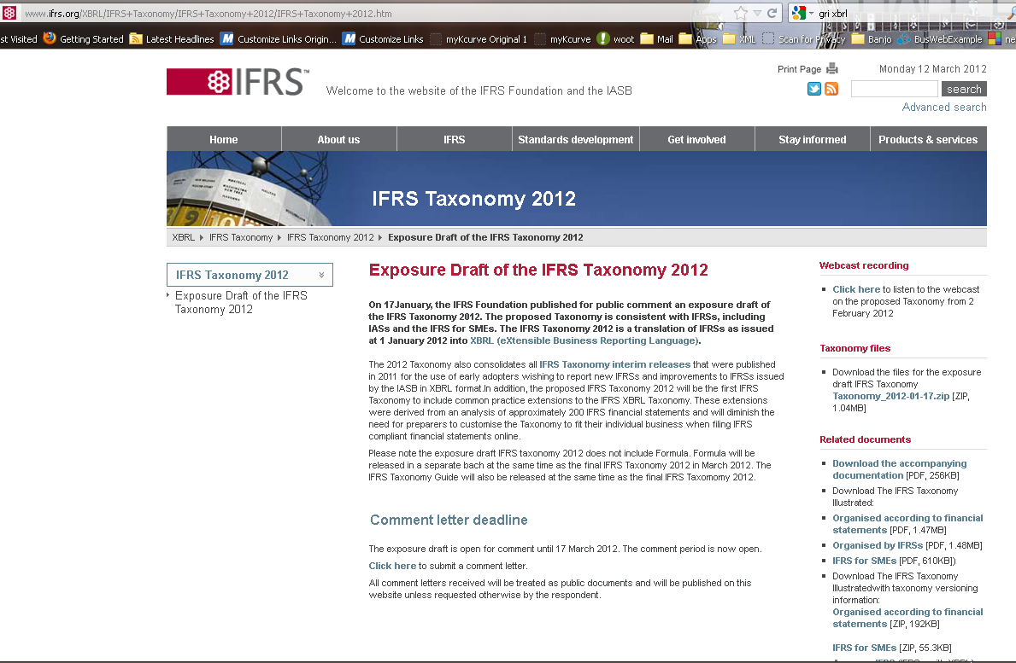
Global Agreement

Slide 46
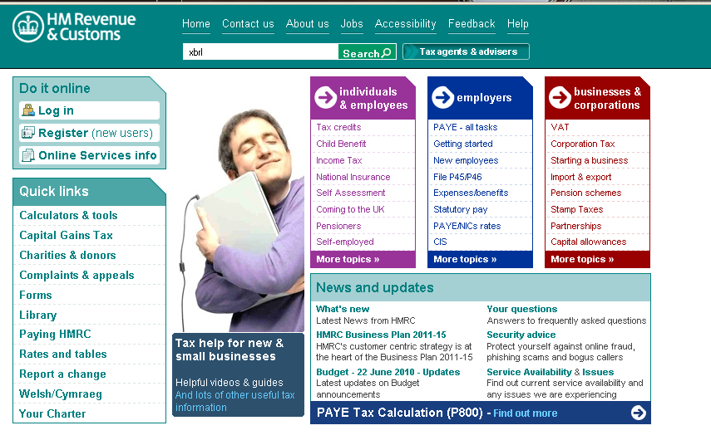
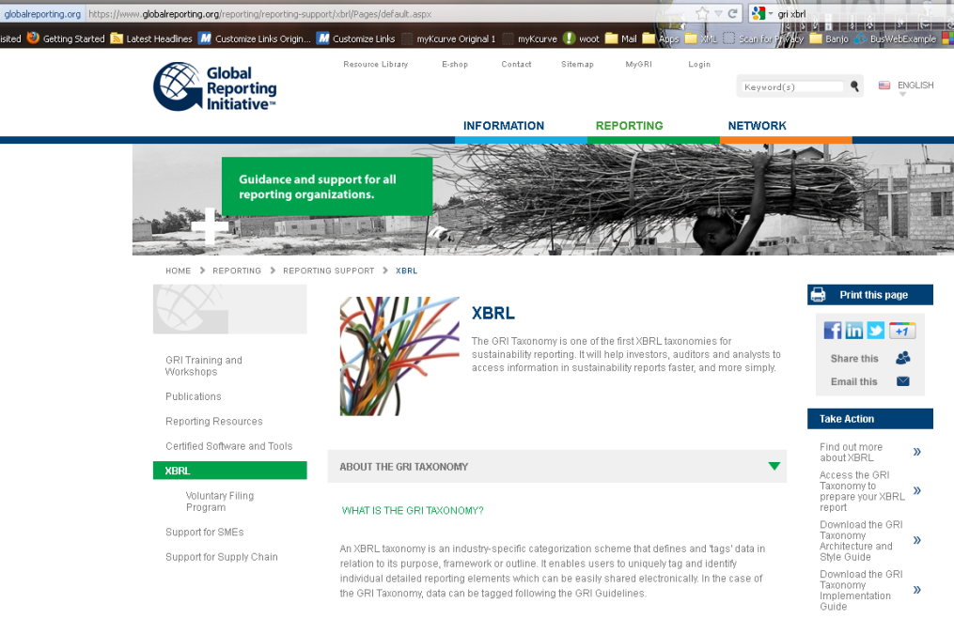
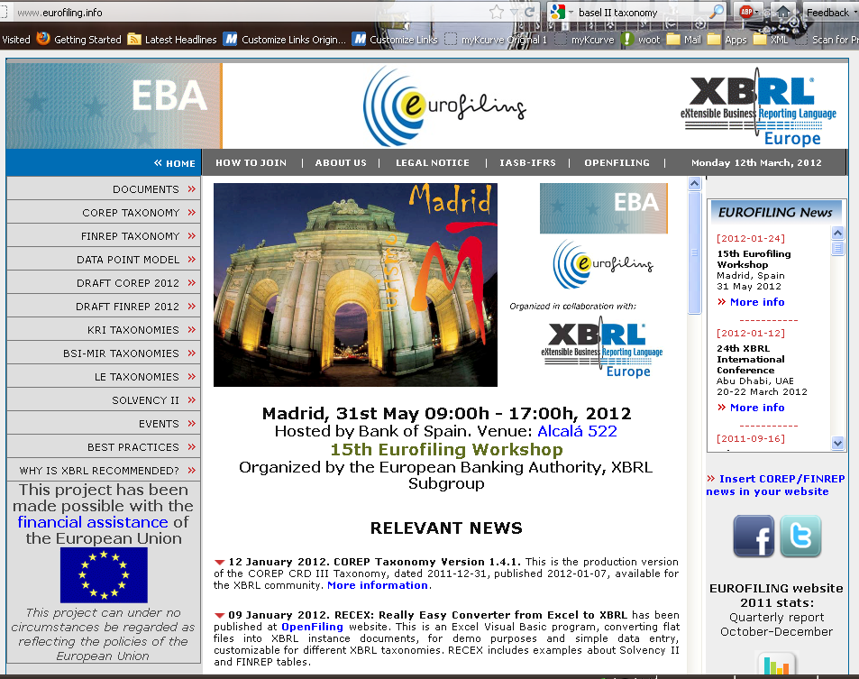
Important Connections

Slide 47
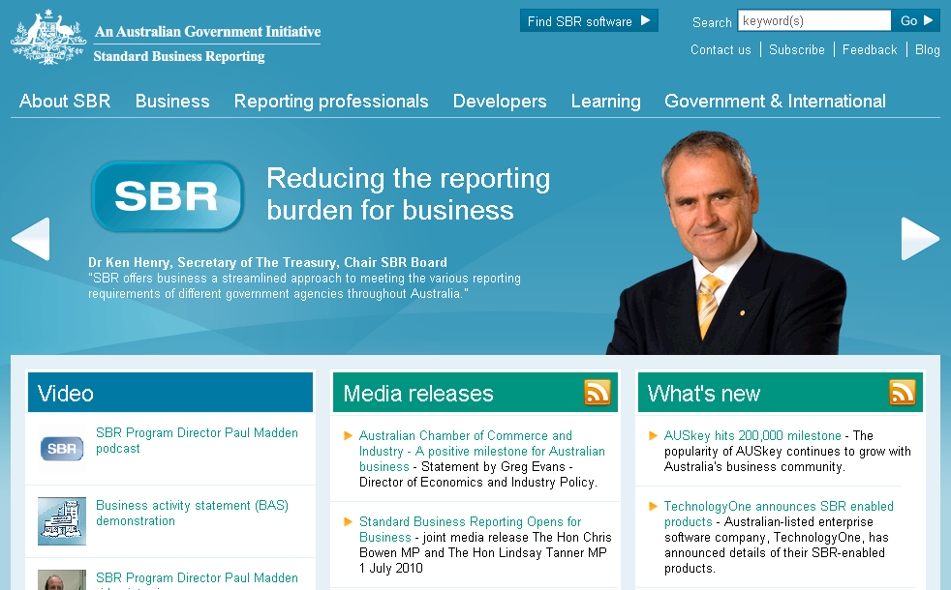
SBR in Australia
Reducing the reporting burden for business

Slide 48
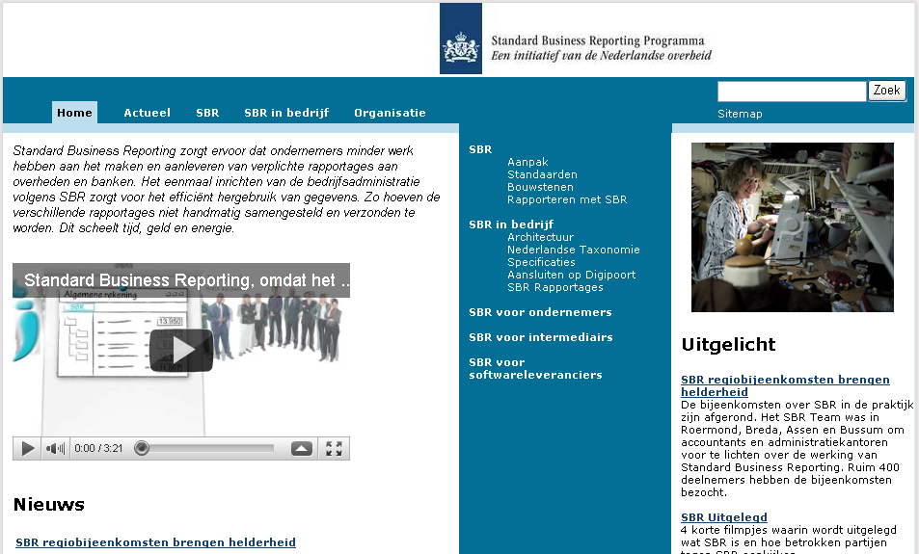
SBR in the Netherlands
Reducing Reporting Burden

Slide 49
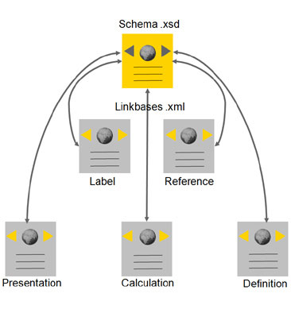
XBRL basics session
XBRL basics refresher – taxonomy basics
Schema
The XBRL taxonomy schema file defines the actual concepts (elements) that form the basis of a taxonomy. It stores the name, data type, period type, how they can be utilized, etc.
Linkbases
An XBRL linkbase file contains the explicit relationship definitions between the concepts defined in the XBRL schema.
1) The label linkbase allows the user to associate various labels with different roles and languages to a given concept.
2) The reference linkbase allows the user to associate external information (authoritative sources) to concepts.
3) The presentation linkbase defines how concepts are nested and ordered.
4) The calculation linkbase defines how concepts sum up from one to another.
5) The definition linkbase allows for additional semantics and relationships (dimensions)
Notes:
3 Minutes

Slide 50
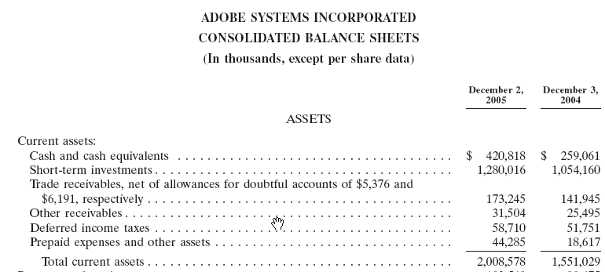
XBRL Instance Document
Contains business data
Constrained by the taxonomy (or taxonomies)
Provides contextual info. – Units of measure, Entity, Period and more
Subject to technical and data validation

Slide 51
<us-gaap:Land unitRef="usd" contextRef="c0_AsOf31Dec2011" decimals="0">5163093</us-gaap:Land>
<us-gaap:Land unitRef="usd" contextRef="c1_AsOf31Dec2010" decimals="0">5139018</us-gaap:Land>
<us-gaap:BuildingsAndImprovementsGross unitRef="usd" contextRef="c0_AsOf31Dec2011" decimals="0">32855932</us-gaap:BuildingsAndImprovementsGross>
<us-gaap:BuildingsAndImprovementsGross unitRef="usd" contextRef="c1_AsOf31Dec2010" decimals="0">32156841</us-gaap:BuildingsAndImprovementsGross>
<us-gaap:MachineryAndEquipmentGross unitRef="usd" contextRef="c0_AsOf31Dec2011" decimals="0">338275</us-gaap:MachineryAndEquipmentGross>
<us-gaap:MachineryAndEquipmentGross unitRef="usd" contextRef="c1_AsOf31Dec2010" decimals="0">280636</us-gaap:MachineryAndEquipmentGross>
<hero:RealEstateGrossBeforeLandHeldForDevelopment unitRef="usd" contextRef="c0_AsOf31Dec2011" decimals="0">38357300</hero:RealEstateGrossBeforeLandHeldForDevelopment>
<hero:RealEstateGrossBeforeLandHeldForDevelopment unitRef="usd" contextRef="c1_AsOf31Dec2010" decimals="0">37576495</hero:RealEstateGrossBeforeLandHeldForDevelopment>
<us-gaap:RealEstateAccumulatedDepreciation unitRef="usd" contextRef="c0_AsOf31Dec2011" decimals="0">5381026</us-gaap:RealEstateAccumulatedDepreciation>
<us-gaap:RealEstateAccumulatedDepreciation unitRef="usd" contextRef="c1_AsOf31Dec2010" decimals="0">4504925</us-gaap:RealEstateAccumulatedDepreciation>
<hero:RealEstateNetBeforeLandHeldForDevelopment unitRef="usd" contextRef="c0_AsOf31Dec2011" decimals="0">32976274</hero:RealEstateNetBeforeLandHeldForDevelopment>
<hero:RealEstateNetBeforeLandHeldForDevelopment unitRef="usd" contextRef="c1_AsOf31Dec2010" decimals="0">33071570</hero:RealEstateNetBeforeLandHeldForDevelopment>
<hero:LandHeldForDevelopment unitRef="usd" contextRef="c0_AsOf31Dec2011" decimals="0">558466</hero:LandHeldForDevelopment>
<hero:LandHeldForDevelopment unitRef="usd" contextRef="c1_AsOf31Dec2010" decimals="0">558466</hero:LandHeldForDevelopment>
<hero:LandDevelopmentCosts unitRef="usd" contextRef="c0_AsOf31Dec2011" decimals="0">1607600</hero:LandDevelopmentCosts>
<hero:LandDevelopmentCosts unitRef="usd" contextRef="c1_AsOf31Dec2010" decimals="0">1482571</hero:LandDevelopmentCosts>
As a preparer or analyst you don’t need to view or read these files.

Slide 52
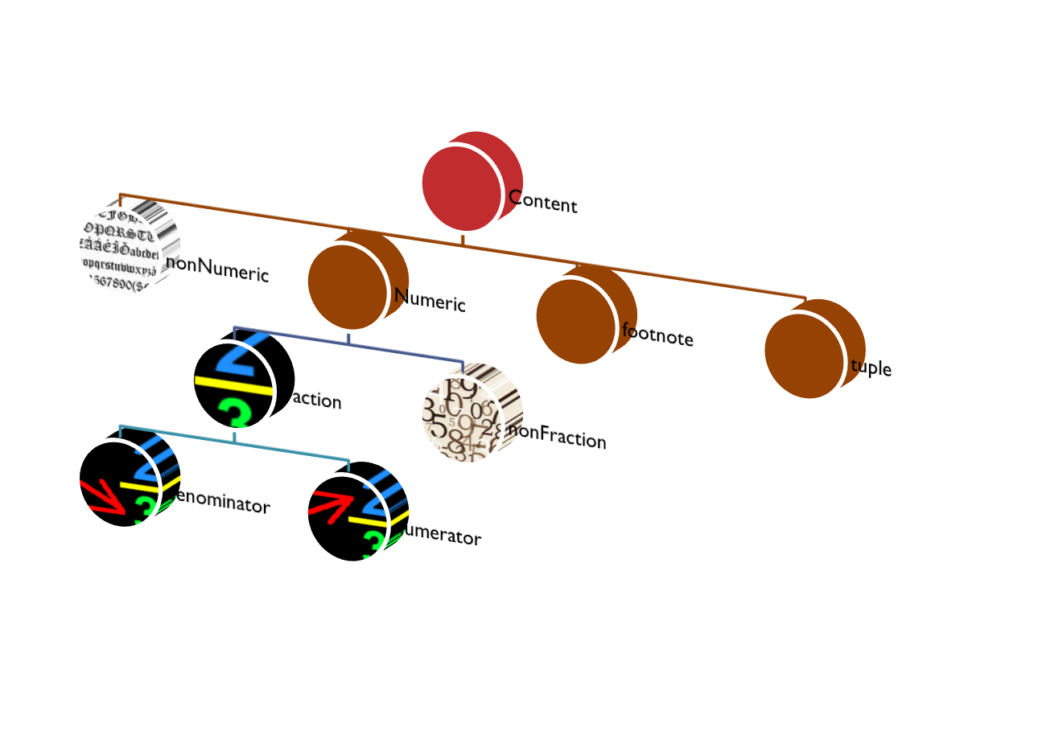
In an Instance Document
Contexts
Entities and segments
Dates
Scenarios
Units

Slide 53
Specification and Its Modular Extensions
Adding functionality to the Specification without “modifying” the Specification itself.

Slide 54
Recommendations
XBRL 2.1 Specification
Dimensions 1.0
Formula 1.0 Specification
Generic Links
Inline XBRL (Rendering) Specification
Registry (for Formula)
Transformation Registry v2 (for Inline HTML)
XBRL Global Ledger Taxonomy Framework
Proposed Edited Recommendations
XBRL 2.1 Specification
Dimensions 1.0
Variables 1.0
Match Filters 1.0
Generic Labels
Function Definitions
Proposed Recommendations
Generic Preferred Label 1.0
Units Registry – Structure, Process
Candidate Recommendations
Formula Tuples 1.0
Variables-Scope Relationships 1.02
Formula Extensions Modules
Versioning Specification - Base, Concept Basic and Concept Extended
Public Working Drafts
Table Linkbase 1.0
XBRL Abstract Model 1.0
Versioning for Dimensions
Dimension Filters 1.0
Formula Extension Modules

Slide 55
Inline XBRL
XML is about separation between content and context (always good) and fixed presentation (with its necessary regional and functional limitations)
XBRL bridges certain practical challenges of stripping away presentation and leaving only the content and context
Inline XBRL reintroduces HTML through a flexible connection between what you see (the HTML) and what it may mean (the XBRL)

Slide 56
Every System as XBRL
Across language
Across data definitions
Across file formats
System 1
System 2
System 3
XBRL GL
XBRL GL
XBRL GL
Account#
Description
Amount
PostDate
勘定科目番号
勘定科目説明文
金額
転記日付
Identificador de la Cuenta
Descripción Principal de la Cuenta
Monto Monetario
Fecha de Asignación/Ingreso
accountMainID
accountMainDescription
amount
postingDate
accountMainID
accountMainDescription
amount
postingDate
accountMainID
accountMainDescription
amount
postingDate

Slide 57
Join Us, Working Together
Gain efficiencies today
While building the foundation for revolutionizing business reporting
Data, processes, rules
For the benefits of everyone in the BRSC
A technical standard for the seamless process of exchange across all audit processes, internationally.
So that a piece of business information, once entered into a computer anywhere, never needs to be retyped as it flows through the business reporting supply chain
From first transaction or business event on through direct or derived use

Slide 58
XBRL and You
Resources of XII
  Web site
    http://www.xbrl.org
    Web site of your jurisdiction or region
  Mailing lists
    XBRL International*
    Yahoo Groups
  Wiki*
  SVN*
*Members only

Slide 59
XBRL and You (Cont.)
Great sessions
Ask the Experts

Slide 60
Have a Great Conference!
Eric E. Cohen
  eric.e.cohen@us.pwc.com

