Slide 1


Features and Status
open source xbrl platform
May 31, 2012

Slide 2

Why?
Response to XSB survey for open source
Foster wider XBRL adoption
Easy-to-learn, compact implementation
Support for XBRL versioning, formula
Fully integrated test suite, RSS feeds
Plug-in extension architecture

Slide 3
What?
XBRL can be loaded, viewed, validated
  Instances, DTSes, Version reports, RSS feeds
  DTS comparisons
  Formula checks
Users can interact directly
  Desktop GUI, Command line, Web Services
Programmers can use features
  API and plug-in access to all features

Slide 4
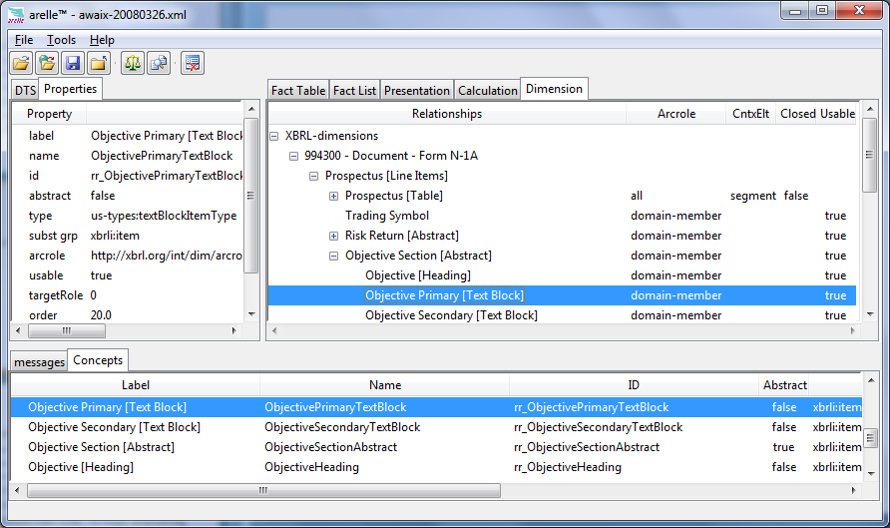
DTS View
screenshot

Slide 5
Implementation
Python 3.2
  Acceptance by financial modeling community
  Reputed high productivity
  No fee-licensed content
Python-specific object model and API
Fresh new code, no reuse of anything
GUI, Command-line, Web-services API
Notes:
Graphics are based on tkinter, which is the only Python graphics with no licensing restrictions

Slide 6

Licensing
Use under Apache 2 license
  No GPL
Contribution under Apache’s Agreements
Copyright, trademark owner is Mark V
  Trademark registered in US, EU

Slide 7
Current Features
XBRL loader/viewer
  instance, inline XBRL, DTS, RSS feed
Integrated test case facility
Validation
Desktop GUI
Command line operation
API examples

Slide 8
Validation
XBRL Specifications
  2.1 Base Spec, Dimensions
  Generic linkbase
  Formula linkbase
  Versioning report
  Units registry
Disclosure systems
  Edgar, Global Filer Manuals

Slide 9



Disclosure Systems
Disclosure system parameters
  Edgar or GFM (rules to apply)
  Standard taxonomies xml file
  Identifiers scheme, format
  Role definitions format
  Label checks (xml, Unicode whitespace)
  DEI element names
  Filer identification

Slide 10
Integrated Test Suite Operation
Test suite object model integration
Load/view/run test cases
Encourage use of test suites
  User-developed suites
  Users can run standard suites
  GUI and Batch operation
Plug-in validation extensions

Slide 11
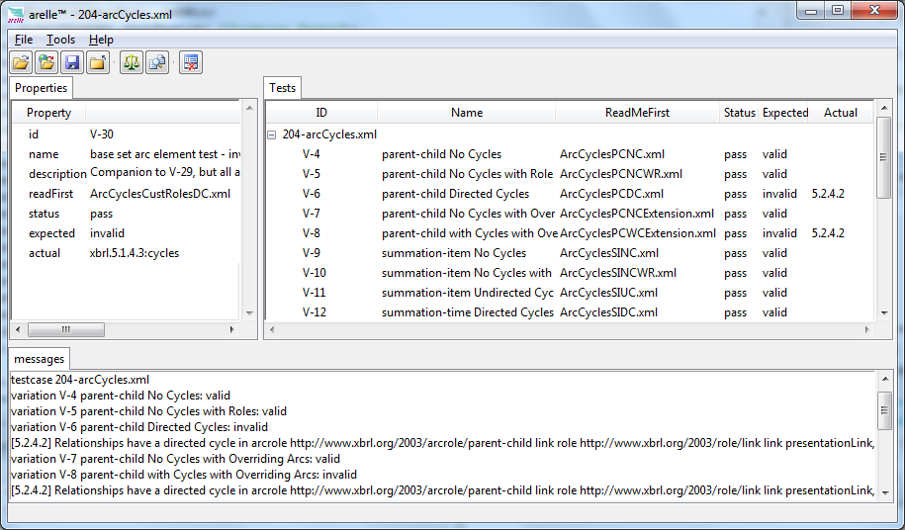
Integrated Test Suite View

Slide 12
Versioning
Produce versioning reports
  Load two DTSes
  Diff produces versioning report
Consume versioning reports
  Validates to CR specifications

Slide 13
Formula linkbase
Formula instance output & assertions
Load formulas, validate
  Debug traces and steps
  Full conformant implementation
  Optimization

Slide 14
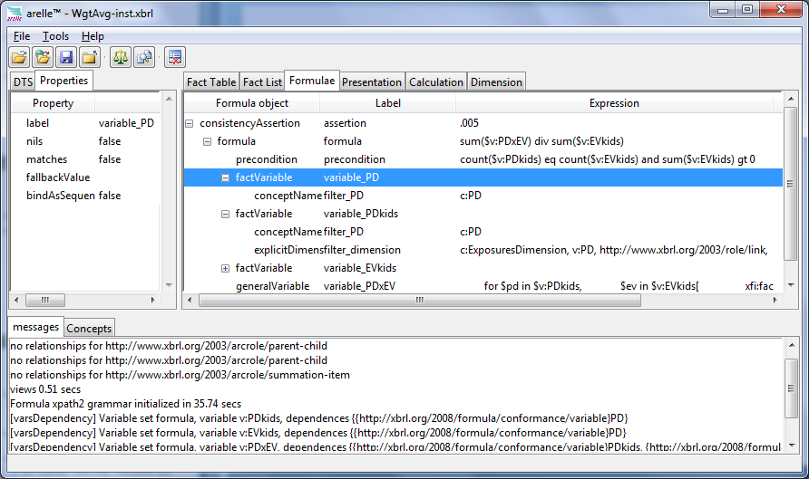
Formula View

Slide 15
“Table” Linkbase
Linkbase view
  Tables, axes, coordinates, labels
  Primary items, dimensions
  GUI and HTML output
Table view, editing, and entry
Validation checks
  Primary items, dimensions, other T.B.D.
Eurofiling and prototype of XII syntax

Slide 16
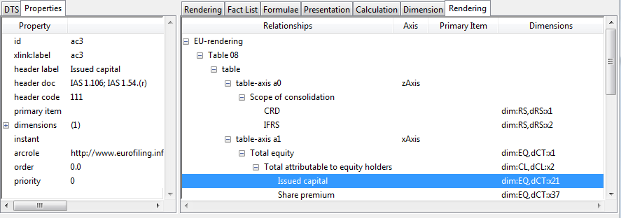
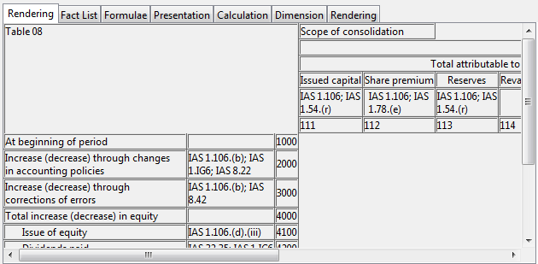
Table Linkbase Views

Slide 17
Integrated RSS Feed Watching
RSS feed object model integration
Watch criteria (e-mail alerts)
  Text (regex) match
  Formula assertion
Motivate XBRL Formula Use
  User formulas to watch filings
  (Better use of your PC than SETI?)

Slide 18
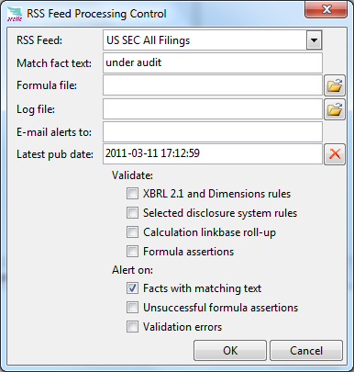
RSS Feed Control

Slide 19
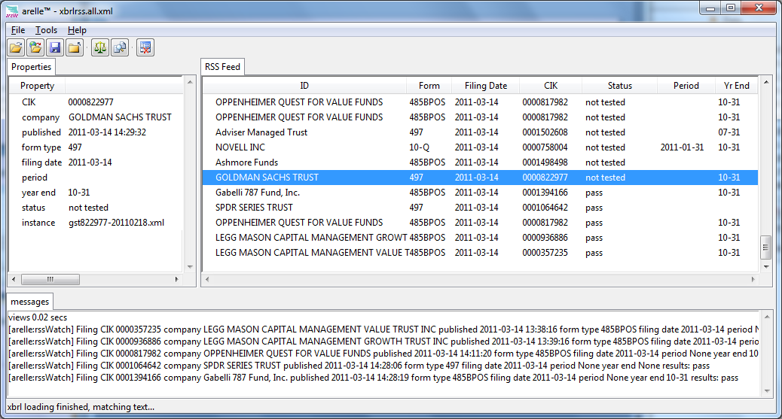
RSS Feed View

Slide 20
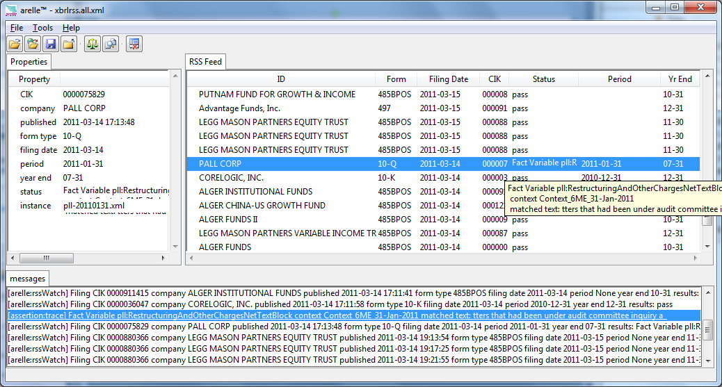
Text matched!

Slide 21
MVC Architecture
Model
  Documents, DTS objects, Vers. objects
  Formula objects
View
  GUI trees, concepts, tests, properties
Controller
  GUI (laptop), Cmd Line, Web (deferred)

Slide 22
API
Examples provided
  Validation (Vers. and Filer manuals)
  Tree walks (Linkbase and XDT)
  DTS, formula objects
Community helps evolve API
  Simplicity of {use, implementation}
  Easy to integrate {external use of API}
  Future transition to AMTF-based API

Slide 23
Performance - Optimization
At present
  Focus is open-source of features
  Memory twice of commercial products
  Dimensional optimization
  Formula optimizations
Future
  Share loaded/validated DTS components

Slide 24
Localization
String translation
  All UI strings translatable
  End users can install translations
Number localization
  Default uses system global settings
  Model for
    per-instance number format
    per-fact-unit currency format

Slide 25
Contributors and Users
Versioning developers
Disclosure system developers
Smaller country banking supervisors
RSS feed watching formulas
Plug-in extensions

Slide 26
Features for Academia
Compact code base
  41k source lines vs. 200k-500k in Java
  Small enough to be teachable
  Coverage of XBRL features
Unified object model
  XBRL, validation, formula, test and GUI

Slide 27
Adopter-driven Roadmap
  Integrated desktop support
  Versioning support
  Validation: 2.1, XDT, Formula, EFM, GFM, SBR
  XML schema validation
  Web services (REST) API
  Optimize formula execution
  OLAP ETL and support (AMTF model)
  AMTF based API
Now

Slide 28
Get Started!
http://arelle.org/download
  Pre-built app (Windows, Mac, Linux)
    Plug-ins to customize behavior
  Source on http://github.com/arelle
  Issues on http://arelle.atlassian.net
  Documentation http://arelle.rtfd.org
  support@arelle.org

