Slide 1
Validation of a XBRL Document Instance in a RDBMS, Proof of Concept.
15th EuroFiling Workshop: International Reporting.
May 31st – June 1st, 2012.
Banco de España (Bank of Spain), Madrid, Spain.
Ignacio Santos & Elena Castro

Slide 2
Summary
Summary
Introduction
Architecture
Automation Process
Conclusions
Introduction.
Architecture.
Automation Process.
Conclusions and future work.

Slide 3
Introduction I
In the past, we proposed the necessary structures and its semantic rules of the XBRL Data Model (XBRLDM) in the MDM.
WEBIST 2011, The Netherlands, May. IADIS 2011, Shanghai, China, December.
Presently we include the validation rules, but in the MDM, and the formalization of these rules, including mathematical definitions
We provide a second way to validate XBRL reports through a RDBMS.
Automatic mapping of XBRL Formulas in RDBMS.
This research work will improve the interoperability among applications (e-government and others projects).
Summary
Introduction
Architecture
Automation Process
Conclusion

Slide 4
Introduction (II)
Summary
Introduction
Architecture
Automation Process
Conclusion
Proof of Concept of mapping a XBRL report versus a RDBMS. September 5th, 2011, XBRL Openfiling 1st. General Assembly, Banca d’Italita, Rome, Italy.
FINREP 2012.
No formulas at this moment.
FINREP 2008, Bank of Spain. Report 6610.

Slide 5
Architecture (I)
We have the structure of Data and metadata in a RDBMS.
We extract the formulas through Arelle.
We generate the validation rules in a RDBMS.
We execute the validation rules.
Summary
Introduction
Architecture
Automation Process
Conclusion

Slide 6
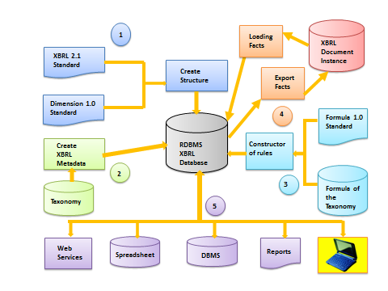
Architecture (II)
Summary
Introduction
Architecture
Automatiun Process
Conclusion
General Structure XBRL vs RDBMS

Slide 7
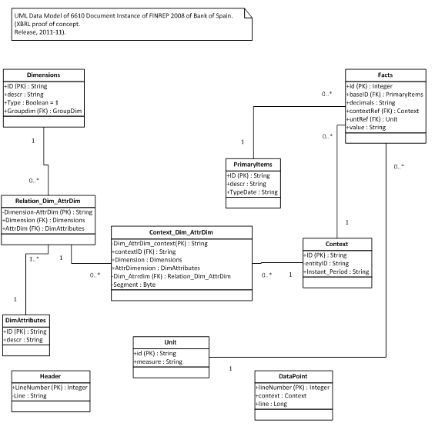
Architecture (III)
Summary
Introduction
Architecture
Automatiun Process
Conclusion
Structure RDBMS from XBRLDM (UML).

Slide 8
Automation Process (I)
Summary
Introduction
Architecture
Automation Process
Conclusion
Structure and data.
DEMO.

Slide 9
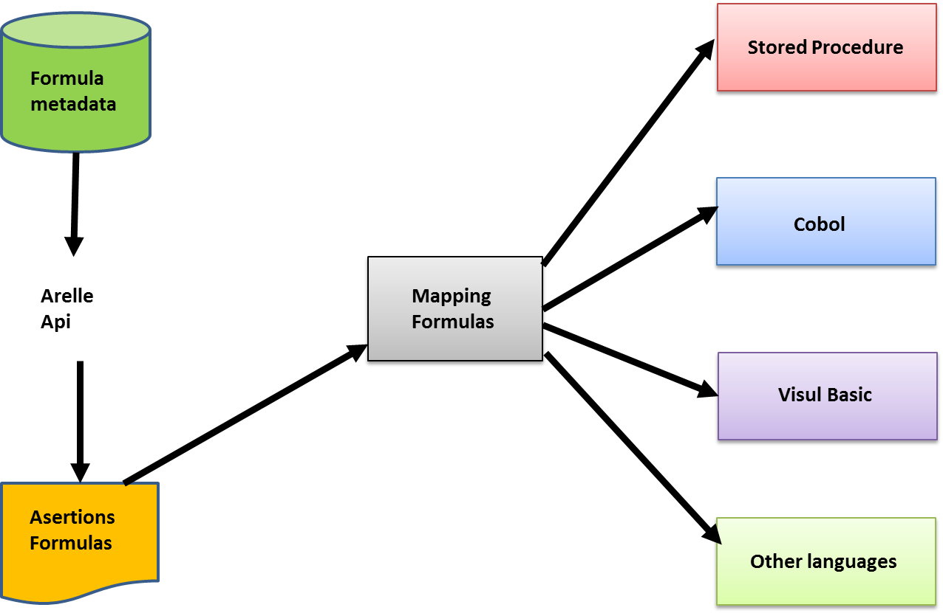
Automation Process (II)
Summary
Introduction
Architecture
Autoration Process
Conclusion
Obtaining the “api” of validation

Slide 10
Automation Process (III)
Summary
Introduction
Architecture
Automation Process
Conclusion
Arelle →Formulas
DEMO.

Slide 11
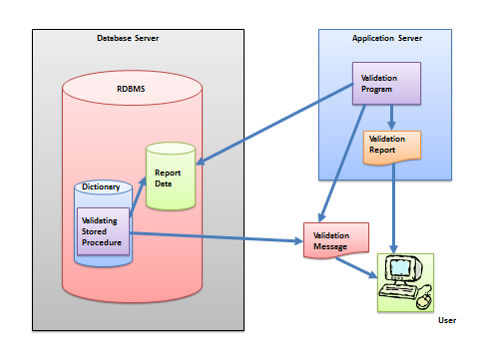
Automation Process (IV)
Summary
Introduction
Architecture
Automation Process
Conclusion
Process of validation

Slide 12
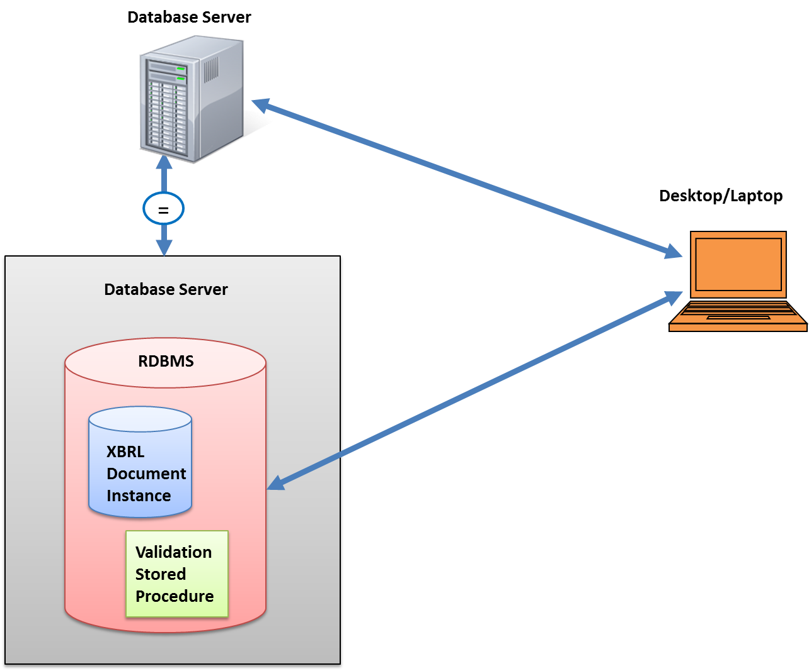
Automation Process (V)
Summary
Introduction
Architecture
Automation Process
Conclusion
Our process of validation

Slide 13
Automation Process (VI)
Validation.
DEMO.
Summary
Introduction
Architecture
Automation Process
Conclusion

Slide 14
Conclusions and future work
Mapping the validation rules.
General process.
Validation in other languages.
Automation.
Summary
Introduction
Architecture
Automation Process
Conclusion

Slide 15
Validation of a XBRL Document Instance in a RDBMS, Proof of Concept.
Ignacio Santos, ignacio.santos@bde.es
Elena Castro, ecastro@infuc3m.es

