Slide 1
IASB and XBRL
Eurofiling seminar
31 May 2012
Olivier Servais – Director of XBRL Activities
Notes:
1

Slide 2
Agenda
The IFRS taxonomy: model, adoption, due process & time line
The future of XBRL
Q&A

Slide 3
The IFRS Taxonomy

Slide 4
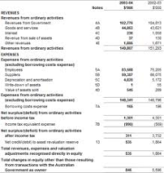
The IFRS Taxonomy: Building Blocks for Preparers
Core disclosure requirement concepts
Revenue
Guidance and example concepts
Operating profit
Common / Industry practice concepts
Sales &Marketing Expense
Local/regulatory concepts
Proved oil reserves
Software revenue
Company concepts

Slide 5
What to disclose?
73 The financial statements shall disclose (...) for (...) property, plant and equipment:
the gross carrying amount and the accumulated depreciation (aggregated with accumulated impairment losses) at the beginning and end of the period; and
a reconciliation of the carrying amount at the beginning and end of the period showing:
additions;
assets classified as held for sale or included in a disposal group classified as held for sale in accordance with IFRS 5 and other disposals;
acquisitions through business combinations;
increases or decreases resulting from revaluations under paragraphs 31, 39 and 40 and from impairment losses recognised or reversed in other comprehensive income in accordance with IAS 36;
impairment losses recognised in profit or loss in accordance with IAS 36;
impairment losses reversed in profit or loss in accordance with IAS 36;
...

Slide 6
Process and challenges for content
identify a disclosure requirement
decide how much detail is required by the disclosure requirement
decide the type of disclosure
consider labels for identified items
provide a hierarchy
indicate any relevant cross-standard disclosure requirements

Slide 7
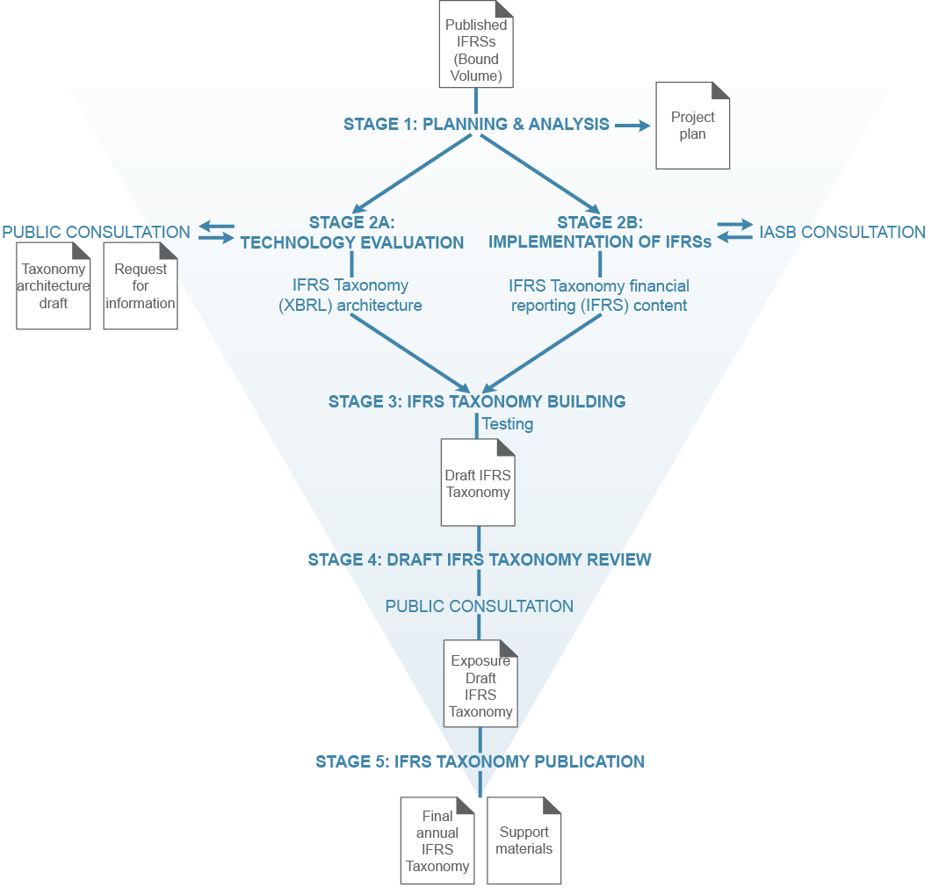
IFRS Taxonomy Due Process
Input from:
XBRL Advisory Council
XBRL Quality Review Team
XBRL international working groups
Other taxonomy developers
Regulators
Software developers
International groups:
- preparers
- financial institutions
- analysts
- users
© 2012 IFRS Foundation. 30 Cannon Street | London EC4M 6XH | UK. www.ifrs.org

Slide 8
Some statistics
Number of taxonomy items | Final 2012 taxonomy | Final 2011 taxonomy | Final 2010 taxonomy
Total | 3,769* | 2,545 | 2,027
Full IFRS (excluding the IFRS for SMEs) (1) | 3,659 | 2,426 | 1,936
IFRS for SMEs (2) | 1,138 | 1,128 | 1,026
Disclosure requirements (part A of the Bound Volume) | 2,272 | 1,851 | 1,688
Examples (part B of the Bound Volume) | 399 | 281 | 2
Common Practices | 682 | 112 | 114
*Also includes 416 technical elements without reference

Slide 9
IFRS Taxonomy: Development Timeline
End of annual taxonomy development cycle
Taxonomy
development*
XBRL Quality Review Team review
Exposure draft IFRS Taxonomy
IFRS Bound Volume
Final IFRS Taxonomy
New improved IFRSs
IFRS Taxonomy interim releases
NOVEMBER
DECEMBER
JANUARY
FEBRUARY/MARCH
MARCH
APRIL to OCTOBER
*including consolidation of IFRS Taxonomy interim releases
© 2012 IFRS Foundation. 30 Cannon Street | London EC4M 6XH | UK. www.ifrs.org

Slide 10
Adoption of the IFRS taxonomy
10
10
The following are examples of organisations that have adopted the IFRS taxonomy:
Corporate/securities filing:
Accounting and Corporate Regulatory Authority of Singapore ACRA Taxonomy;
Danish Chamber of Commerce Association, Denmark;
DART System of the Financial Supervisory Service, Korea;
Financial Services Agency of Japan EDINET;
Israel Securities Authority MAGNA platform;
Ministry of Finance, PR of China Chinese Accounting StandardsTaxonomy;
Standard Business Reporting Program in Australia and The Netherlands;
Superintendencia de Valores y Seguros información del Mercado de Valores of Chile;
Johannesburg Stock Exchange, South Africa SA Taxonomy;
Comisión Nacional del Mercado de Valores of Spain;
UK HRMC and Companies House UK-IFRS Taxonomy;
Emirates (UAE) Securities and Commodities Authority UAE taxonomy;
Microfinance Information eXchange MIX Microfinance Taxonomy
Banking/Insurance regulation:
EBA (European Banking Authority) Financial Reporting framework taxonomy;
Bermuda Monetary Authority Solvency II XBRL Taxonomy and IFRS for Insurance XBRL Taxonomy
Other XBRL (not IFRS and/or non financial) initiatives that are consistent with our development: CDP taxonomy, GRI taxonomy, EIOPA-Solvency II…
Most countries that have adopted IFRSs are also considering whether to adopt XBRL and the IFRS taxonomy. These countries include Brazil, Canada, India, Indonesia, Italy, Korea, Luxembourg, Malaysia, Mexico, Poland, Switzerland and others.
Notes:
10

Slide 11
Activities for 2012
Update of the core taxonomy, with interim releases, and related tools, materials & translations
Improvement of the common practice (DTTF)
Industry related concepts (FI, insurance & extracting activities)
Release of Documentation labels
Outreach activities
Webinar during ED
IFRS Taxonomy Annual Convention (25th April 2012)
F2F meetings (Australia, Malaysia, Singapore, US, Japan, China, UAE..)
Website, quarterly newsletter…

Slide 12
The future of XBRL

Slide 13
Trends in …
… leadership
… enforcement
… engagement
… regional adoption
… specs
… filing format
… tools & applications
… content
… filing requirements
… user engagement
And … one more thing

Slide 14
Questions or comments?
Expressions of individual views by members of the IASB and its staff are encouraged. The views expressed in this presentation are those of the presenter. Official positions of the IASB on accounting matters are determined only after extensive due process and deliberation.
Notes:
14

