Slide 1
German Banking Supervisory IT Systems
Overview, Architecture, Challenges
Katrin Heinze

Slide 2
Agenda
German reporting situation
Objectives and requirements on the new banking supervisory IT systems
Target architecture
Open issues and questions
Seite 2

Slide 3
German reporting situation
ExtraNet
…eBusiness infrastructure for business processes between Deutsche Bundesbank and external partners, using internet technology
Services:
Data transfer (manual or automated file upload and download)
Data entry component (HTML forms based on XBRL definitions)
Banking supervisory, status quo of 03.04.2012
Registered users: 19.600
Connects… using functions: number at last quarter:
Manual web form input 6.000
File transfer upload 9.480
Seite 3

Slide 4
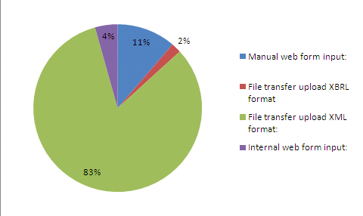
German reporting situation
banking supervisory information
Data entry (sample: number of solvency regulation, liquidity regulation; monthly return)
Manual web form input: 4.785
File transfer upload XBRL format 804
File transfer upload XML format: 34.851
Internal web form input: 1.838
(December 2011)
Seite 4

Slide 5
Agenda
German banking sector and reporting situation
Objectives and requirements on the new banking supervisory IT systems
Target architecture
Open issues and questions
Seite 5

Slide 6
Objectives and requirements on the new banking supervisory IT systems
Stakeholder (C2A, A2A)
Bundesbank: banking supervision (B)
Bundesbank: financial system stability (F)
BaFin *: banking supervision
EBA/ESRB, ECB and other NSA in Europe
Requirements
national
collecting reports relating to banking supervision
providing of a technical infrastructure for supervisory reporting and data analysis
international
information providing for all stakeholders
* Federal Financial Supervisory Authority
Seite 6

Slide 7
Agenda
German banking sector and reporting situation
Objectives and requirements on the new banking supervisory IT systems
Target architecture
Open issues and questions
Seite 7

Slide 8
Target architecture Following the IT strategy by using standard software
tight time constraints
shortage of human resources
IT strategy
rapid evolution of the technology
Why using standard software?
core XBRL processing components
cost and time saving
high quality
close to specification
Seite 8

Slide 9
Target architecture DPM as metadata for all components
Area specific computations
COREP
…
LE
Invoke, XWand
Oracle
XBRL-Extension
SAP-BI
Common Data Entry
Common operational XBRL database
Comprehensive Reports and Analysis
Own implementation
DPMs / Taxonomies
Seite 9

Slide 10
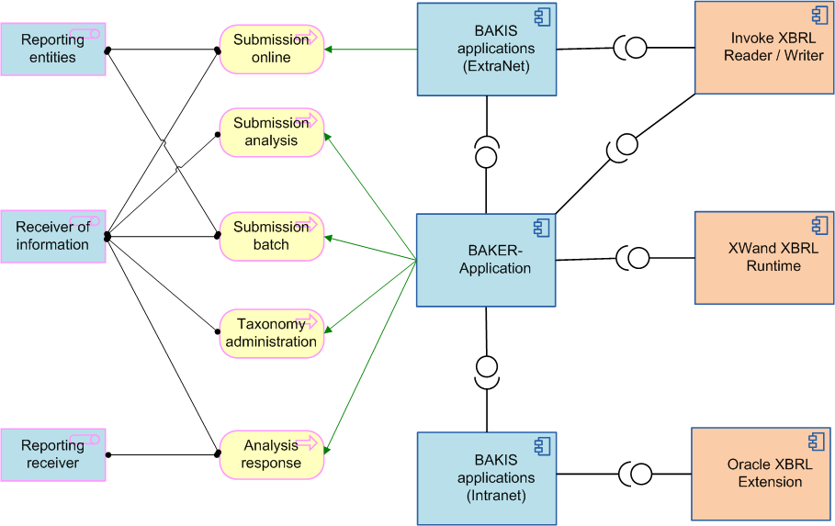
Target architecture BAKER: Common reporting platform
Seite 10

Slide 11
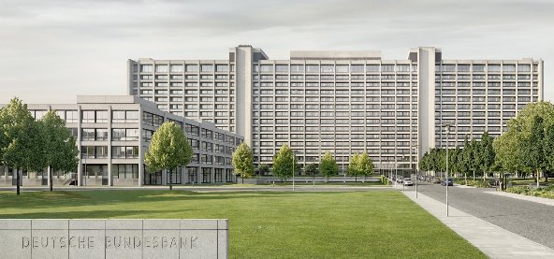
Target architecture Data entry and processing
Feedback
Fomula Validation
and electronic
feedback
Submitter
Supervisor
Seite 11

Slide 12
Target architecture Data entry and processing - Challenges
Moving targets
New business requirements
New technology
New people working together
New processes
Dimensions replace positions: substantial changes in business thinking
Substancial and costly changes for financial institutions
Open requirements, ambiguous specifications
New technology
Use of standard software
High demands on the will and ability for change
High demands for training
Time pressure
Highly professional and respectful
Seite 12

Slide 13
Agenda
German banking sector and reporting situation
Objectives and requirements on the new banking supervisory IT systems
Target architecture
Open issues and questions
Seite 13

Slide 14
Open issues and questions
How to extend the European taxonomies?
Quality requirements
Rules defined in a common filing manual?
Information about the management of different taxonomy/DPM versions
How to deal with cross-taxonomy validations?
How to include German translation on DPMs/taxonomies on time?
How to deal with English DPMs/taxonomies in the meantime?
How to deal with corrections after the final reporting date for the submission to EBA?
Seite 14

Slide 15
Thank you for your attention!
√

