Slide 1
FINREP translations
Derek De Brandt, XBRL Europe
February 2013

Slide 2
Objective of this presentation
Explain the XBRL Case: translating the FINREP taxonomy
Background to the COREP case (slide 4-6)
Background to the FINREP case (slide 7-10)
FINREP, December 2012 (slide 11-17)
  Input from the draft FINREP XBRL taxonomy
  Result with language pairs (en-de-nl)
  Visualisation back and from the XBRL taxonomy

Slide 3
General comments
The COREP / FINREP XBRL case has external dependencies:
Release of the XBRL taxonomies by EBA (1 for COREP, 1 for FINREP)
Translation of the underlying Directives by Europe
February 2013:
Monnet is technically capable to translate both COREP and FINREP
FINREP draft taxonomy available since December 2012
First taxonomy translation case: FINREP in German
Next steps:
FINREP and COREP translation is further picked up by XBRL Europe and the Eurofiling community with MT, as soon as Taxonomies and translation base are available.

Slide 4







COREP Background
Basel - CRD
Directives 2006/48/EC and 2006/49/EC = Capital Requirements Directive (CRD) Directives 2009/27/EC, 2009/83/EC and 2009/111/EC amendments = CRD II
Transcription of BIS Basel II Guidelines
REGULATORY REQUIREMENTS
REGULATORY TEMPLATES
Guidelines on Common Reporting and Financial Reporting
COREP/FINREP TAXONOMIES
COREP Taxonomy V1.3.0 (2010-01-06) + 2012 Release (Draft 2010-07-20)

Slide 5


COREP Background
COREP 1.3.0
CAPITAL ADEQUACY RATIO
2
CA, GROUP Solvency Details
CA
Capital Adequacy
Group Solvency Details
Own Funds
CR SA, SEC SA
CR IRB, EQU IRB, SEC IRB
CR SEC Details, CR TB SETT
CR
Credit Risk, Standard Approach
Securitizations, Standard Approach
Credit Risk, Internal Rating Based Ap.
Securitizations, Internal Rating Based Ap.
Securitizations, Details
Trading Book Settlement Risk
CREDIT RISK CR
7
MKR
Market Risk, Standard Approach
- Traded Debt Instruments
- Equities
- Foreign Exchange
- Commodities
Market Risk, Internal Models
Internal Models, Details
MARKET RISK MKR
6
MKR SA TDI, SA EQU, SA FX, SA COM
MKR IM, IM Details
OPERATIONAL RISK OR
3
OR OPR, OPR Loss, OPR Loss Details
OR
Operational Risk
Operational Risk, Gross Losses
Operational Risk, Major Losses

Slide 6
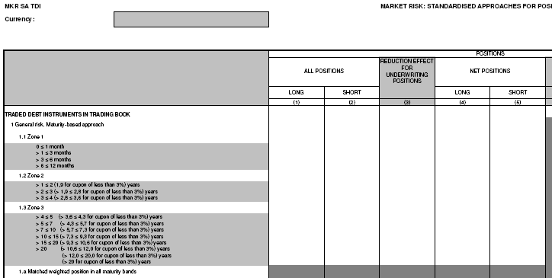
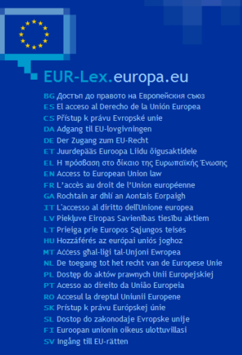
COREP Background
COREP Templates
CRD TRANSLATED IN VARIOUS LANGUAGES

Slide 7

FINREP Background
IFRS and Regulatory Reporting
Transcription of IAS/IFRS from IASCF Publications
REGULATORY REQUIREMENTS
REGULATORY TEMPLATES
GL06 CEBS Revised Guidelines on Financial Reporting 15 December 2009
FINREP TAXONOMY
FINREP Taxonomy V1.3.1 (2009-07-16) + 2012 Release (Draft 2010-05-12)

Slide 8
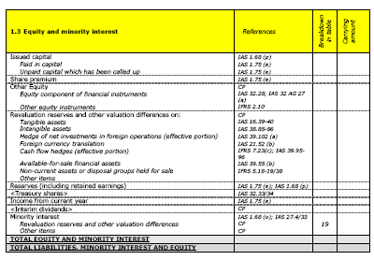
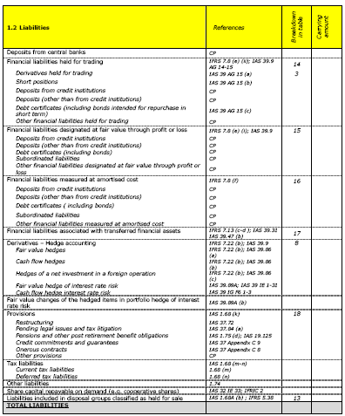
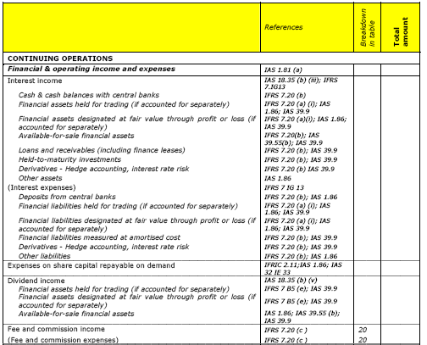
FINREP Background
FINREP 1.3.1
BS (FIN1)
ZOOM
Details BS (FIN3→19)
Capital + MI
Assets
Liabilities
IS (FIN2)
ZOOM
Details IS (FIN20→29)
Annexes (FIN30+)
BS = Balance Sheet
IS = Income Statement

Slide 9
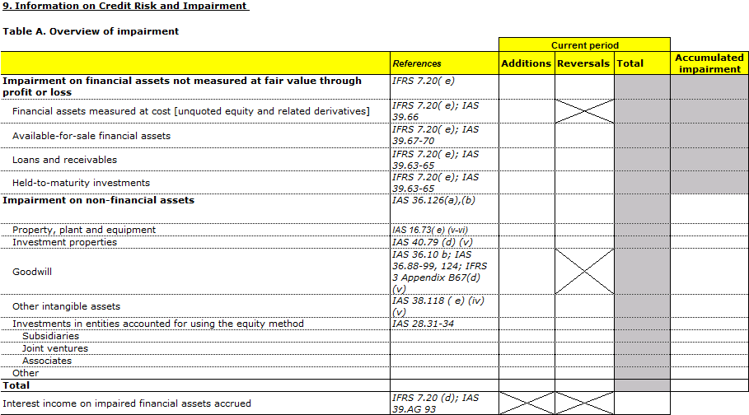
FINREP Background
FINREP templates
REFERENCES TO IAS/IFRS AVAILABLE IN MANY LANGUAGES

Slide 10


COREP & FINREP Requirements
Both frameworks consist in a set of material
in English, which is subject to translation
ANDREAS
THE REGULATOR
Guidelines and legislation
Templates (presentation layer)
XBRL Taxonomy set and corresponding documentation
Having COREP and/or FINREP frameworks available in other languages will significantly increase cross-Europe adoption and enhance transparency
Translation requirements similar to the IFRS translator
Additional requirements on translating the templates
Additional requirements on translating the documentation : data model, architecture, etc.

Slide 11
FINREP, DRAFT XBRL TAXONOMY
December 2012
Step 1: from CRD regulation and IFRS standards to templates
Step 2: from templates to XBRL Taxonomy
- templates contain text labels
- templates contain references to IFRSs and regulation
Step 3: from XBRL Taxonomy to ontology
Step 4: automatically translate with Monnet Translation techniques
Step 5: enrich XBRL Taxonomy with translated labels
Step 6: automatically render templates from Taxonomy in new language

Slide 12
Step 1: from regulation to templates
Transcription of IAS/IFRS from IASCF Publications
REGULATORY REQUIREMENTS
The European regulator defines the templates representing the information which will be required to be reported by regulated entities. Templates are only available in English.

Slide 13
Step 2: from templates to XBRL taxonomy
The templates are analysed and converted in a dimensional datamodel, as preparation to the XBRL taxonomy, with only English labels.
DATA MODELLING
FOR XBRL TAXONOMY CREATION
FINREP XBRL TAXONOMY

Slide 14
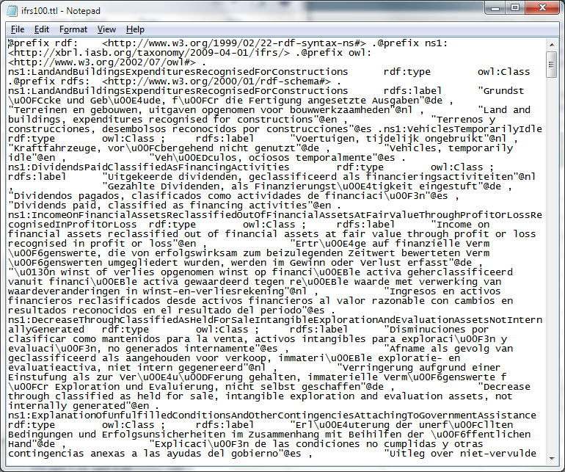

Step 3: from XBRL Taxonomy to ontology
XBRL format
(label, XML linkbase)
FINREP XBRL TAXONOMY
The English label sets are transformed from the XBRL Taxonomy into the Monnet turtle format.
Monnet turtle format

Slide 15
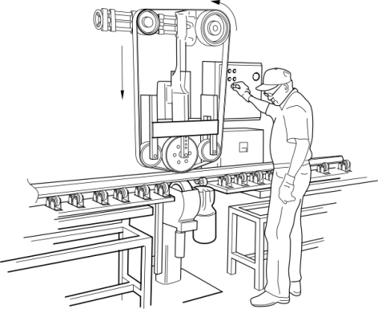




Step 4: translate with MT
MT
Automatic handling of turtle by MT

Slide 16
Step 5: enrich taxonomy with translations
Monnet turtle format
Integration of translated
labels into the XBRL taxonomy
FINREP XBRL TAXONOMY
** TRANSLATED VERSION
XBRL format
(label, XML linkbase)

Slide 17
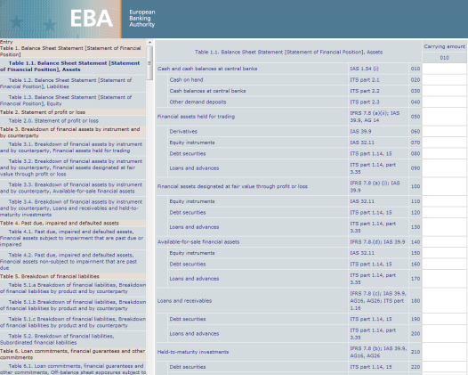
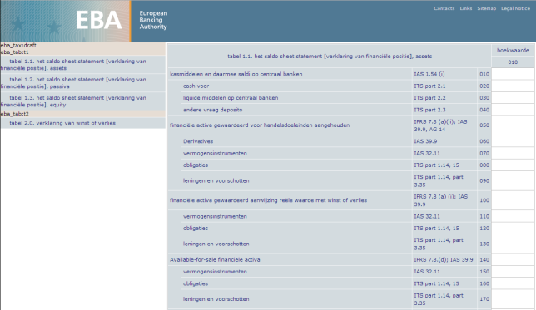

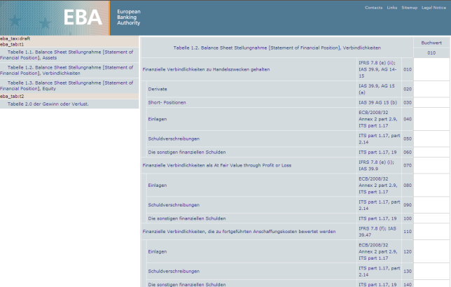

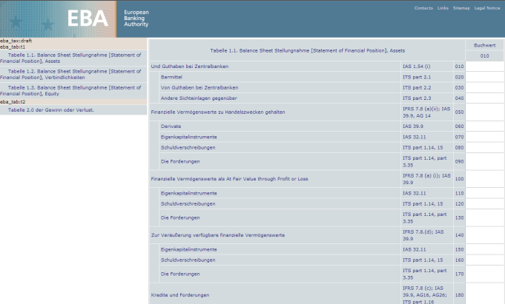
Step 6: automatic rendering of tables
XBRL tools automatically
display tables in the selected
label language role from the translated taxonomy
FINREP XBRL TAXONOMY
** TRANSLATED VERSION

