Slide 1
CRD IV to the XBRL Taxonomy Technical Topics
10 December 2013 | Luxembourg
Owen Jones | CRR Taxonomy Project EBA

Slide 2
Outline
The taxonomy – purpose, history and structure
The modules/entry points
Filing Indicators
Accompanying documents
Architecture document
Filing Rules
Table layout rendering
Validation rules
The future

Slide 3
EBA XBRL Taxonomy
Main purpose:
Data transmission from ‘Competent Authorities’ to EBA
“Secondary reporting”
Regulations
Transmit to EBA
Report to SA
Templates
DPM
Taxonomy
Transmit to EBA
Instructions
Validations
Understand Requirements
EBA Business experts
EBA IT experts
CA IT experts
Credit Institutions
Many authorities will use (nearly) the same for primary reporting

Slide 4
Primary Reporting
For primary reporting (Credit Institution to CAs)
each CA may, at their discretion:
Use the EBA taxonomy
Modify the EBA taxonomy
Build their own XBRL taxonomy
Not use XBRL at all
But they all must produce
EBA format XBRL files to send to the EBA
EBA XBRL
CI
CA
Modified XBRL
CI
CA
EBA
Own format
EBA XBRL
CI
CA

Slide 5
History of the taxonomy – how did we get here?
FINREP Prototype (2012)
Public Consultation (Sep/Oct 2013)
Publication
(01 Dec)
First Reporting (End May 2014)
Proof of Concept (2011)
Final draft ITS/DPM (Jul 2013)
ITS/DPM update
(Oct 2013)
CRR Implementation 01 Jan 2014
EBA rollout,
CA adoption or modification

Slide 6
Contents of the taxonomy
At the base – a dictionary of concepts, describing the COREP and FINREP subject area.
But also,
Definition and Table linkbase layer
Defining the data items to be reported and layout of the reported forms
Validations
Defining and ensuring the basic relationships of the data items
Modules
Defining the units of reporting (sets of reported tables)

Slide 7
Structure of the taxonomy
Dimensions
Dictionary
Hierarchies
Domains
Members
Data Model layer
Metrics
Hierarchies
Modules
COREP
Table Groups
Tables
Reporting layer
Reporting Frameworks
Validations
FINREP
Modules
Tables
Validations

Slide 8
Structure of the taxonomy
Dimensions
Dictionary
Hierarchies
Instance Files
Domains
Members
Metrics
Hierarchies
Modules
A
B
C
COREP
Tables
1
2
3
4
5
6
Reporting Frameworks
Table Groups
Validations
v1
v2
v3
v4
v5
v6
FINREP
Modules
Tables
Validations

Slide 9
Conceptual groupings
COREP
FINREP
COREP
LCR
FINREP
Capital Adequacy
Group Solvency
Credit Risk
Operational Risk
Market Risk
Leverage Ratio
Liquidity Coverage
Part 1
Part 2
Part 3
Part 4
Part 5
NSFR
LE
Net Stable Funding Ratio
Large Exposures

Slide 10
High level variations
For COREP
The key distinction is the consolidation / reporting level:
INDIVIDUAL or CONSOLIDATED
For FINREP
The key distinction is the accounting standard used:
IFRS or National GAAP

Slide 11
Modules / Reports / Entry points
Corep
Finrep
Core
Individual
Core
Consolidated
GAAP
Consolidated
LE
Solo
LE
Consolidated
IFRS
Consolidated
LCR
Solo
LCR
Consolidated
NSFR
Solo
NSFR
Consolidated

Slide 12
Remittance Control
BUT - Not every template in these groupings has to be reported
by everyone, every time they report
Frequency
Templates are monthly, quarterly, semi-annual or annual
Submission periods
different templates have different deadlines
Proportionality
Some templates only apply to some approaches
There are exit and entry criteria and materiality thresholds
The possible combinations are huge…

Slide 13
Filing Indicators - flexibility
Allow any subset of templates to form an XBRL-valid file
Reporters indicate which templates they intended to report
XBRL layer is “Flexible” rather than “Prescriptive”
Receivers may check that the templates indicated are appropriate (i.e. expected)
 | Reporter A | Reporter B | Reporter C
CA 1 | Y | Y
CA 2 | Y | Y | Y
CA 3 | Y | Y
CA 4 | Y
CA 5.01 | Y | Y | Y
CA 5.02 | Y | Y
GS | Y |  | Y
CR SA | Y
CR IRB 1 | Y

Slide 14
Filing Indicators
Instance files MUST contain XML Tuples indicating which templates are reported
<find:fIndicators>
<find:filingIndicator contextRef="c1">C_26.00
</find:filingIndicator>
<find:filingIndicator contextRef="c1">C_27.00
</find:filingIndicator>
</find:fIndicators>

Slide 15
Control of validations
ITS validation rules are included in the taxonomy as XBRL formula.
These formulae check a variety of simple things e.g.
Totals are equal to the sum of a breakdown
Accounting identities hold
Basic calculations (ratios etc.) are correct
Signs of data are correct
Values for qualitative data are valid (i.e. from the right list)
Evaluation of rules is controlled by the filing indicators
Rules only run when filing indicators for necessary tables are set

Slide 16
Control of validations: preconditions
Instance document
Perform validation
Taxonomy
table A reported?
table B reported?
Result of assertion 1
Precondition
(table A reported?)
Assertion 1
Result of assertion 2
Assertion 2
Result of assertion 3
Assertion 3
Precondition
(table B reported?)
Assertion 4
Assertion 5
Application layer
XBRL Processor

Slide 17
Understanding the taxonomy
Several key documents accompany the taxonomy:
DPM formal model
Taxonomy Architecture
Filing Rules
DPM – Table layouts and Validation rules

Slide 18
Architecture document
Describes in detail how the Data Point Model is mapped to XBRL
Documents all the components of the taxonomy.
Primary resource for anyone wishing to understand
What the taxonomy looks like
Why
What all the files and elements of those files are
How the taxonomy is expected to operate
Primarily relevant for software developers / in house development teams

Slide 19
Filing Rules
XBRL is very flexible - it can be used in a myriad of ways
For each specific use, this flexibility needs to be constrained in pre-agreed ways, so all participants can interact effectively.
We have prepared a set of “Filing rules”.
Give the detail of how an instance document should be prepared.
Based very closely on the work of the CEN XBRL Workshop
maximise harmonisation across European Supervisory reporting.

Slide 20
Filing Rules
Include
Requirements and guidance on the preparation and validation of XBRL instance documents
To ensure that CAs can send the EBA instance documents we can process.
Many CAs are likely to adopt the EBA taxonomy
Also likely to adopt in large part the EBA filing rules
Beneficial as can then send us the files they receive.
CAs may well deviate slightly from our rules / add additional restrictions to facilitate their reporting processes.

Slide 21
Filing Rules
Anyone producing CRD IV XBRL instances should
Review the filing rules
(Confirm with relevant CAs where they will follow / tweak our rules)
Ensure the instances you produce can conform to the rules
Instances not following the rules will likely be rejected by the EBA /CAs

Slide 22
Table layouts and validation rules
Show the
layout of the reported tables
DPM categorisation of the elements of the tables
unique IDs for each data point.
Easily comprehensible definitions of the validation rules
These documents are a good way of exploring the reporting requirements without XBRL tooling / using the table or formula linkbases – and of course a help in understanding those.

Slide 23
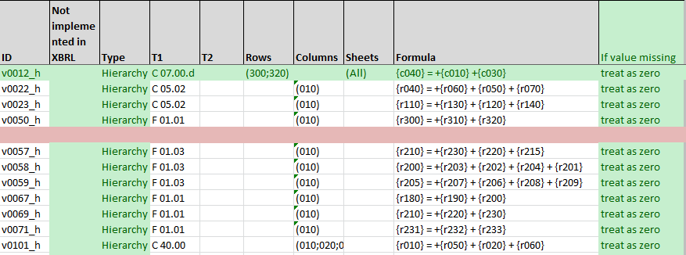
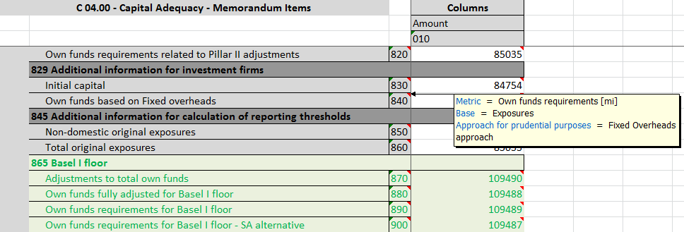
Table layouts and validation rules

Slide 24
Validation rules
The majority of the validation rules from the ITS are expressed in XBRL.
The taxonomy documents include an Excel spreadsheet detailing the rules.
Also indicated are those rules that are NOT expressed in XBRL
These may be checked on receipt by CAs & the EBA.

Slide 25
The future
Next Steps
CAs to clarify what variation of the taxonomy (or other method) they will use for data collection
Implementation in CAs and reporting institutions
Data collection
Remittance by CAs to the EBA
Future Versions
Update expected in early 2013 for additional reporting area (Asset Encumbrance)
Update expected later in 2013 for use from Jan 2014
At least yearly updates/additions after that

Slide 26
Owen Jones
owen.jones@eba.europa.eu

