Slide 1
19th Eurofiling workshop. Rome 2014
workshop on XBRL
Update by Ignacio Boixo, Chair
XII Best Practices Board, Eric Jarry

Slide 2
cen.eurofiling.info

Slide 3
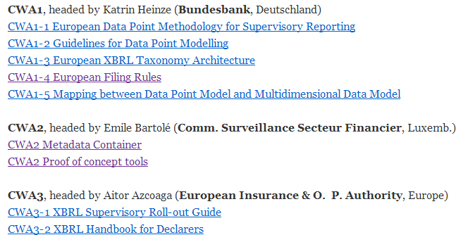
cen.eurofiling.info

Slide 4
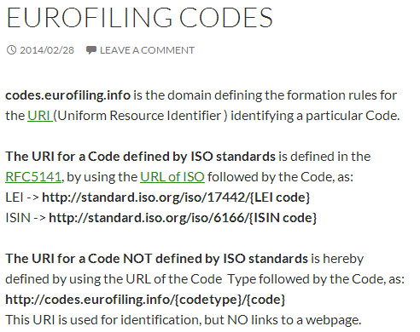
codes.eurofiling.info

Slide 5
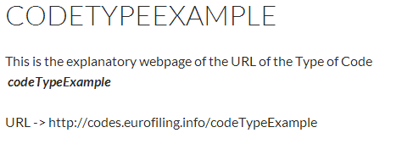
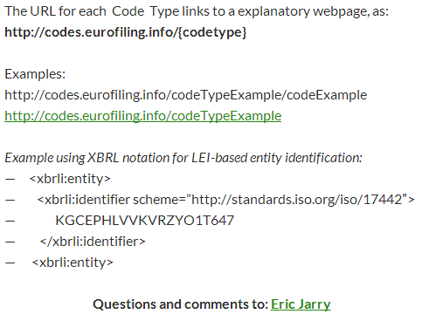

Slide 6
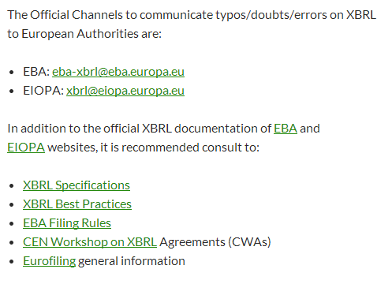
faq.eurofiling.info

Slide 7
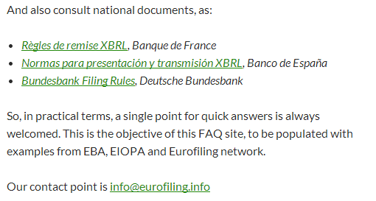
faq.eurofiling.info

Slide 8
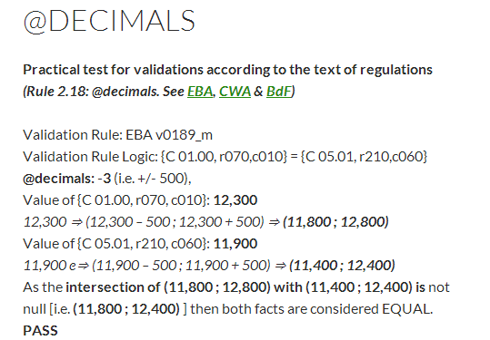
faq.eurofiling.info

Slide 9
19th Eurofiling workshop. Rome’14
workshop on XBRL
Many thanks!

