Slide 1
EBA Update and recap
XBRL Europe Rome May 2014
Andreas Weller, Head of IT EBA

Slide 2
The start with Basel 3 / the Ibex
BASEL 3

Slide 3
And where we are today
CRDIV / ITS
COREP / FINREP

Slide 4
The Framework of EBA

Slide 5
The Reporting
COREP
FINREP
-
Capital Adequacy
Group Solvency
Credit Risk
IP Losses
Operational Risk
Market Risk
Primary Statements
Assets & Liabilities
Financial Asset Disclosures & Off Balance Sheet
Income & Equity
Financial & Non-Financial Disclosures, OBS
Large Exposures
Leverage
Liquidity Coverage
Net Stable Funding
Forbearance
Non-performance
Asset Encumbrance
...
...
...
...

Slide 6
The DPM and the acceptance from the market
How to have clear business descriptions and modeling?
Templates and Excel descriptions are not rich enough.
A new way of modeling was requested.
DPM (Data Point Model) in an RDBMS format was the proposal from EBA.
After 2 years it get a wide acceptance on the market
One year ago a harmonisation approach through all European Taxonomy provider started
Most of them adopted the methodology
Further discussions and intiatives are on the way to adopt worldwide.
The vision left some marks in the snow

Slide 7
XBRL
Table Linkbase
EBA as visionary in this area
Table Linkbase base specs are now a recommendation
A majority of the vendors have adopted
The advantages for the end users are well received and other taxonomies will follow.
Validation rules
First time to have complex formulas implemented in XBRL
Critical to submission
A majority of the vendors have adopted

Slide 8
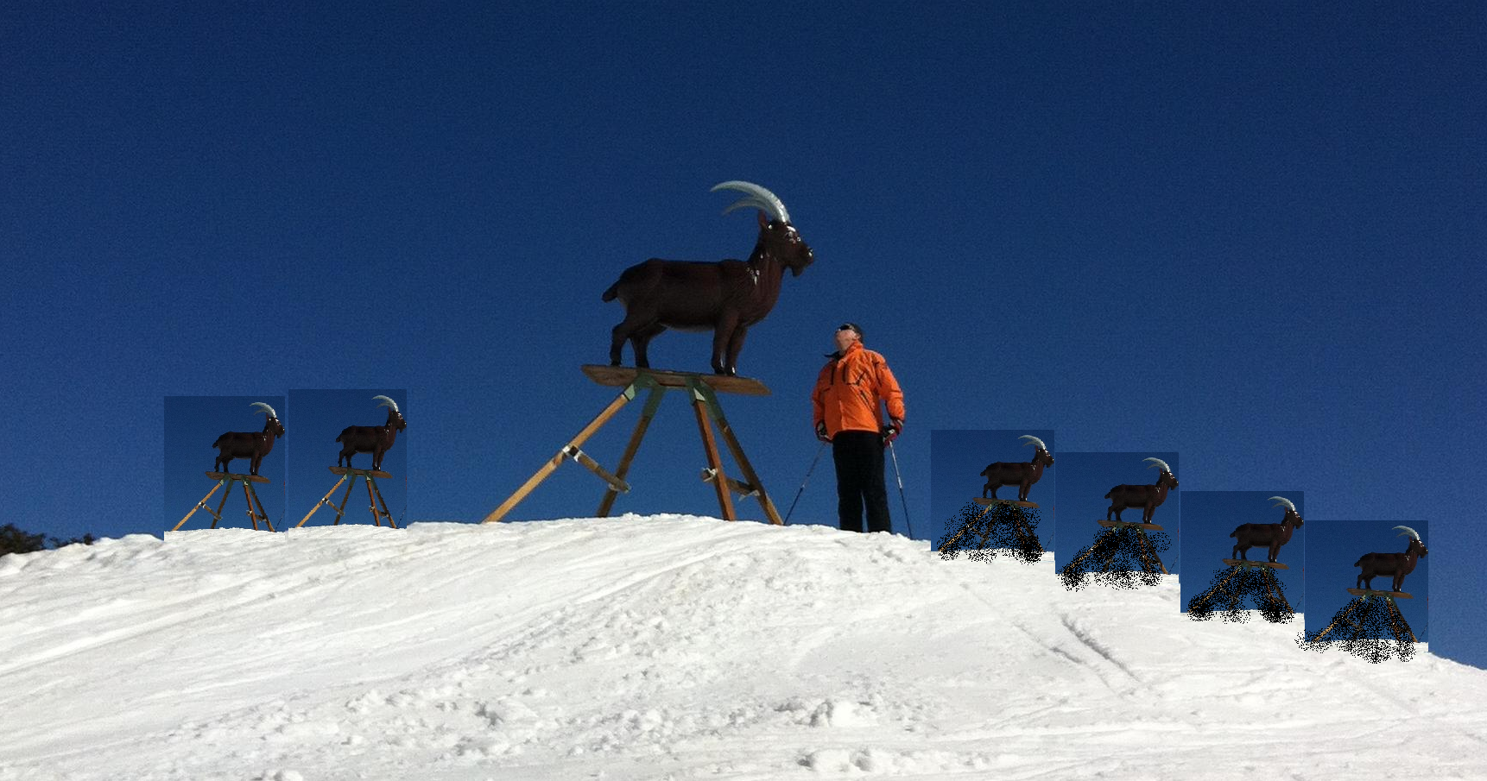
The current implementation 1st/2nd level reporting
1 st level reporting for credit institutions is not equal 2 nd level reporting to EBA
60- 70 % of Harmonisation is reached.
In the next years it should be fully harmonised

Slide 9
The Supporter
The difference is the peoples and community:
Thanks to the people working in the NSA‘s for their continuous support
Thanks to the vendors for the fast adoption of the tools
Thanks to the staff of EBA for the visionary ideas
Thanks to the XBRL community (XI) for adopting the standards
Thanks to the credit institutions which have recognised the technology XBRL is not the problem it is the amount of Data and the complexity which is requested.

Slide 10
COREP Version 2.0
The remittance dates of the first set of supervisory reports will be postponed from April/May 2014 to end June 2014, but there is no change to reference dates.
Main lessons learned:
The IT implementation of the wild animal is in the blue sky
The business dependencies
trigger sometimes more time.
Future releases and changes
In the taxonomies will follow
this year. - The intention of the EBA is to
adopt after an initial phase a
yearly process.

Slide 11
Questions on the IBEX?

